Slide 1
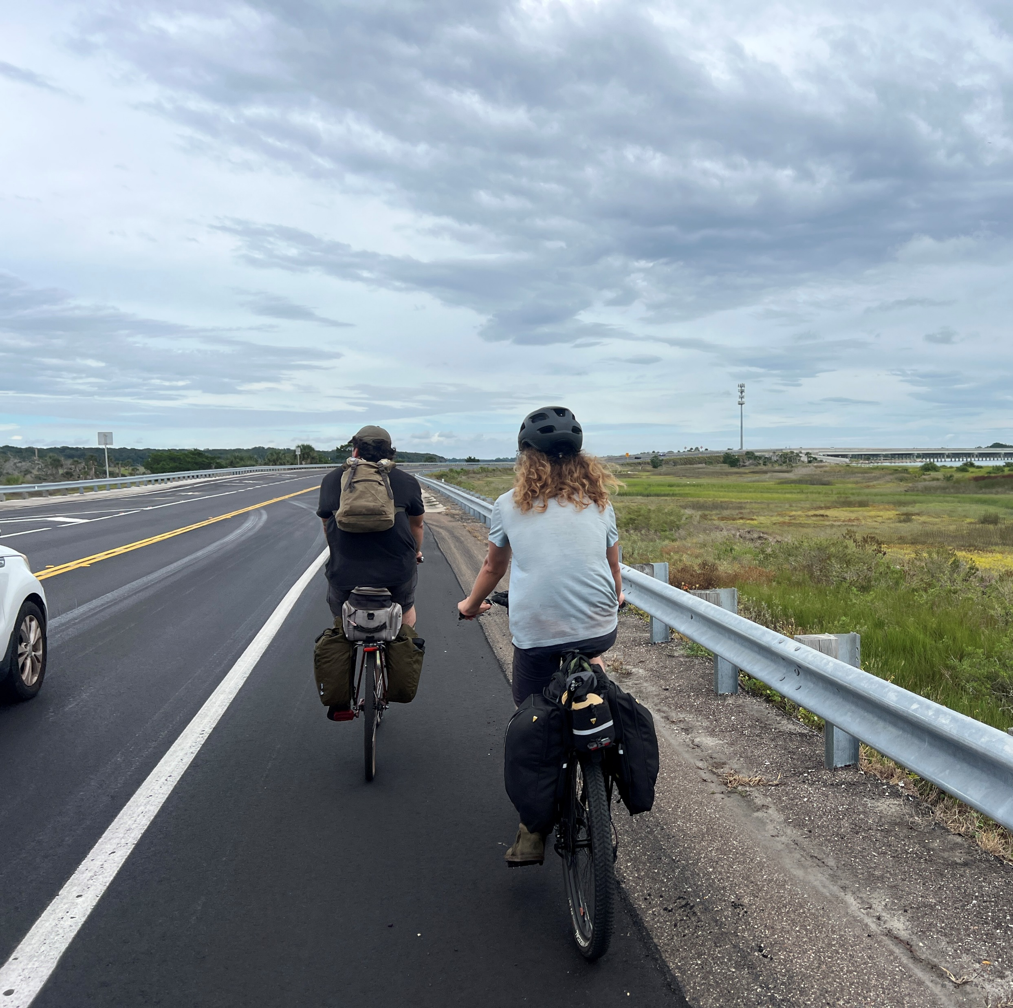



BIKE WALK JAX
FORMERLY: BICYCLE & PEDESTRIAN ADVISORY COMMITTEE
October 2nd, 2025
Ed Ball Building, Room #3112

Slide 2

Bike Walk Jax educates, supports, promotes, & advocates for the needs of pedestrians & bicyclists throughout the City of Jacksonville.
2

Slide 3

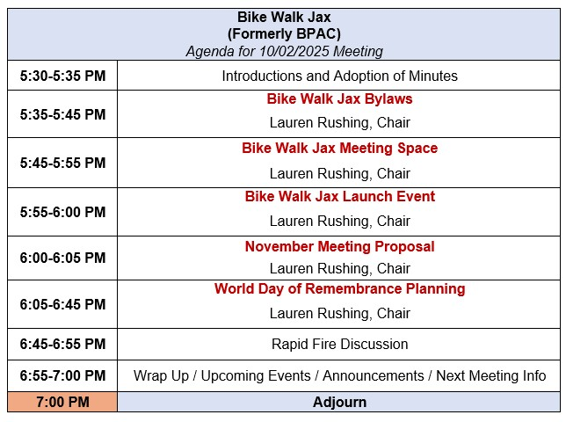
3

Slide 4
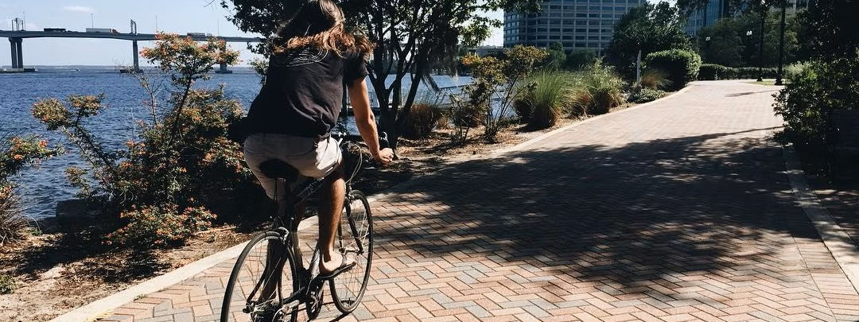
Bike Walk Jax: Bylaws
Lauren Rushing, Chair

Slide 5

Bylaws Recommendations
Give board the Authority to establish committee
  Governance Committee: reviews the bylaws
  Finance Committee: budget, finance oversight, book keeping
  Development Committee: All aspects of fund generating activities, fundraising, planned giving, membership fundraising, sponsorships, etc.
Attendance clause
“The Board may have cause for the removal of a Director after that Director’s absence from more than three consecutive meetings or more than one-
fourth (1/4) of the meetings during a one-year period.”

Slide 6
Bylaws Recommendations
Action by Directors without a Meeting
“Any action required or permitted to be taken at any meeting of the Board of Directors may be taken without a meeting through written or e-mail consent, if approved by a majority of the full membership of the Board of Directors. Such consent shall have the same effect as a majority vote of the directors at a special meeting called for the purpose of considering the action authorized and shall be effective on the date on which the last such director signs such consent or e-mail and files it with the officer of the corporation having custody of its books and records. The Secretary shall be responsible for documenting e-mail approval and shall file such documentation with the minutes of the proceeding meeting of the Board of Directors.”

Slide 7
Bylaws Recommendations
Indemnification
“Each Director of this corporation shall be indemnified by this corporation against those expenses which are allowed by the laws of the State of Florida, and which are reasonably incurred in connection with any action, suit, or proceeding, pending or threatened, in which such person may be involved by reason of his/her being, or having been, a director of this corporation or of such other enterprises.
Such indemnification shall be made only in accordance with the laws of the State of Florida and subject to the conditions prescribed therein.
The corporation may purchase and maintain insurance on behalf of any such officers and directors against any liabilities asserted against such person whether or not the corporation would have the power to indemnify such officers and directors against such liability under the laws of the State of Florida.”

Slide 8
Bylaws Recommendations
Inspection of Financial Records
“The Board of Directors shall have the power to determine which financial records of the corporation shall be opened to the inspection of the public, except such as may by law be specifically open to inspection, and shall have power to fix reasonable rules and regulations not in conflict with the applicable law for the inspection of accounts, books, and records, which by law, or by determination of the Board of Directors shall be open to inspection.

Slide 9
Bylaws Recommendations
Annual Statements
“Not later than four (4) months after the close of each fiscal year, the corporation shall prepare a balance sheet showing in detail the financial condition of the corporation as of the close of its fiscal year and a profit and loss statement showing the results of its operations during the fiscal year.”

Slide 10

Bike Walk Jax: New Meeting Space Discussion
Lauren Rushing, Chair
10

Slide 11
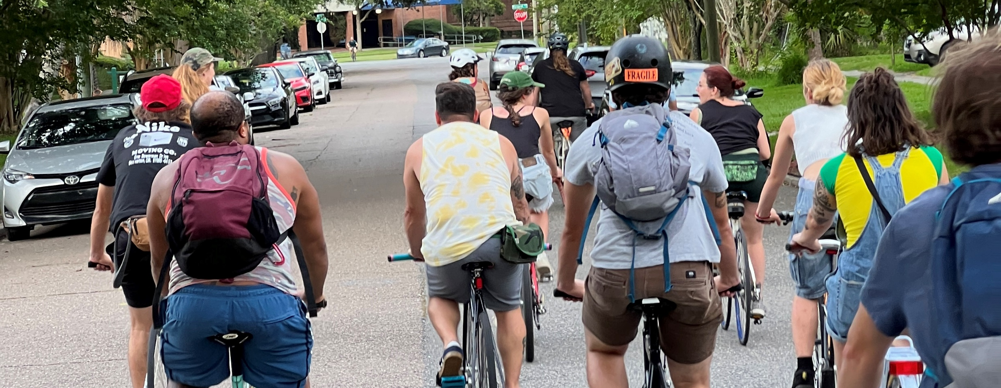
Bike Walk Jax: Launch Event Discussion
Lauren Rushing, Chair
11

Slide 12
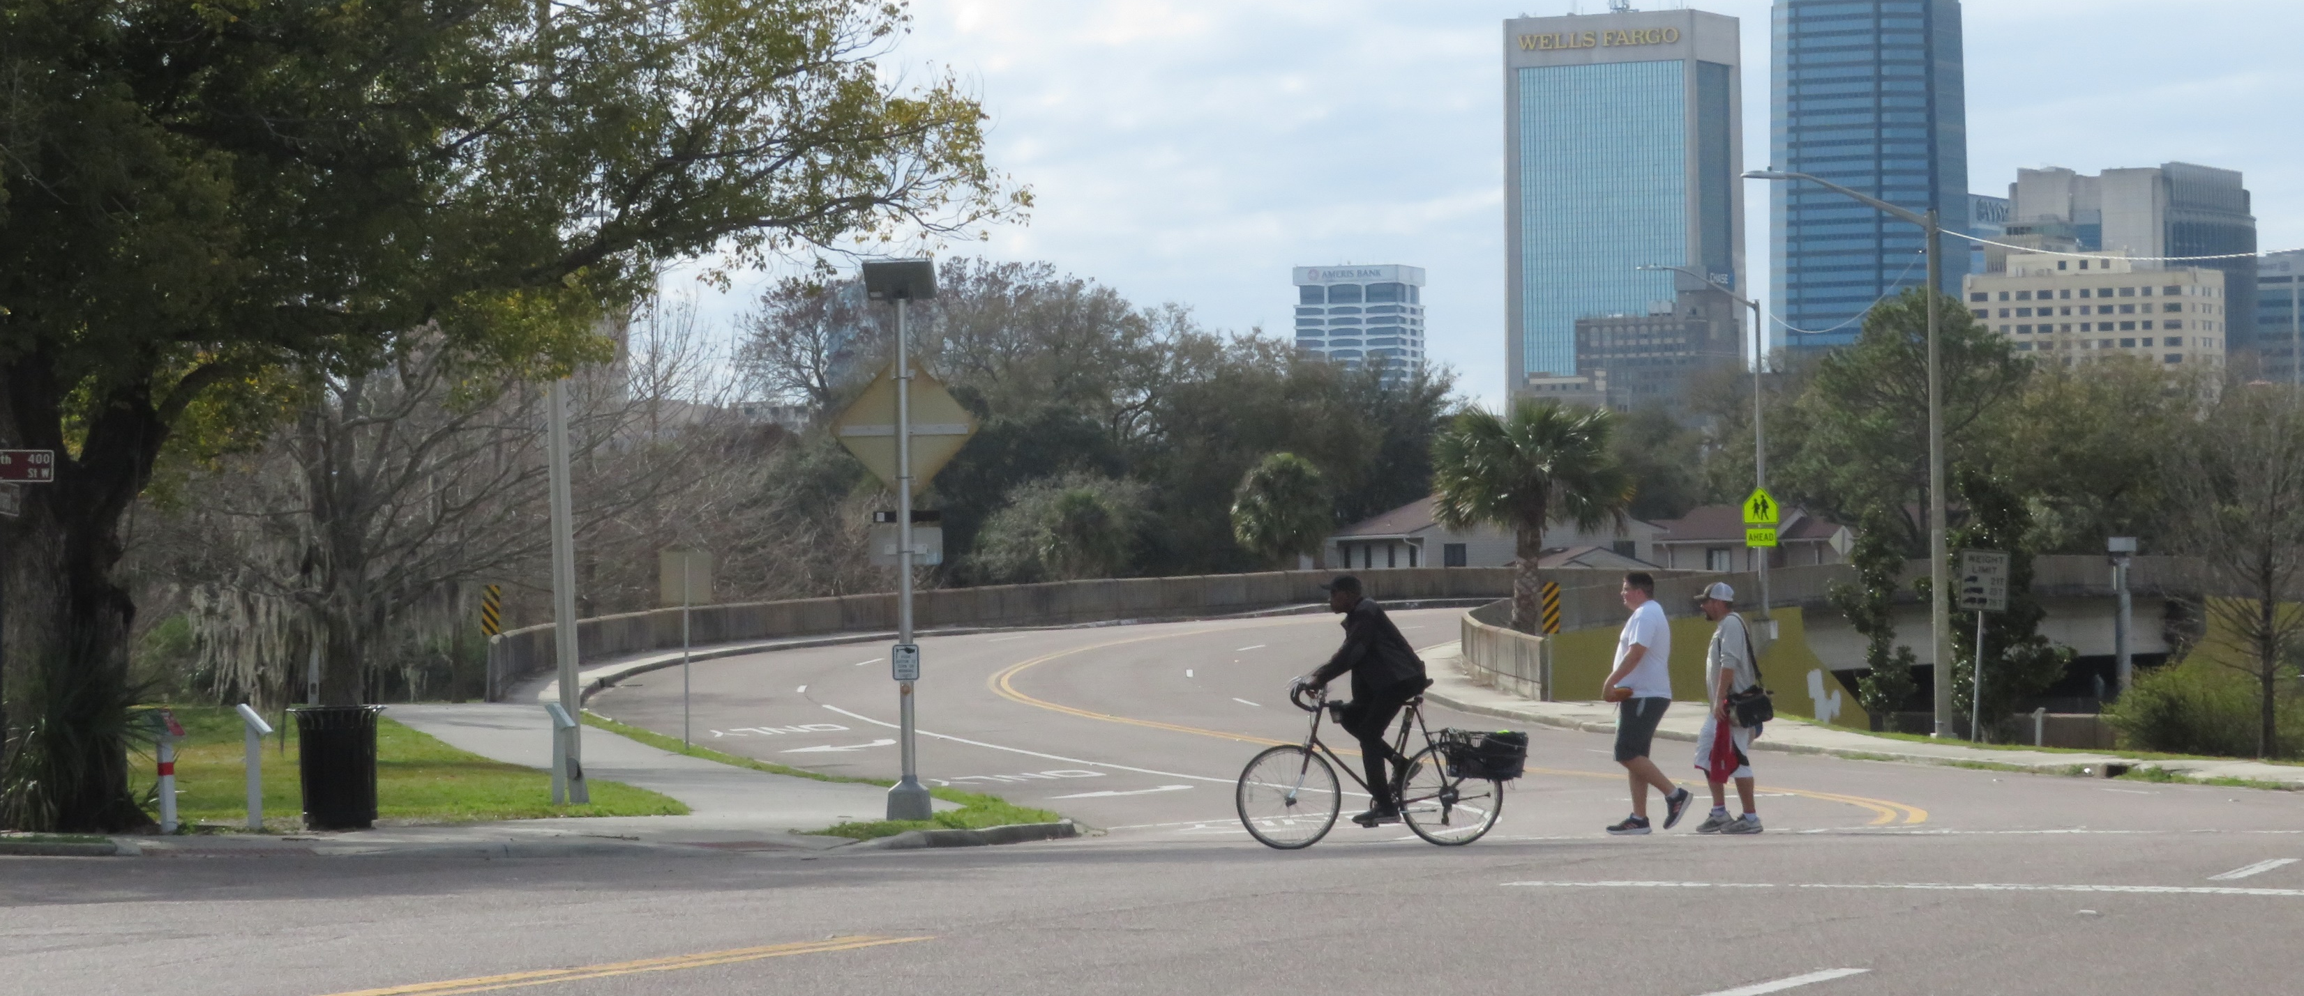
Bike Walk Jax: November Meeting Proposal
Lauren Rushing, Chair
12

Slide 13

World Day of Remembrance
For Traffic Victims
2025
JAcksonville
Notes:
“To educate, support, promote, and advocate for the needs of pedestrians and bicyclists throughout Jacksonville.”

Slide 14
SAVE THE DATE
Saturday
November 15th, 2025
at
10:00 AM – 12:00 PM
Ceremony @ 10:30

Slide 15
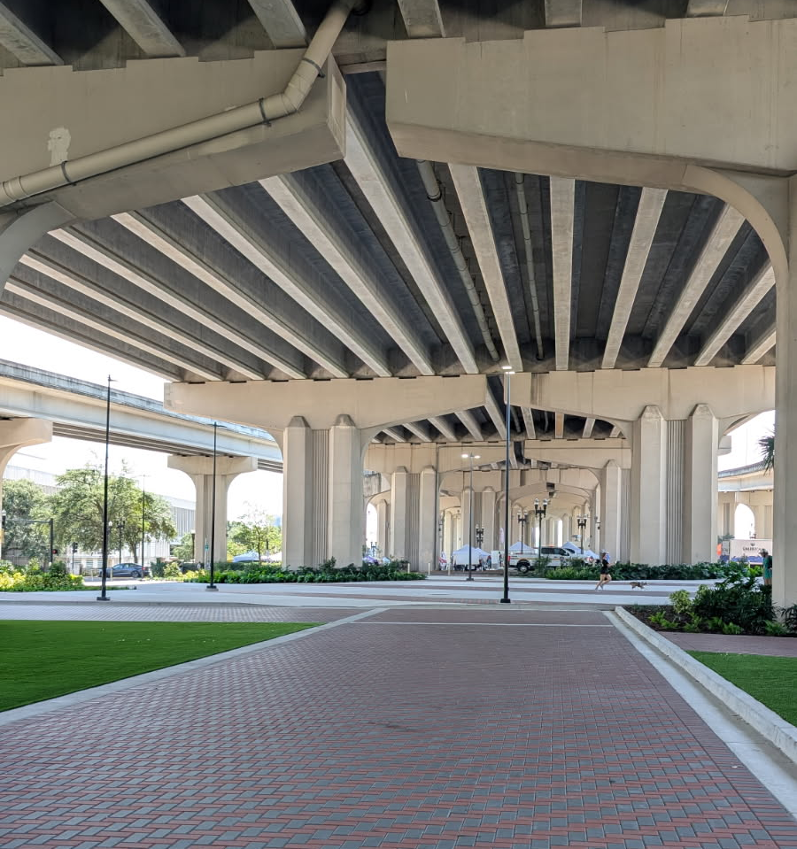
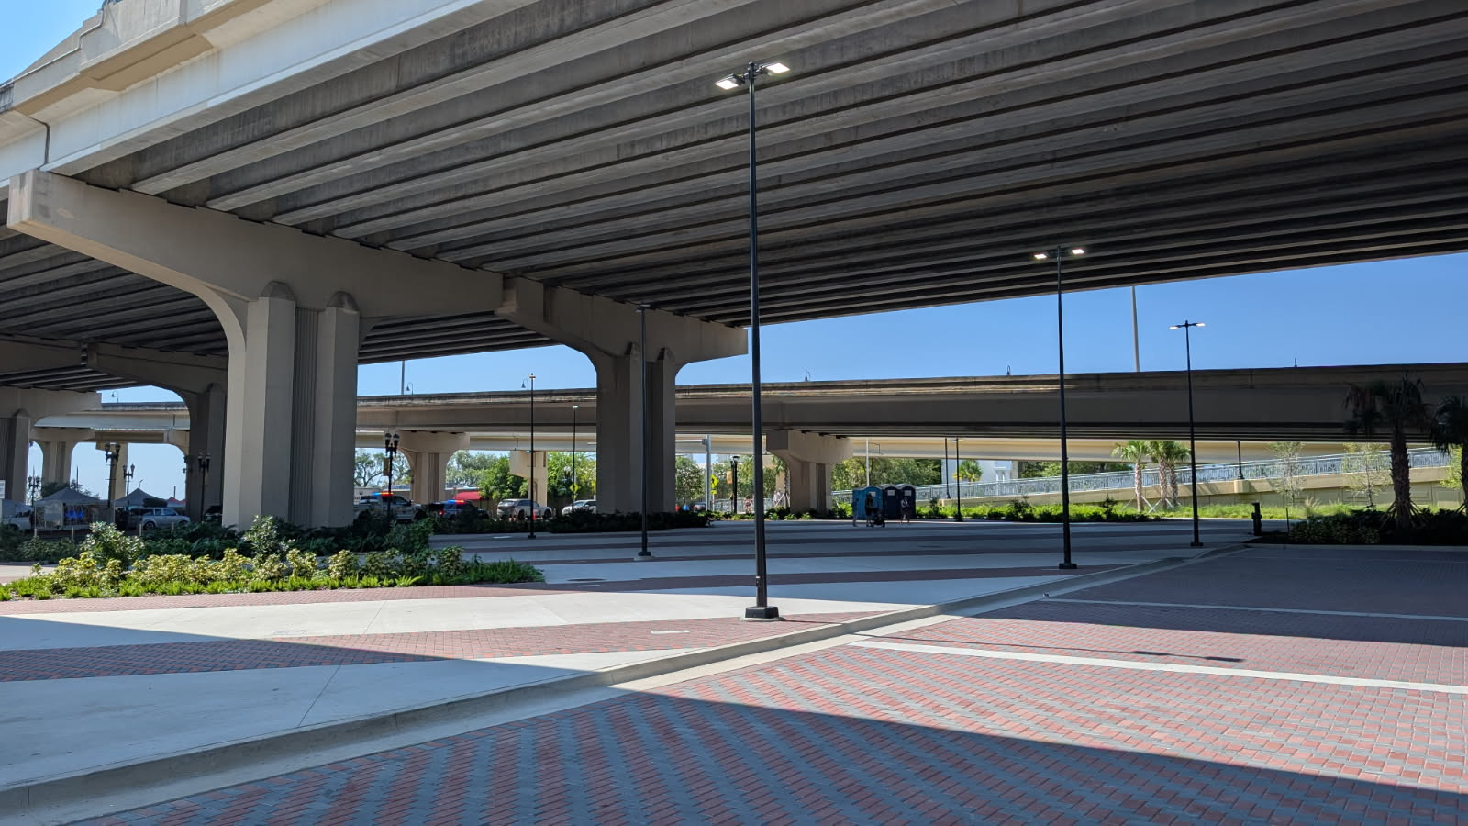
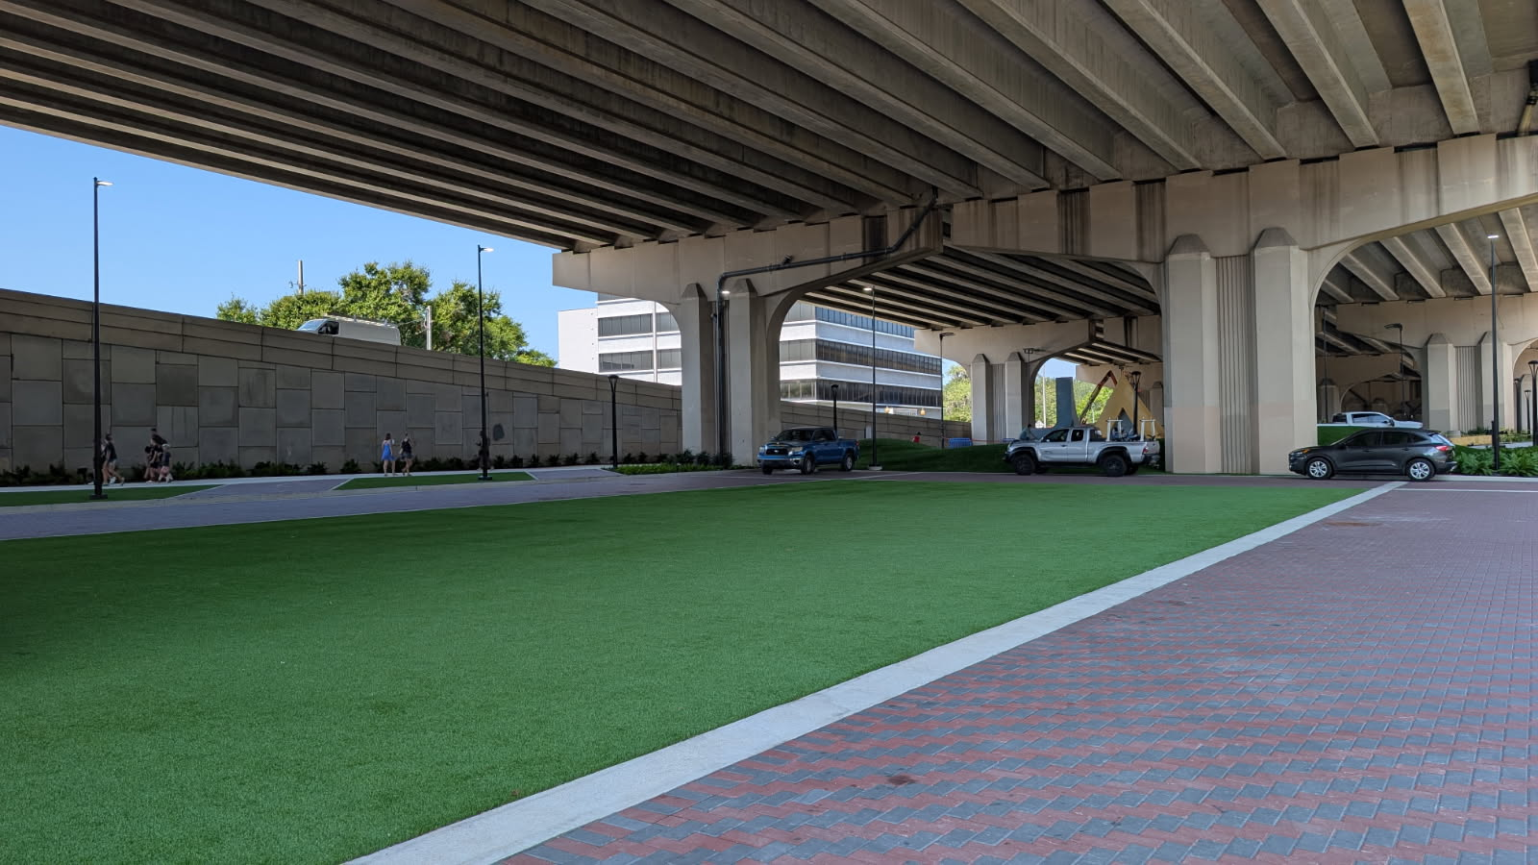
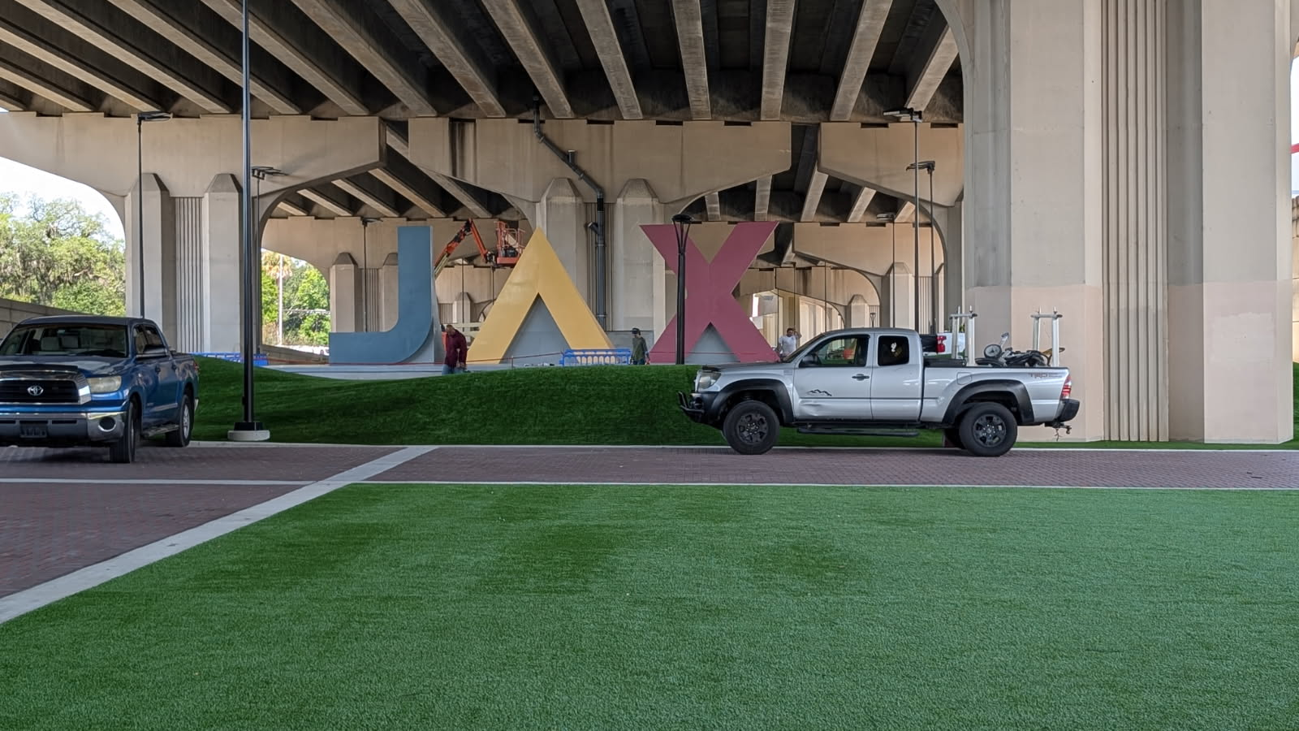
VENUE: CONFIRMED
Artist Square at Riverside Arts Market – NO FEE

Slide 16
DAY-OF LOGISTICS
  RAM doesn’t have a lot of storage
  May have room for the speaker /microphone /podium, but not for the 40 chairs
  Chairs maybe could be stored in restroom
  Vystar, the Cummer, or the Friday Musicale
  James also has an alternative through the Boy Scouts

Slide 17
SPEAKERS
  JSO – Commander & Police officer (confirmed)
  DCPS or School Board Member (confirmed) – Chief Academic Officer, Paula Renfro
  Council Member Jimmy Peluso’s Assistant – Brooks Dame (confirmed)
  Family member: Madison Jackson (confirmed)
  Council Member Joe Carlucci (No Response)
  Contacted FDOT (No Response)
  Back up: City – Matt on Vision Zero

Slide 18
VICTIM LEADS
  UF Trama One Unit
  NFBC – friends of Joe
  Teresa – St Augustine Wheelers
  Angels for Allison – not participating
  iHeart Radio

Slide 19
EXHIBITORS
  Invitation sent out to all potential exhibitors
    Bike Walk Jax
    NF TPO (confirmed)
    City of Jacksonville (confirmed)
    Safety Town Pop-Up (confirmed)
    First Coast APA?

Slide 20
EXHIBITORS CONT’D
  Leads
    Triple A – bicycle helmets (trained volunteers?)
    Lime
    UF Health Community Engagement
    UF Trauma One - Truck

Slide 21
SUPPORTING ACTIVITIES
  Bike ride – Zencog
    Need graphic
  Bicycle mechanic/maintenance class – Zencog / Honeypot
  Safety Town Pop-Up

Slide 22
VENDORS
  Update from Emily?

Slide 23
FUNDRAISING
Fundraising:
  Charging Exhibitors ? No
  Taking Donations ? Hopefully
    Nonprofit corporation established!!!
    EIN obtained from IRS
    1023EZ form submitted to IRS – SEPTEMBER 19 (2 WEEKS)
    Register under the Solicitations and Contributions Act as a Florida Charitable Organization
    Open bank account
Contingent on federal paperwork being approved

Slide 24
MEDIA
  Media Advisory
  First Coast Connect episode
  Newspaper Op-Ed
    JaxToday
    The Resident
  MyJax.com – hold message
Please share any media contacts with
lauren.rushing@jacksonvillebpac.com

Slide 25
PROMOTION MATERIALS
New Logo (Bike Walk Jax) ✓
Save the Date graphic ✓ (New Facebook!)
1-pager ✓
Social Media Promotional Graphics (4 weeks out)
Flyer (3 weeks out)

Slide 26
IMMEDIATE NEXT STEPS
What is needed for advertising?
  Follow up with Council Members
  Follow Victim Leads
  Follow up with Exhibitors
  Confirm speaker line up
  Social media graphics

Slide 27
Volunteers Needed
  Graphics
  Photographer
  Web designer
  Moving materials and set-up the day of

Slide 28
CALL TO ACTION
  Last Year
    Vision Zero Resolution
    Speed Cameras in School Zones
  Potential New
    Updating City’s school zone policy
    Thoughts?

Slide 29
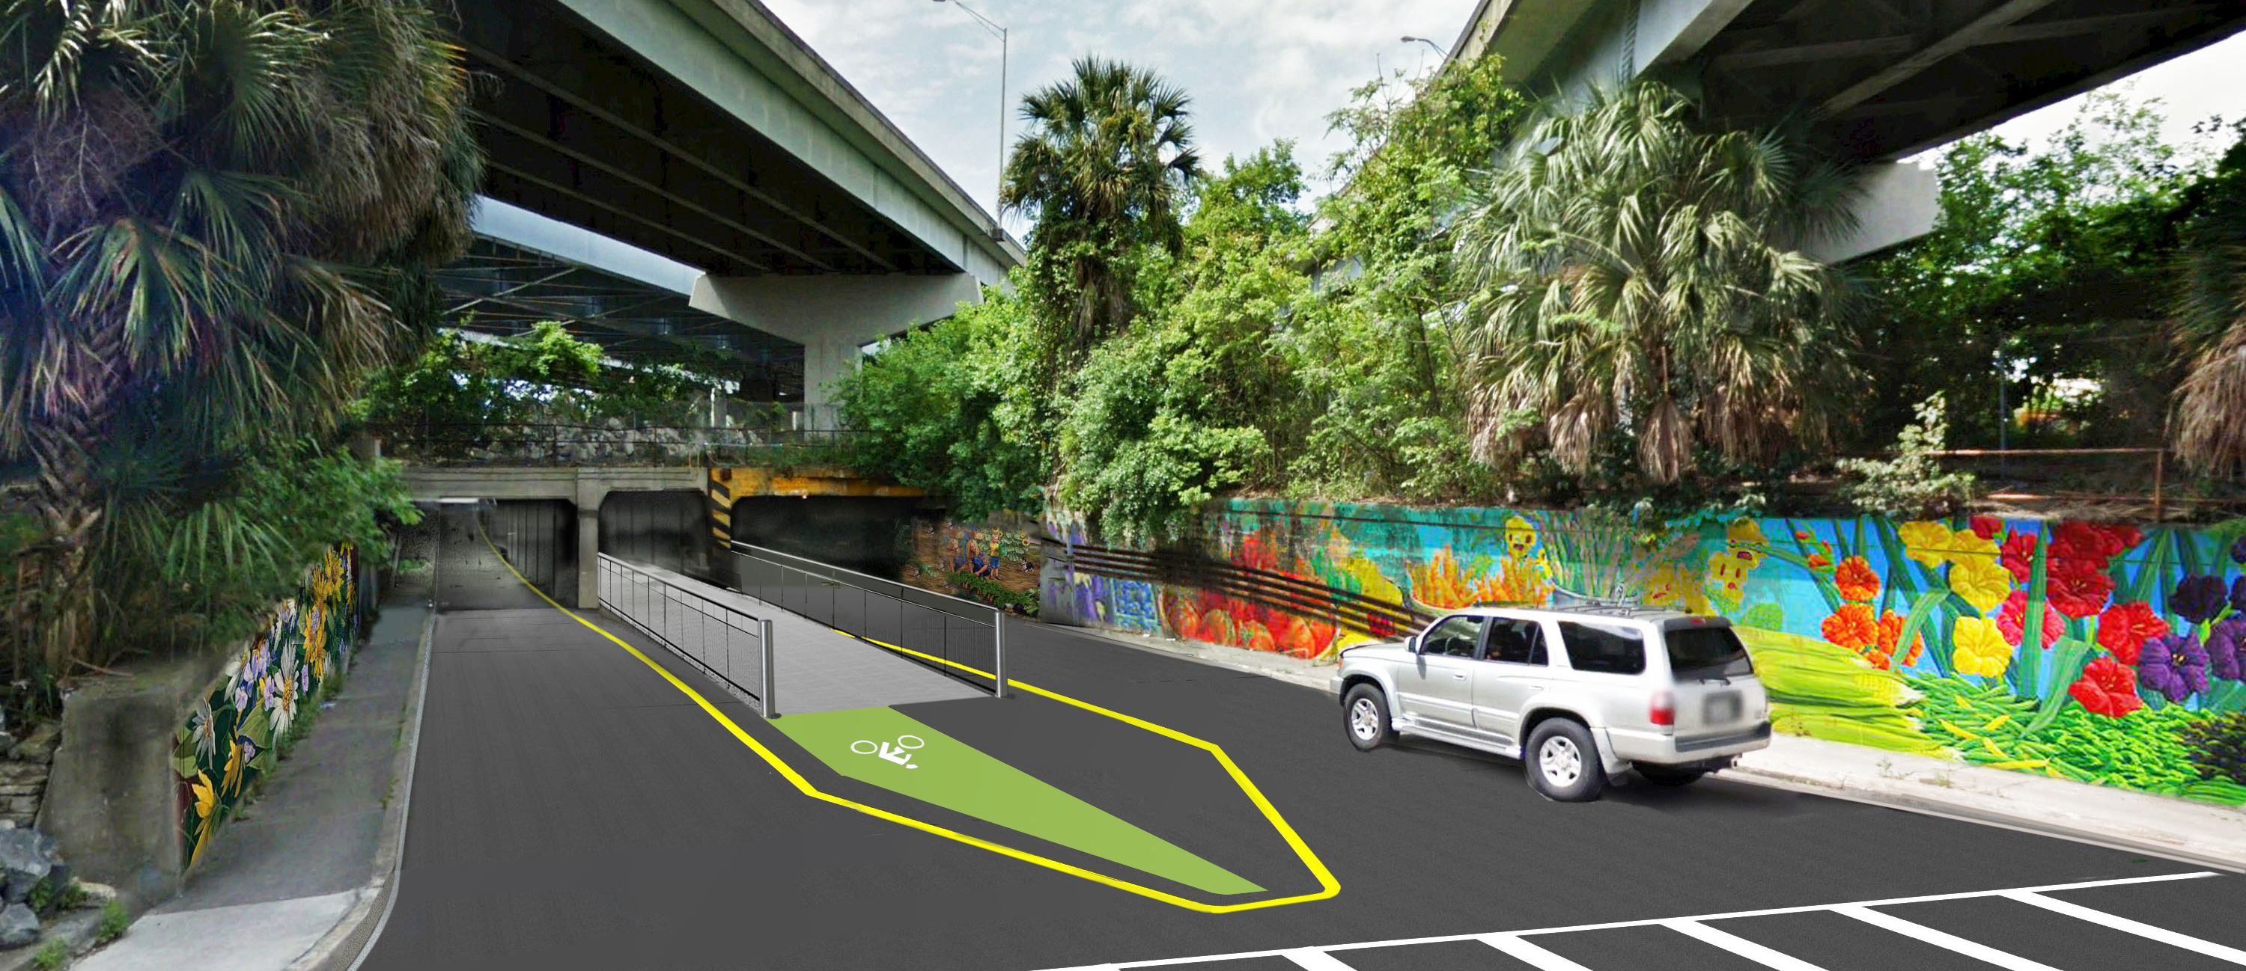

Rapid-Fire Discussion and Upcoming Events
29

Slide 30

THANK YOU!
NEXT MEETING
ADJOURN
30

