Slide 1
Responding to the Demo by Neglect Committee's Partnership Initiative
Following the Demo by Neglect Committee's approach to the Jacksonville Community Land Trust (JCLT), we will explore potential collaborative opportunities to address properties at risk, focusing on partnership with the City of Jacksonville.
RP
by Robin Pfalzgraf

Slide 2
About the Jacksonville Community Land Trust
Background
Partnership Approach
Community Impact
The Jacksonville Community Land Trust (JCLT) was approached by the Demo by Neglect Committee to explore collaborative opportunities that support affordable housing through strategic partnerships and community-driven development.
Founded in 2021, with non-profit status achieved in 2022, the JCLT serves as a community partner, working alongside city committees and developers to address housing challenges in Jacksonville, FL. We don't bank properties jus to bank them but rather facilitate collaborative solutions.
Through strategic partnerships, JCLT aims to support initiatives that increase homeownership opportunities and stabilize communities, while ensuring sustainable, long-term affordable housing solutions for Jacksonville residents.

Slide 3
Community Partnership Opportunities
Collaborative Solutions
Strategic Partnership Focus
Following the Demo by Neglect Committee's approach to JCLT, we're exploring partnership opportunities to address Jacksonville's affordable housing challenges through collaborative community efforts.
The JCLT aims to partner with the Demo by Neglect Committee to develop sustainable solutions that benefit neighborhood stability and community well-being.

Slide 4
Demo by Neglect Committee: Exploring Partnership
Collaborative Approach
Strategic Role
The Demo by Neglect Committee has approached JCLT to explore potential partnership solutions with developers, or area non-profit organizations.
JCLT aims to serve as a collaborative partner, with you and/or the City of Jacksonville focusing on community-driven solutions.
The goal of the JCLT is to work with you to help to improve to city.
Shared Goals
Working together to address property deterioration while maintaining focus on community needs and neighborhood stability.

Slide 5
Responding to the Demo by Neglect Committee
1
Committee Initiative
2
Strategic Partnership
Through an exploratory meeting with Bill, the Jacksonville Community Land Trust (JCLT) is willing to explore potential partnerships in addressing neglected properties, focusing on preservation and community benefit rather than property acquisition.
JCLT aims to serve as a collaborative partner, offering our expertise in community-focused development while working within the Committee's established framework.
3
Focused Approach
Our role is assist you, in a way that will work for both organizations to provide targeted support when specific opportunities align with both organizations' community development goals.

Slide 6
JCLT's Collaborative Role with Demo by Neglect Committee
Preservation Partnerships
Supporting Demolition and Redevelopment Efforts
Strategic Partnership for Housing Solutions
Collaborating with the Committee/City to help create affordable housing opportunities, prioritizing community needs while ensuring sustainable development
Partnering with the Committee/City to assist in property rehabilitation or reconstruction when needed, focusing on community benefit
Working with developers when restoration isn't viable, ensuring community-focused outcomes
The Jacksonville Community Land Trust (JCLT) serves as a partner to the Demo by Neglect Committee/City of Jacksonville, but also as a resource for creating lasting housing solutions for our community.

Slide 7
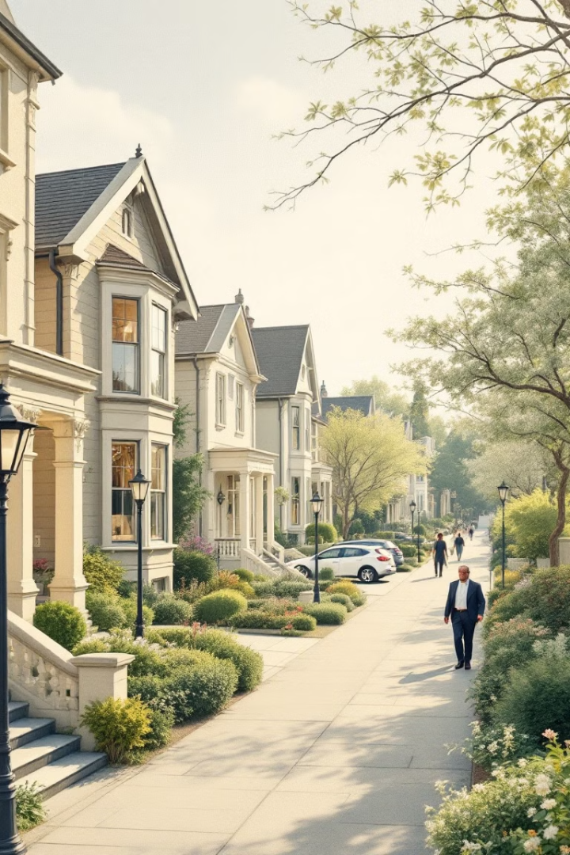
Benefits of JCLT-Committee Partnership
1
Supporting Affordable Housing Goals
Partner with the Demo by Neglect Committee to transform neglected properties into affordable housing options for Jacksonville families.
2
Collaborative Neighborhood Improvement
Work alongside the Committee to address problem properties and enhance neighborhood safety and aesthetics.
3
Community-Focused Development
Unite resources to revitalize properties, benefiting current residents while preventing property banking or speculation.

Slide 8
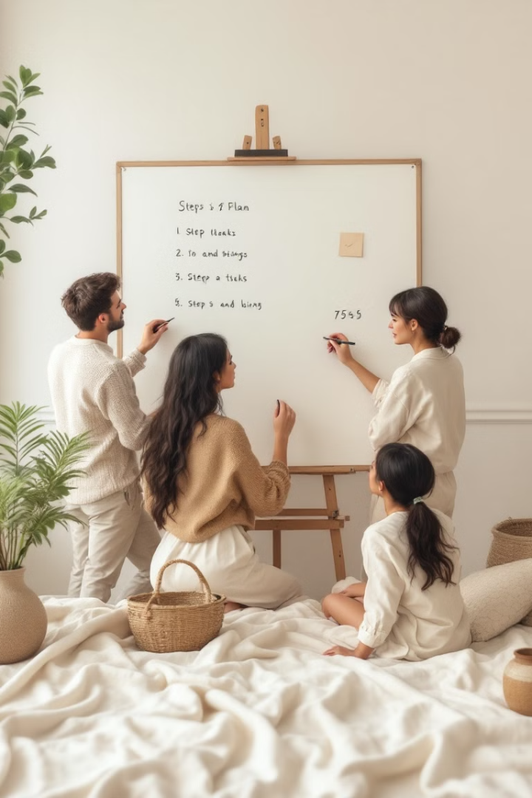
Implementation Plan
Respond to Committee Partnership Request
Following the Demo by Neglect Committee's approach, establish a collaborative framework to address community needs. Explore partnerships with organizations such as HabiJax , a local CDC or area developers.
Joint Property Assessment
Work with the Committee to evaluate properties they've identified that could benefit from community-focused rehabilitation.
Build Support Network
Together with the Committee, identify funding sources and community partners to support targeted improvement .
Community-Focused Development
Collaborate on transforming identified properties into housing solutions that directly benefit Jacksonville residents, ensuring responsible community development.

Slide 9
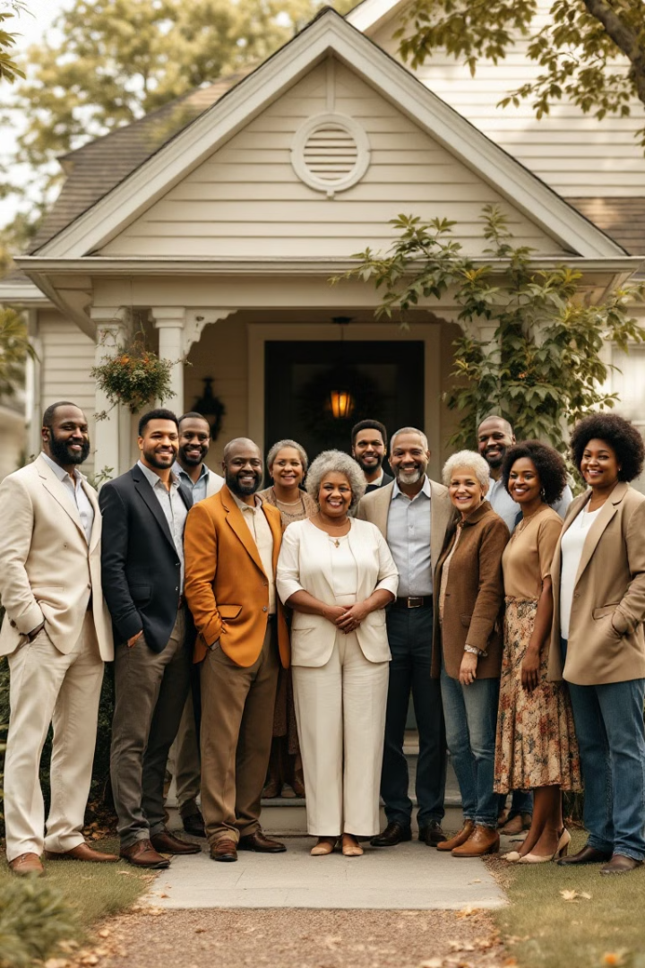
Conclusion and Call to Action
The Demo by Neglect Committee's initiative to partner with the JCLT opens new possibilities for addressing Jacksonville's housing challenges. Our role is not to accumulate properties, but to be a ready and willing partner in transforming neglected properties into homes that strengthen our community. Together, we can create positive change for Jacksonville's families.

