Slide 1
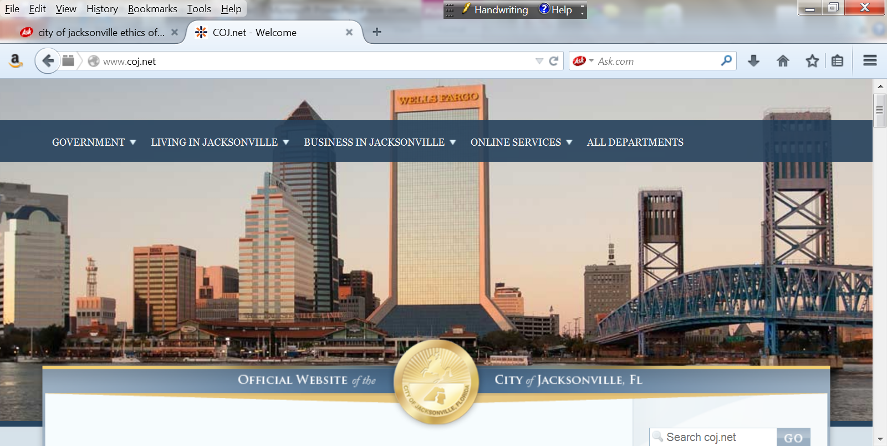

Office of
Inspector General
“Enhancing Public Trust in Government Through Independent and Responsible Oversight”
Activities Update
October 1, 2020 - September 30, 2021
Activities under former Inspector General
&
Recent Actions
January 25, 2022
Interim Inspector General
Sheryl Goodman

Slide 2
Introduction
Began November 30, 2021, as the Interim Inspector General hired via the Inspector General Retention & Selection Committee.
  Bring over 14 years as an Inspector General (IG) in both the State of Florida and Florida Municipal/County governments.
  Helped create the Jacksonville Office of Inspector General (OIG) in 2014-2015.
  Helped draft the Commission for Florida Law Enforcement Accreditation Inspector General standards; was the first OIG to become Accredited; and was the first IG to Accredit two OIGs.
  International subject matter expert for the United Nations on Drugs and Crime on Whistleblower Protection Programs and Complaint Intake systems.
  Creator of the Inspector General automated case and audit management systems utilized by various Florida OIGs. Jacksonville OIG has the Investigative system, and we are working on obtaining the audit system from the State.

Slide 3
Chapter 602; Part 3
Inspector General
Jacksonville Code of Ordinances
Sec. 602.303. Duties and Functions.
(n) Issue an annual report to the Ethics Commission, the Inspector General Selection and Retention Committee, Mayor, the Council and deliver to the full City Council and the Inspector General Selection and Retention Committee a verbal briefing on activities of the Office every six months.

Slide 4
October 1, 2020 – September 30, 2021
Correspondences Handled (170)
Represents the number of written communications sent to the OIG, to include allegations of waste, fraud and abuse.
  Management Referrals: 58
  Closed No Further Action: 56
  Investigations Unit Activity: 47
    Preliminary Reviews – 29
    Referred to OIG Contract Oversight – 11
    Investigation Reports – 3
    Referred to OIG Audit – 2
    Corrective Action Memorandums – 2
  Non-Jurisdiction Referral: 5
  Management Inquiry: 4

Slide 5
October 1, 2020 – September 30, 2021
Return On Investment
Corrective Action (CA) Recommendations: 38
Number of CA’s Accepted: 100%
Number of CA’s Implemented: 35
Number of CA’s Pending: 3
Questioned, Identified and/or Recovered Costs: $74,895
    Audits (Identified) - $53,297
    Investigations (Identified) - $15,875
    Investigative Costs (Recovered): $5,723

Slide 6
OIG Impact
ACTIONS | October 1, 2020 - September 30, 2021 | Since Inception (FY2015)
Correspondences Received | 118 | 798
Closed | 99 | 721
Open | 19 | 77
Reports Issued (Contract, Audit, Investigations) | 5 | 55
Costs Identified (Recoverable) & Investigative Costs Recovered | $69,172 $ 5,723 | $1,048,409
Costs Questioned (potentially recoverable) | -- | $952,567
Corrective Actions Recommended | 38 | 271
Accepted | 38 | 261

Slide 7
November 30, 2021 to the Present
Highlights

Slide 8
Highlights
Conducted internal and external assessments regarding compliance status of Inspector General (IG) Accreditation.
Set timeline expectations for staff regarding receipt of correspondences and future administrative investigations.
Issued Mandatory OIG Annual Report, dated December 30, 2021. Report posted to the OIG Website.
Currently obtaining from the State (at no cost) an automated audit tracking system for work product.
Establishing appropriate internal controls (locked offices/case, restricted access in the Investigation's system and shared drives) to ensure accreditation standards are met.
Completed dispositions on overdue correspondences (69) with notifications to complainants of decision, as appropriate/required.

Slide 9
Highlights
Correspondences represent the number of written communications sent to the OIG to include allegations of waste, fraud and abuse.
Closed 69 correspondences (dating back to 2017):
  Investigation’s Unit Activity – 52
    Preliminary Reviews (Closed) – 25
    Cross referenced to existing Investigation(s) – 21
    Investigations – 2
    Referrals to Audit – 2
    Criminal Referral – 1
    Management Review – 1
  Management Referral – 10
  Management Inquiry – 4
  Closed No Further Action – 3

Slide 10
Whistle-blower Protection
Interpretation of who can be a Whistle-blower (WB) pursuant to Florida Statute has been mis-applied. OIG was granting WB protection to only current employees and current contracted employees.
The Act under §112.3189, Florida Statutes, Investigative procedures includes employee or former employee, or applicant for employment.
The law also includes provisions for persons who perform services for, and under the control and direction of, or contracts with, an agency or independent contractor for wages or other remuneration.
IG best practice utilizes the “gross” modifier: mismanagement, malfeasance, misfeasance, waste of public funds, or neglect of duty.

Slide 11


New Focus
ADDING VALUE TO THOSE
UNDER ITS JURISDICTION
RETURN ON INVESTMENT
  Impact Change
  Identify Cost Savings ($)
TIMELINESS
  Correspondence decision – 5 Days
  Administrative Investigations – 90 Days (exceptions documented)
  * Exceptions should not be the norm

Slide 12
Future Outlook
OIG Strategic Plan (update)
Preventative and Proactive in our work
Enhance Outreach

Slide 13
Thank You
Sheryl Goodman,
Interim Inspector General
Office:
Email: inspector@coj.net
(904) 255-5800
http://www.coj.net/oig

