Slide 1

Jacksonville
Journey Forward
Journey Forward
Jacksonville, FL

Slide 2

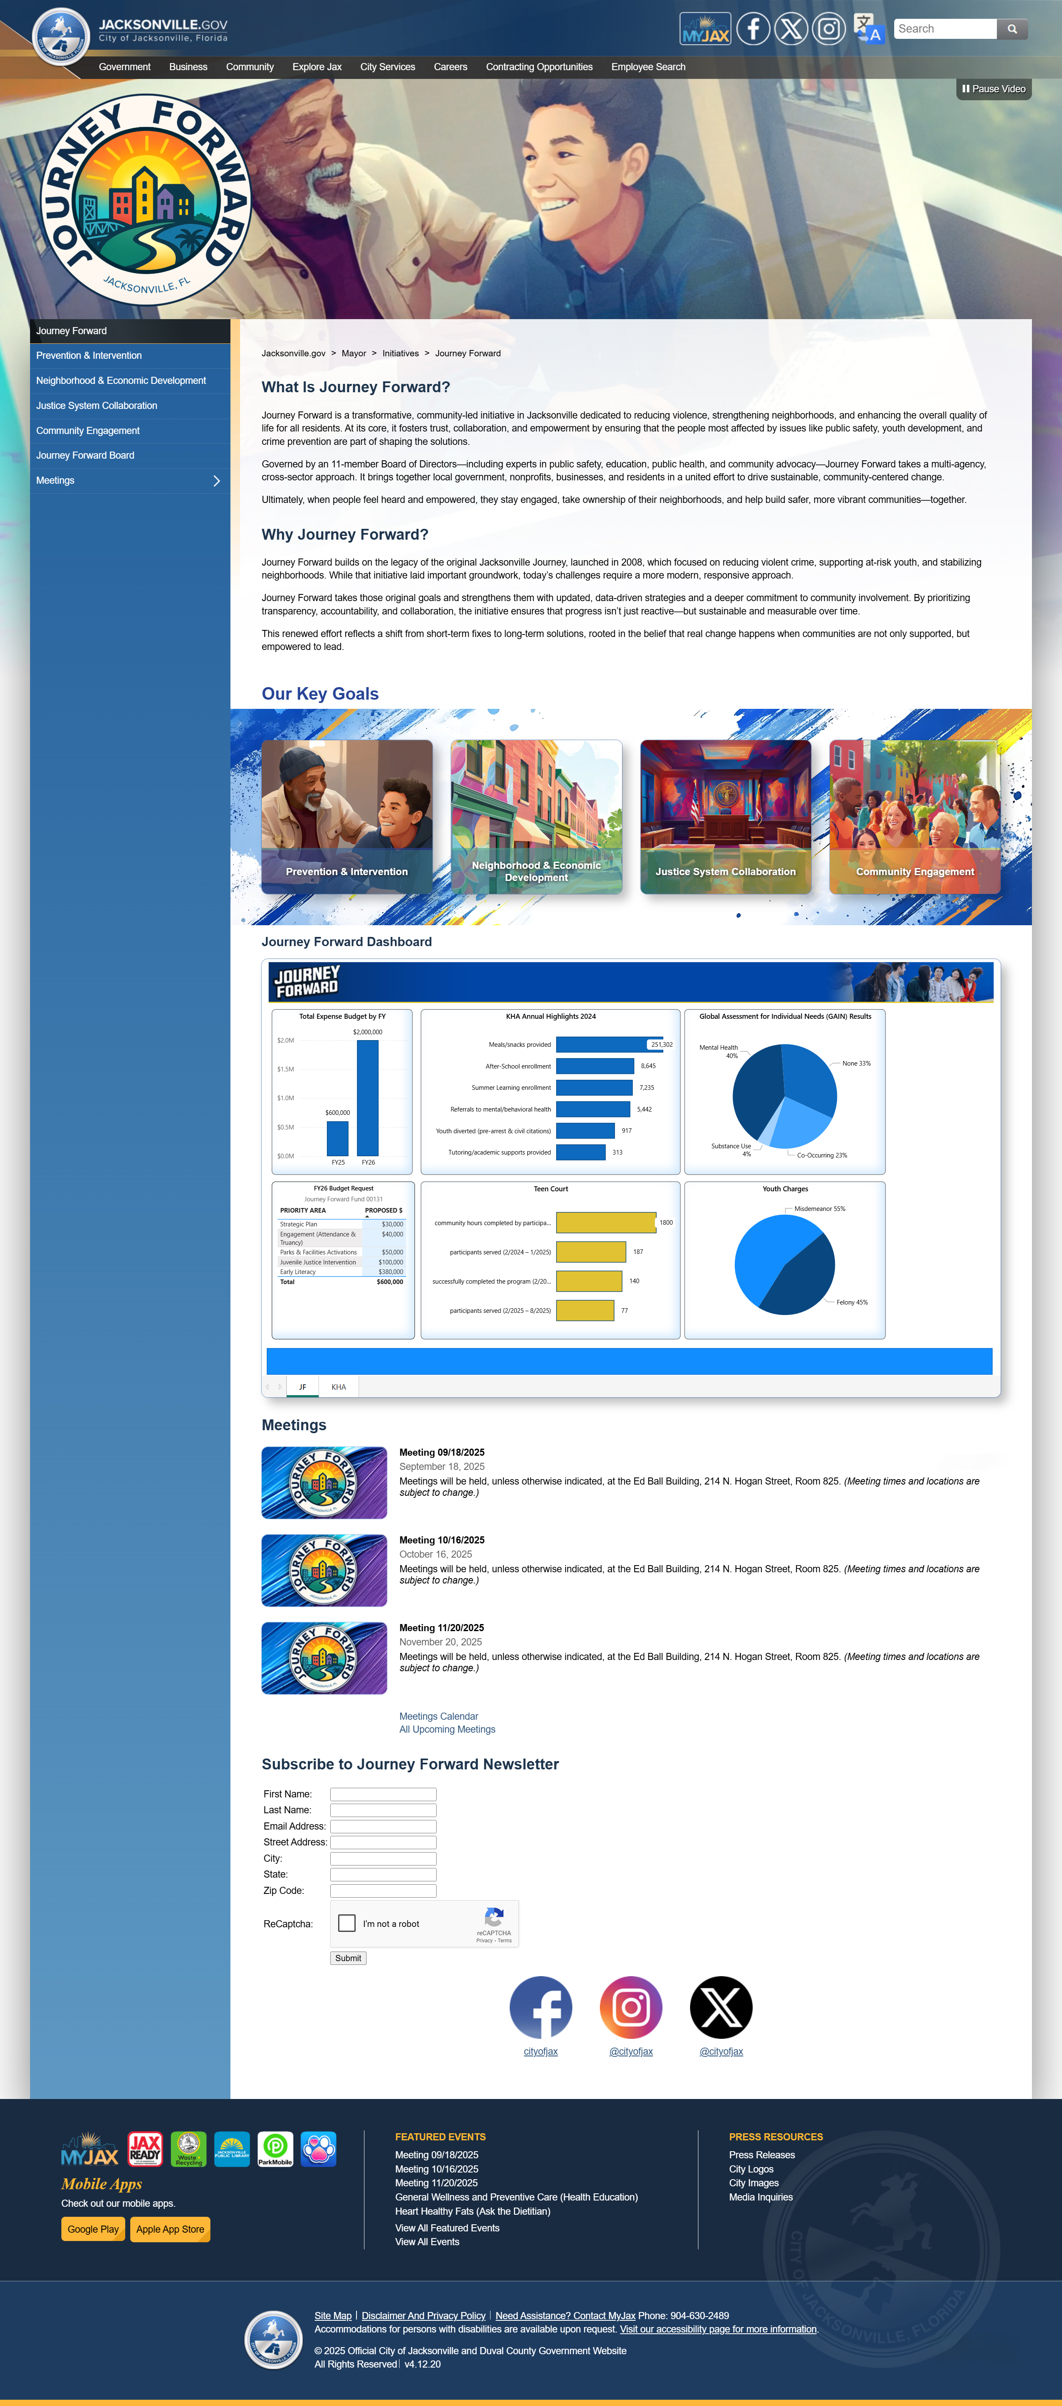
Journey Forward website
The “Journey Forward” page outlines our vision for the city’s future, focusing on key priorities such as economic development, public safety, infrastructure, and community well-being. By presenting these goals in a centralized and accessible format, the page serves as both a roadmap and a progress tracker—demonstrating the city’s commitment to transparency, accountability, and inclusive growth.
This page is significant because it invites residents to be active participants in Jacksonville’s transformation. It reflects a collaborative spirit, encouraging civic engagement and shared responsibility. Whether through community programs, public feedback opportunities, or updates on ongoing initiatives, “Journey Forward” positions itself as a living document—one that evolves with the city and its people, reinforcing the idea that progress is a collective journey.

Slide 3

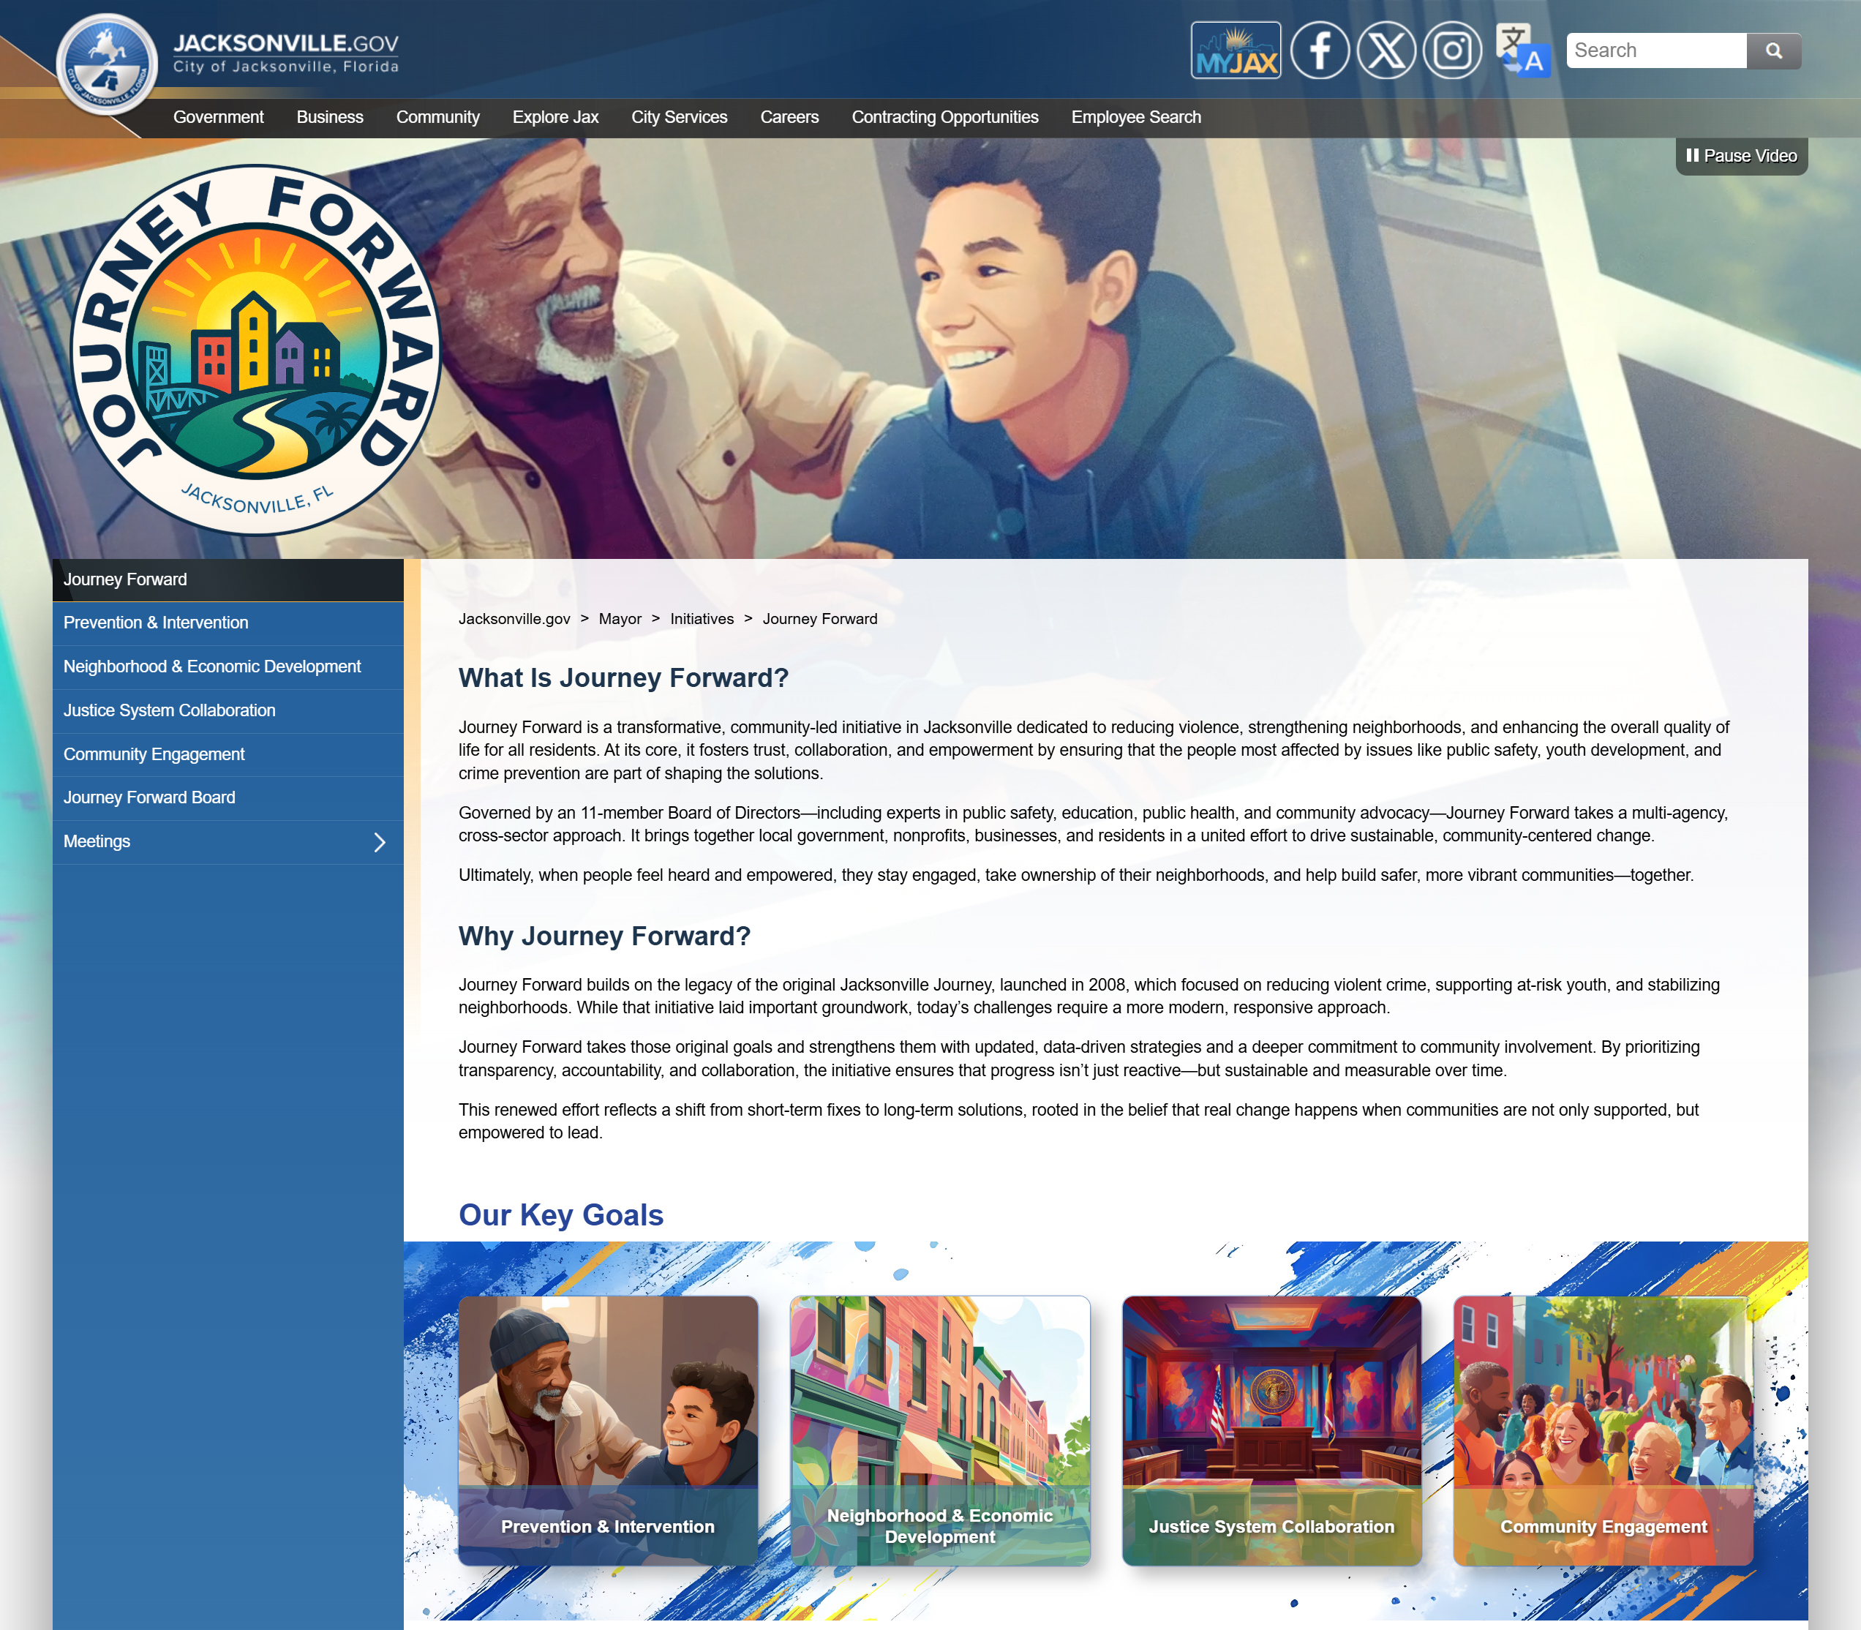
Journey Forward website

Slide 4
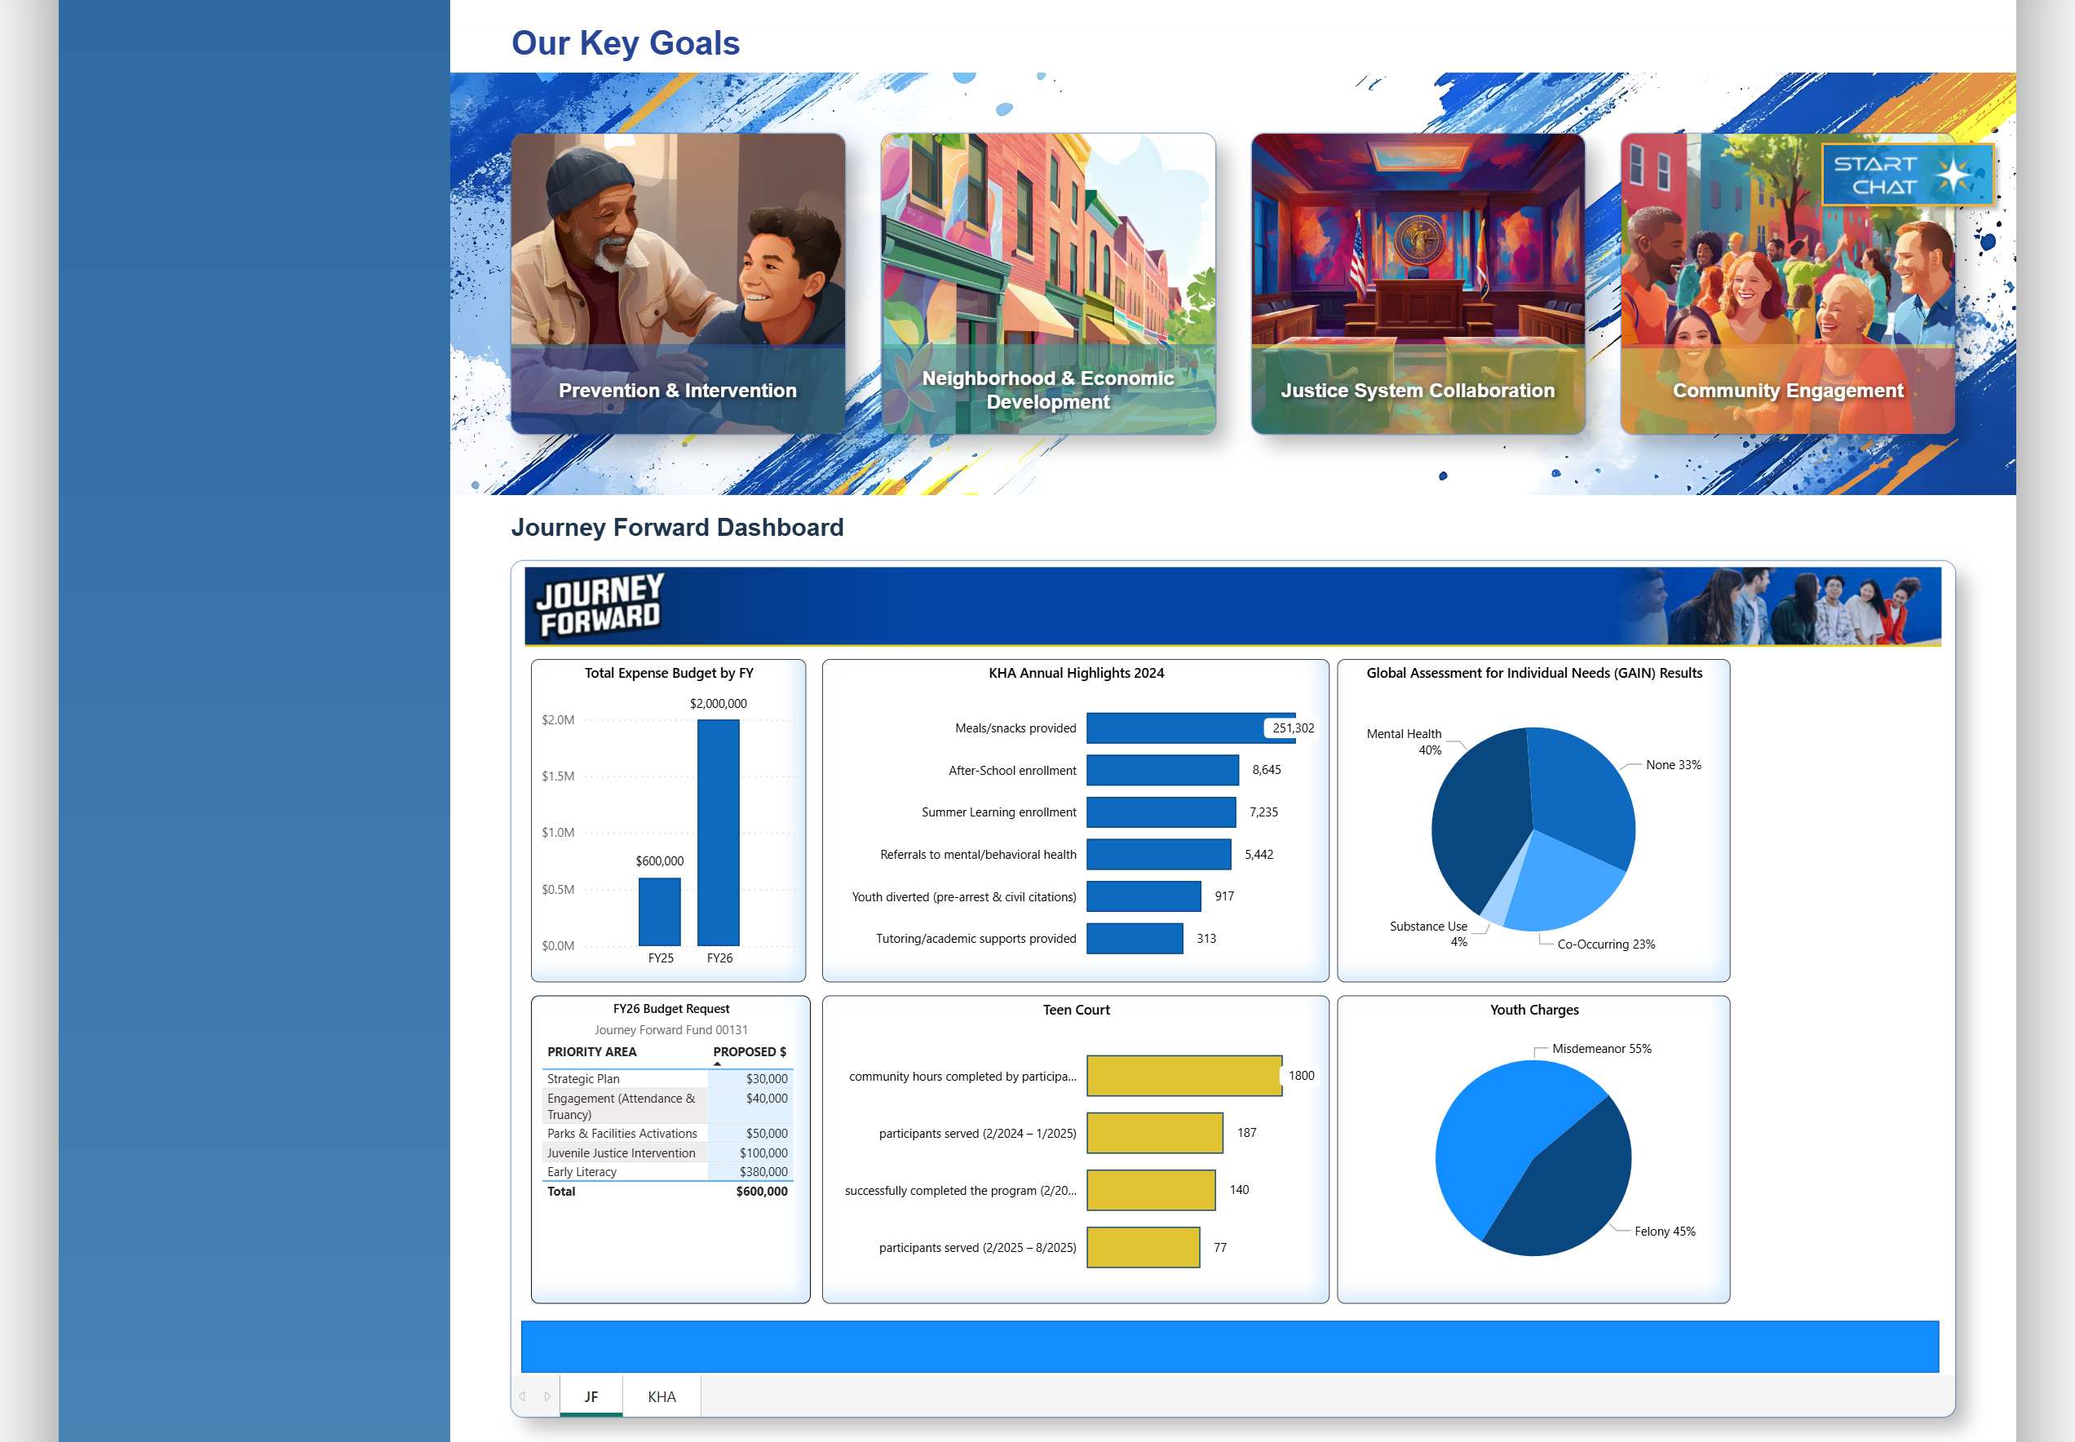
Journey Forward website

Slide 5
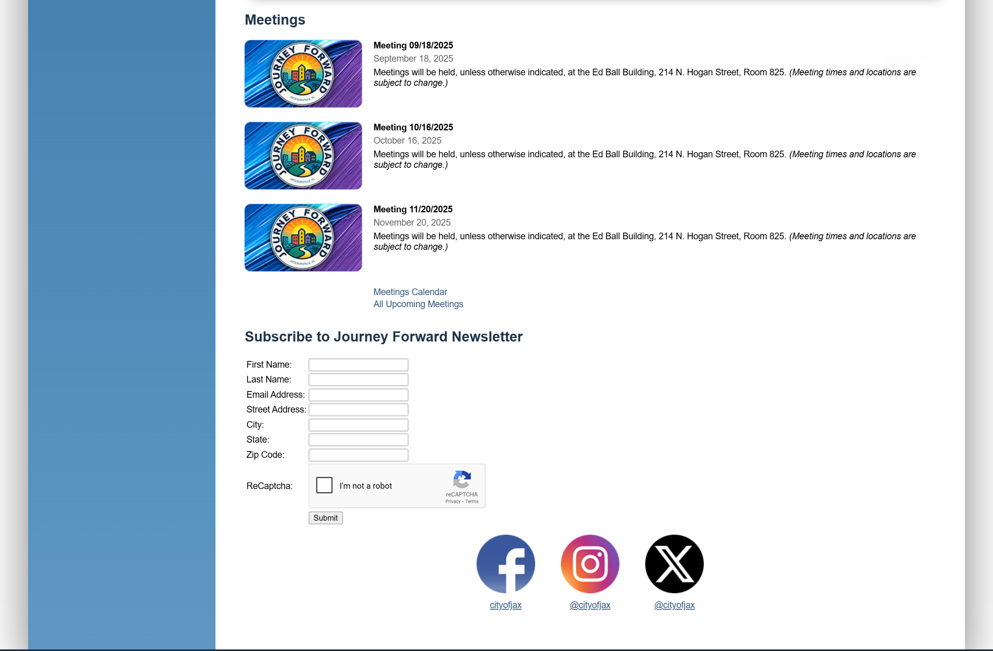
Journey Forward website

