Slide 1
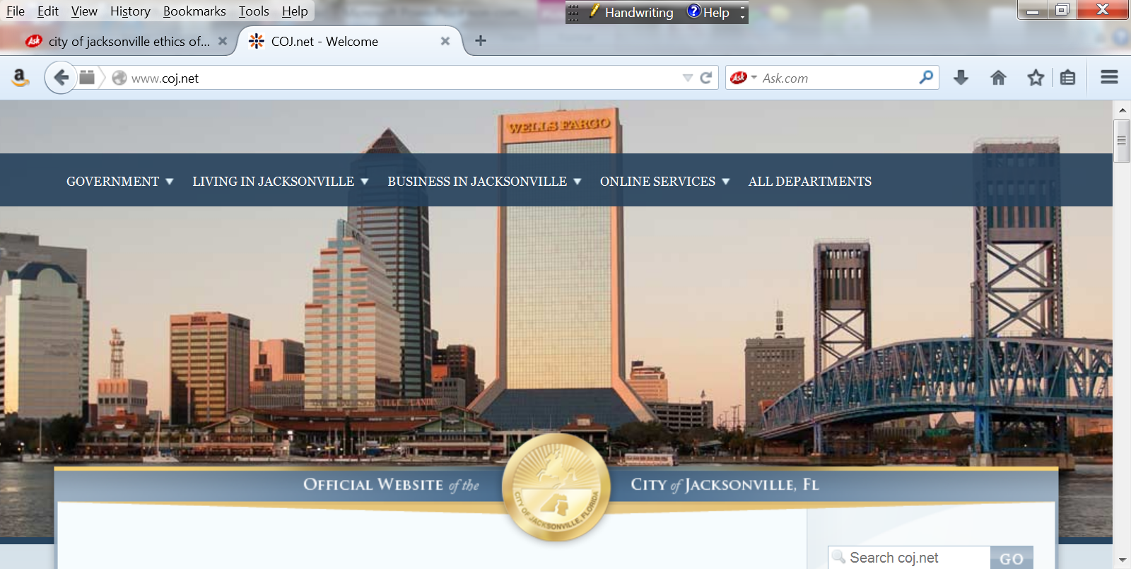

Office of
Inspector General
“Enhancing Public Trust in Government Through Independent and Responsible Oversight”
Activities Update
October 1, 2020 - September 30, 2021
Activities under former Inspector General
&
Recent Actions
January 6, 2022
Interim Inspector General
Sheryl Goodman

Slide 2
Chapter 602; Part 3
Inspector General
Jacksonville Code of Ordinances
Sec. 602.303. Duties and Functions.
(n) Issue an annual report to the Ethics Commission, the Inspector General Selection and Retention Committee, Mayor, the Council and deliver to the full City Council and the Inspector General Selection and Retention Committee a verbal briefing on activities of the Office every six months.

Slide 3
October 1, 2020 – September 30, 2021
Correspondences Handled (170)
Represents the number of written communications sent to the OIG, to include allegations of waste, fraud and abuse.
  Management Referrals: 58
  Closed No Further Action: 56
  Investigations Unit Activity: 47
    Preliminary Reviews – 29
    Referred to OIG Contract Oversight – 11
    Investigation Reports – 3
    Referred to OIG Audit – 2
    Corrective Action Memorandums – 2
  Non-Jurisdiction Referral: 5
  Management Inquiry: 4

Slide 4
October 1, 2020 – September 30, 2021
Return On Investment
Corrective Action (CA) Recommendations: 38
Number of CA’s Accepted: 100%
Number of CA’s Implemented: 35
Number of CA’s Pending: 3
Questioned, Identified and/or Recovered Costs: $74,895
    Audits (Identified) - $53,297
    Investigations (Identified) - $15,875
    Investigative Costs (Recovered): $5,723

Slide 5
OIG Impact
ACTIONS | October 1, 2020 - September 30, 2021 | Since Inception (FY2015)
Correspondences Received | 118 | 798
Closed | 99 | 721
Open | 19 | 77
Reports Issued (Contract, Audit, Investigations) | 5 | 55
Costs Identified (Recoverable) & Investigative Costs Recovered | $69,172 $ 5,723 | $1,048,409
Costs Questioned (potentially recoverable) | -- | $952,567
Corrective Actions Recommended | 38 | 271
Accepted | 38 | 261

Slide 6
Inspector General Overview

Slide 7
Inspector General Responsibilities
Promote accountability, efficiency, integrity, and transparency in government;
Prevent and detect fraud, waste, abuse, inefficiencies and mismanagement;
Conduct audits, investigations and contract oversight reviews;
Provide independent oversight; and
Receive full and unrestricted access to the records.

Slide 8
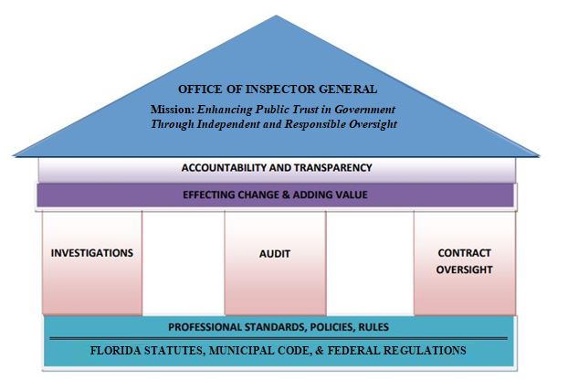
Foundation

Slide 9

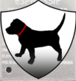
Who Watches the Watchdog
A Very Common Question

Slide 10
Principles and Standards
Inspectors Generals are granted substantial powers to perform their duties.
In exercising these powers, inspectors general regard their offices as a public trust, and their prime duty is safeguarding the public interest.

Slide 11

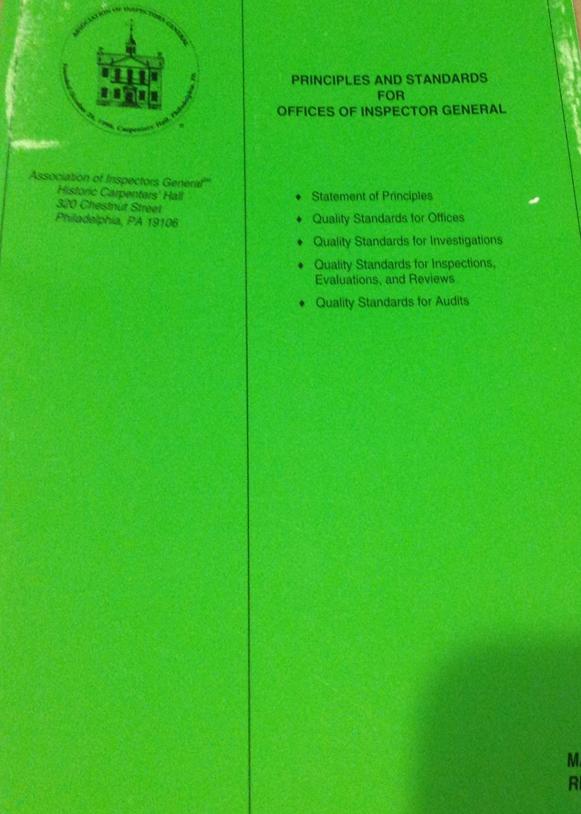
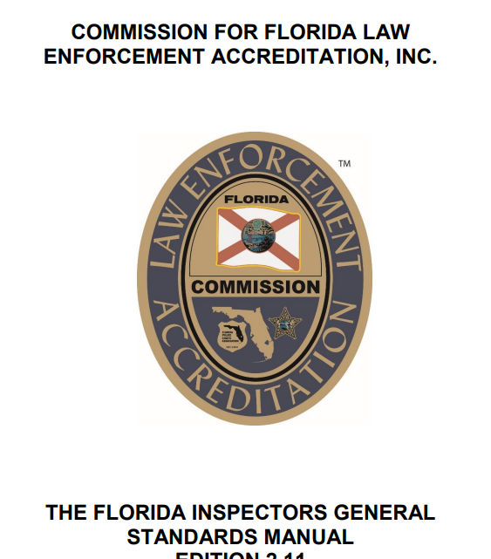

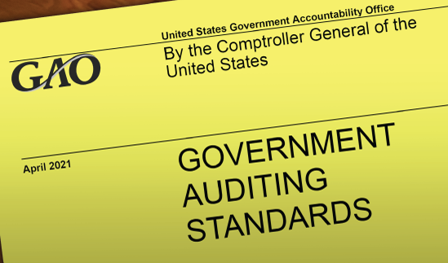
Foundation
PRINCIPLES AND STANDARDS
Review every
3 years
GREEN
BOOK
Association of
Inspectors General
RED
BOOK
Conducts Peer Reviews
YELLOW
BOOK
Review every
5 years
Review every
3 years

Slide 12
Statement of
Principles
Integrity
Objectivity
Independence
Confidentiality
Professionalism
Competence
Courage
Trust
Fairness
Honesty
Forthrightness
Public
Accountability
Respect for
Others and
Themselves

Slide 13
Nine Quality Standards for
Offices of Inspectors General
Independence
Planning
Organizing
Staff Qualifications
Directing & Controlling
Coordination
Reporting
Confidentiality
Quality Assurance

Slide 14
What the OIG Does Do?
Fact Finders
Issue Recommendations to Enhance Policies, Procedures, Rules and Internal Controls
Make Recommendations to Take Appropriate Corrective Actions
Provide Transparency to the Public

Slide 15
What the OIG Does Not Do To Those Under Its Jurisdiction
Recommend discipline or adverse action involving employees
Conduct Criminal Investigations
Arrest people
Make policy

Slide 16
December 2021 Highlights
Conducted internal and external assessments regarding compliance status of Inspector General (IG) Accreditation.
Set timeline expectations for staff regarding receipt of correspondences and future administrative investigations.
Issued Mandatory OIG Annual Report, dated December 30, 2021. Report posted to the OIG Website.
Currently obtaining from the State (at no cost) an automated audit tracking system for work product.
Establishing appropriate internal controls (locked offices/case, restricted access in the Investigation's system and shared drives) to ensure accreditation standards are met.
Completed disposition on overdue correspondences (69) with notifications to complainants of decision, as appropriate/required.

Slide 17
December 2021 Highlights
Correspondences represent the number of written communications sent to the OIG to include allegations of waste, fraud and abuse.
Closed 69 correspondences (dating back to 2017):
  Investigation’s Unit Activity – 52
    Preliminary Reviews (Closed) – 25
    Cross referenced to existing Investigation(s) – 21
    Investigations – 2
    Referrals to Audit – 2
    Criminal Referral – 1
    Management Review – 1
  Management Referral – 10
  Management Inquiry – 4
  Closed No Further Action – 3

Slide 18
Whistle-blower Protection
Interpretation of who can be a Whistle-blower (WB) pursuant to Florida Statute has been mis-applied. OIG was granting WB protection to only current employees and current contracted employees.
The Act under §112.3189, Florida Statutes, Investigative procedures includes employee or former employee, or applicant for employment.
The law also includes provisions for persons who perform services for, and under the control and direction of, or contracts with, an agency or independent contractor for wages or other remuneration.
IG best practice utilizes the “gross” modifier: mismanagement, malfeasance, misfeasance, waste of public funds, or neglect of duty.

Slide 19
Inspector General Accreditation
Commission for Florida Law Enforcement Accreditation (CFLEA)
IG Accreditation Directives:
  Whistle-blower Protection designation (6.01) (revised)
  Legal Sufficiency (4.09) (revised)
  Receipt of Evidence (5.03) (in progress)
  New Directives (by February 18, 2022):
  Refresher training: Sexual Harassment/Discrimination (3.05) (all staff completed)
  Refresher training: Ethics (3.05) (set for January 27, 2022)
  Directive 4.10: Other Investigative Activity will be documented (due by February 18, 2022)

Slide 20
Inspector General Charter
The Attribute Standard (1000) under the International Standards for the
Professional Practice of Internal Auditing (IIA) – Red Book addresses
characteristics of organizations and individuals performing internal
audit activities.
The purpose, authority, and responsibility of an internal audit (OIG)
activity must be formally defined in an internal audit (OIG) Charter.
The Charter defines the purpose of the audit office, gives authority to
conduct audits and defines areas of responsibility. The Charter also
defines others' responsibilities for providing access and cooperation
during audits or other reviews. It is now in place.

Slide 21
Inspector General Annual Audit Plan
An OIG annual audit plan is a guide that is developed for the utilization of the Office of Inspector General (OIG) Audit Unit resources during the fiscal year.
The FY2022 audit plan is based on the full utilization of the staffing level which is currently 2.
  Auditors conduct reviews that examine the economy, efficiency, and effectiveness of programs and operations; government’s compliance with applicable laws and regulations; as well as testing the effectiveness of internal controls.
  Audits return the most money in this process as they recommend efficiencies to include eliminating government waste. They also are a strong fraud deterrent.
The OIG audit plan may be modified during the fiscal year as circumstances change. Requests from management, changes in audit resources, and changes in the COJ Consolidated Government’s organization or operations could result in updates to the plan.

Slide 22
Inspector General Selection
& Retention Committee
Proposed revisions to Directive 2015-0003 - Complaints against the Inspector General
Proposed revisions to the Inspector General Annual Performance Evaluation

Slide 23


New Focus
ADDING VALUE TO THOSE
UNDER ITS JURISDICTION
RETURN ON INVESTMENT
  Impact Change
  Identify Cost Savings ($)
TIMELINESS
  Correspondence decision – 5 Days
  Administrative Investigations – 90 Days (exceptions documented)
  * Exceptions should not be the norm

Slide 24

Leadership
Director of Investigations
Director of Audit
IG General Counsel /
Director of Contract Oversight
Does Not Currently Exist

Slide 25
Future Outlook
OIG Strategic Plan (update)
Preventative and Proactive in our work
Enhance Outreach

Slide 26
Thank You
Sheryl Goodman,
Interim Inspector General
Office:
Email: inspector@coj.net
(904) 255-5800
http://www.coj.net/oig

