Slide 1

City of Jacksonville
Procurement Division
Supplier Training Guide
Responding to bidding opportunities using the 1Cloud E-Procurement System

Slide 2
Introduction
As previously announced, the City of Jacksonville’s Procurement Division is now launching updated Invitation to Quote templates as part of the process of bringing our entire solicitation and bid submission process into the future! Starting on Monday, December 4, 2023, suppliers will notice some additional questions, prompts and attachments as part of Invitation to Quotes received for our low-dollar purchases using 1Cloud. This is a minor modification to the previous design so the learning curve should not be that steep. Our formal solicitation templates will be introduced over the next few months and will have the same look and feel as the new ITQ design.

Slide 3
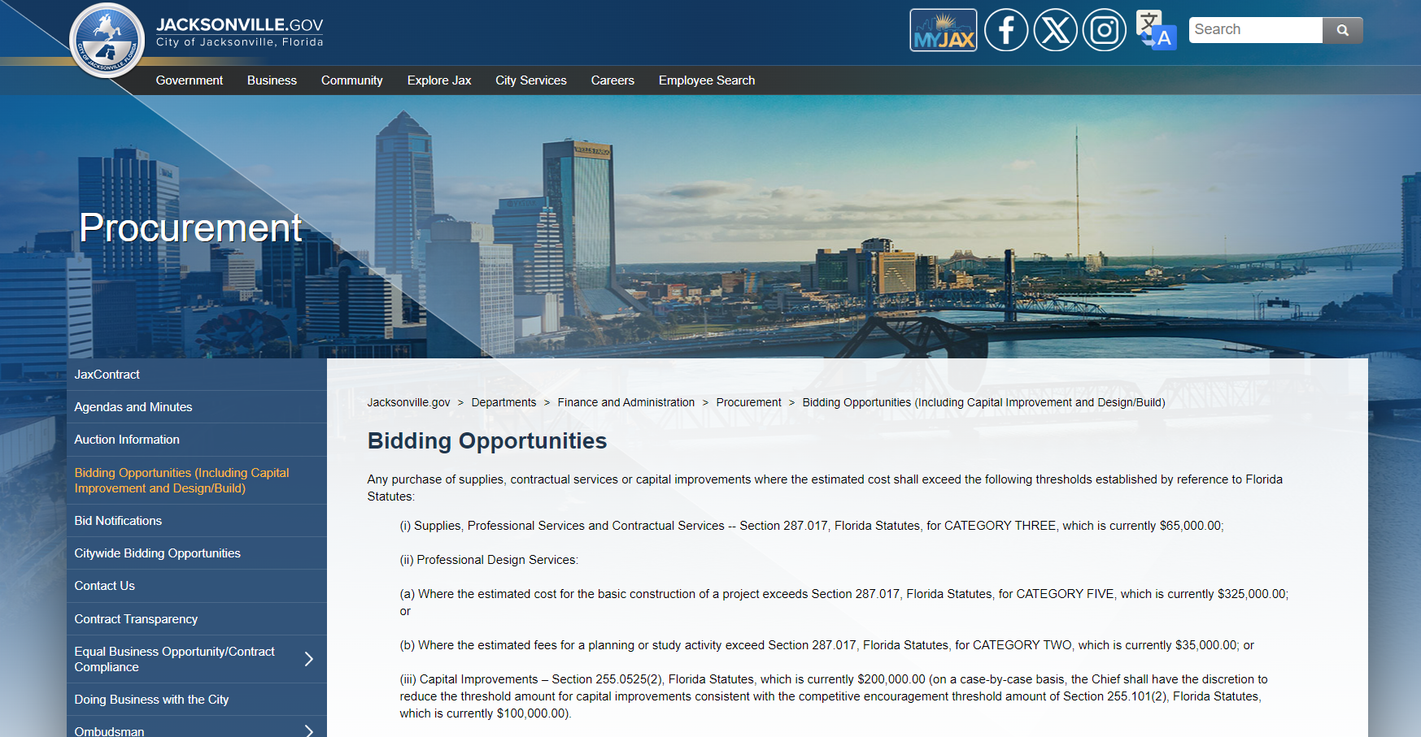
Opportunities Posted on COJ Procurement Website.
All invitations for bidding opportunities, both informal and soon formal, will be available in the same location on the COJ Supplier Portal Section of our website. Be sure to scroll down to Current Solicitations and Single Source Awards.

Slide 4
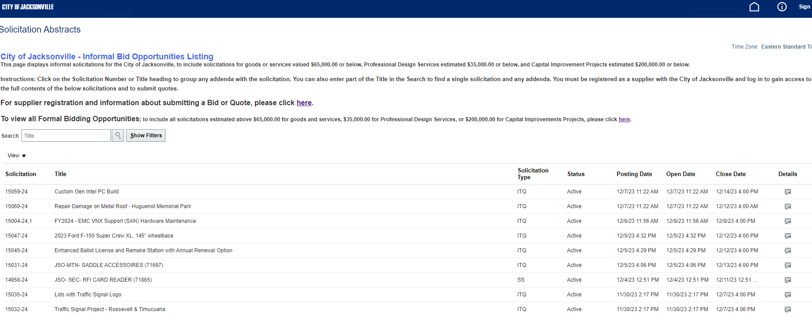
Notifications
Click on the details to see additional information. Suppliers will also be sent an invitation to participate by email through the 1Cloud E-Procurement system based on the commodity codes they have selected when registering.

Slide 5
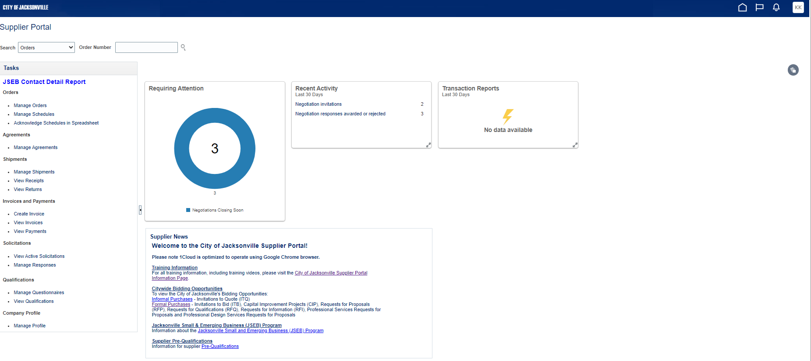
Suppliers must sign into the Supplier Portal in order to respond to solicitations.

Slide 6
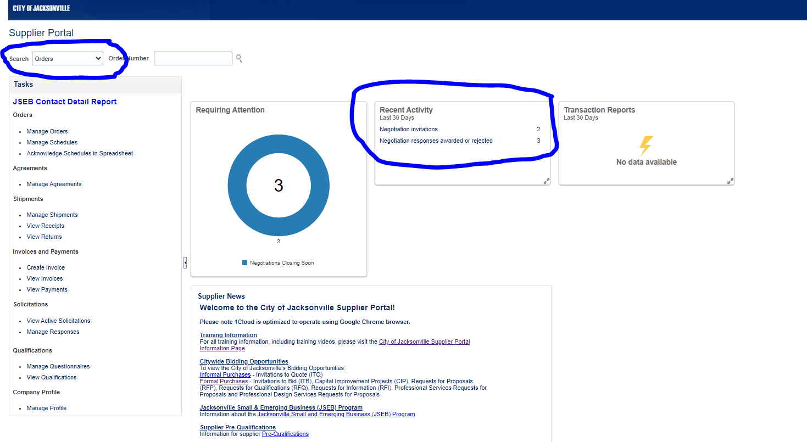
After logging into the Supplier Portal, suppliers may search for specific solicitations or review invitations.

Slide 7
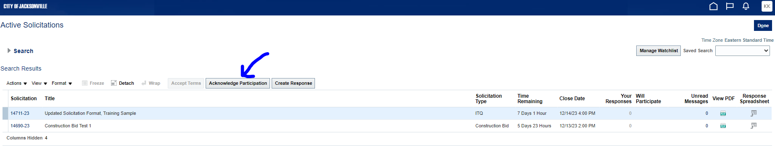
The first step to responding is to acknowledge participation.

Slide 8
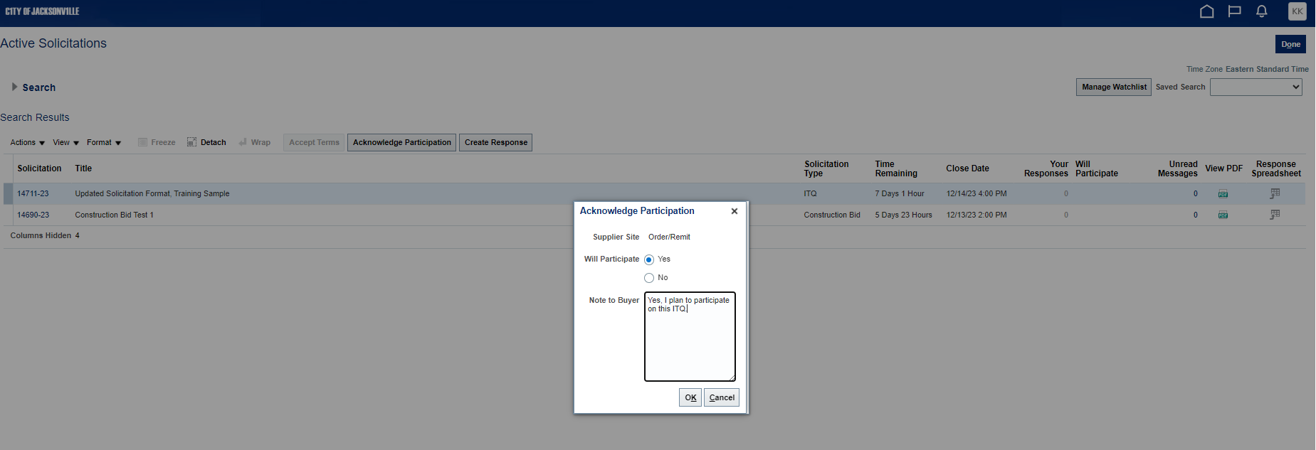
Please enter a note to the buyer indicating your intention to participate.

Slide 9
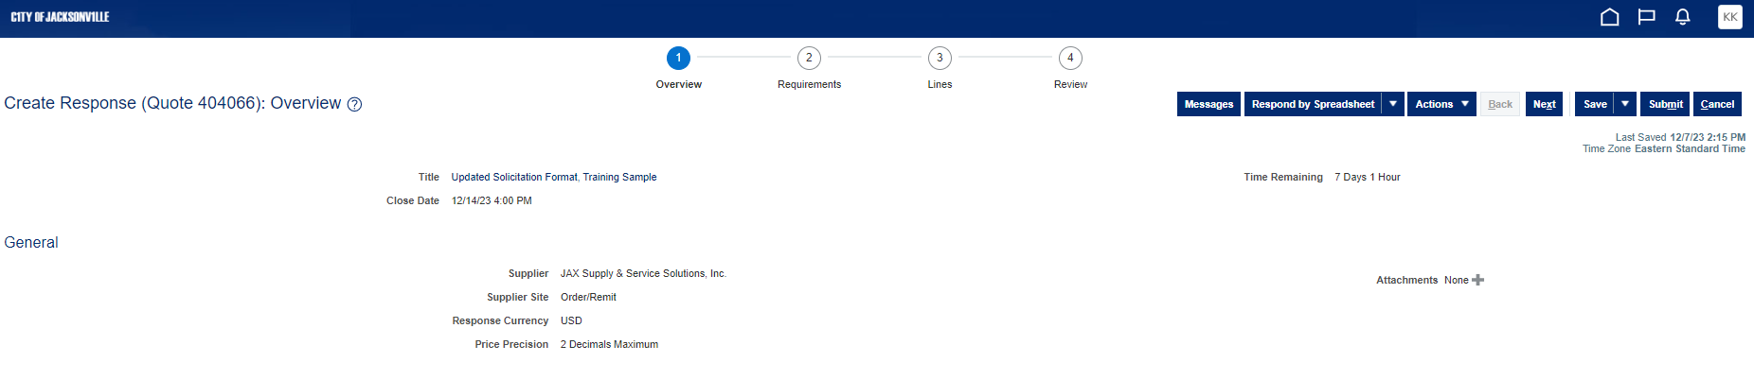
The next step is to select Create Response. Before starting, carefully review all sections, clauses and terms and conditions of the invitation. Before submitting ensure all sections are completed, requirements are acknowledged, and attachments are inserted prior to submission.

Slide 10
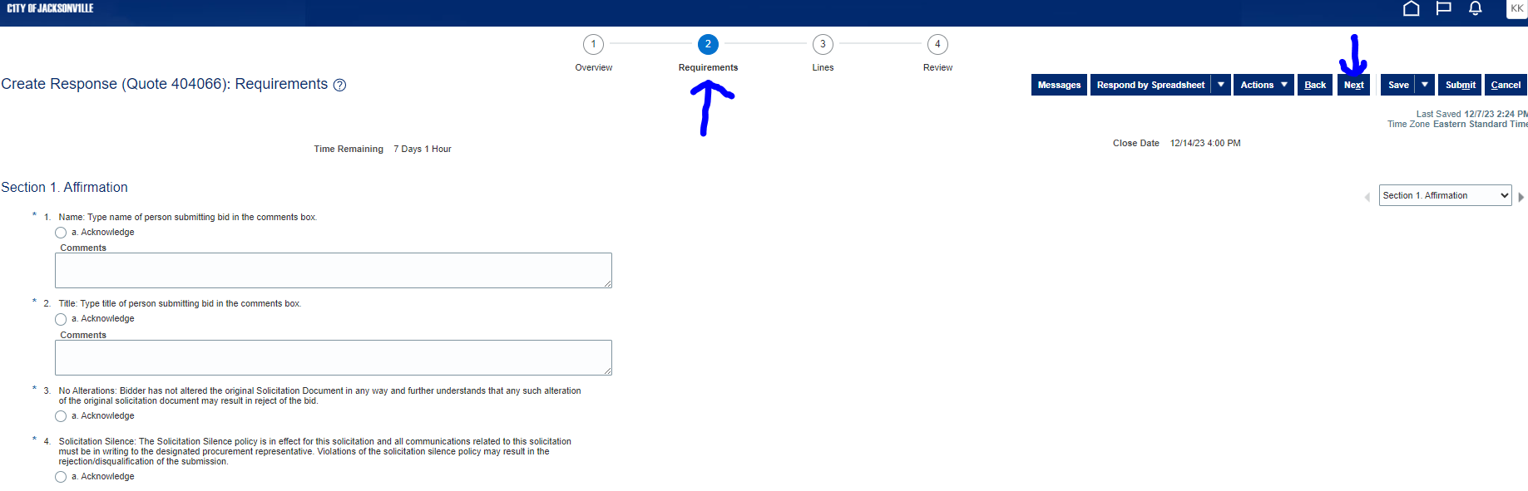
Suppliers may select the next circle or press the Next Button to advance through each section of the ITQ.

Slide 11
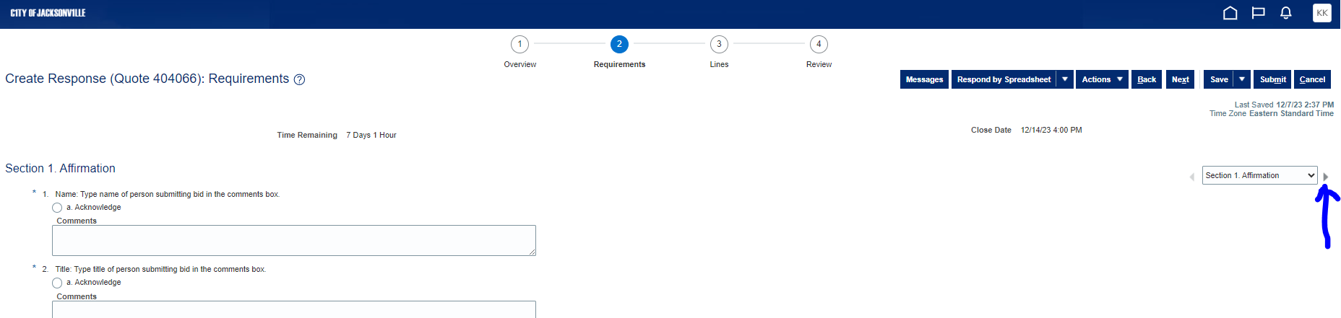
Review all requirements by section using the arrows to the right. Enter all information or select Acknowledge when prompted. Be sure to attach any files which are requested.

Slide 12
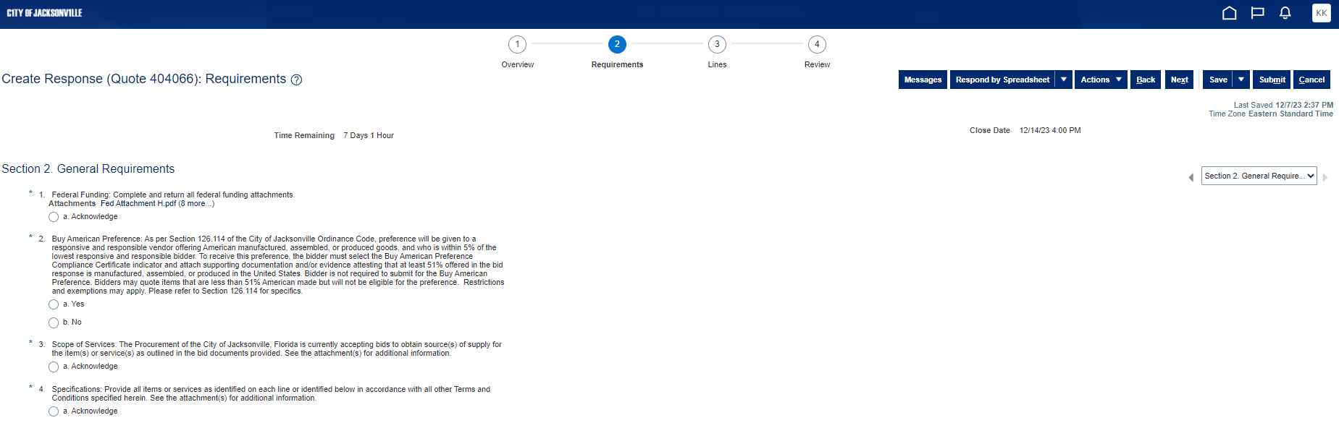
After reviewing all Requirements review lines to enter your quote price.

Slide 13
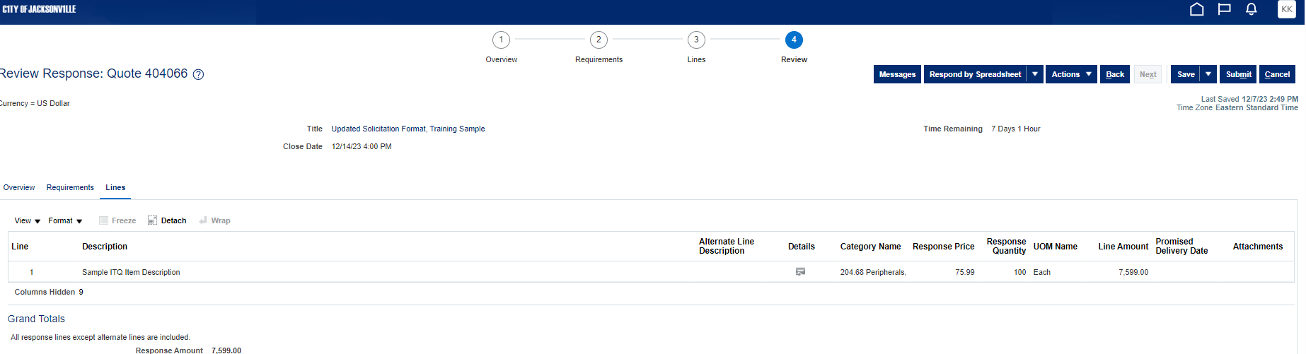
We recommend periodically saving your progress as you go. You may log-off after saving your draft then return later to complete the submission as needed. Be aware of the time remaining for timely submission. Once done, review all entries, select Validate under Actions, then Submit.

Slide 14
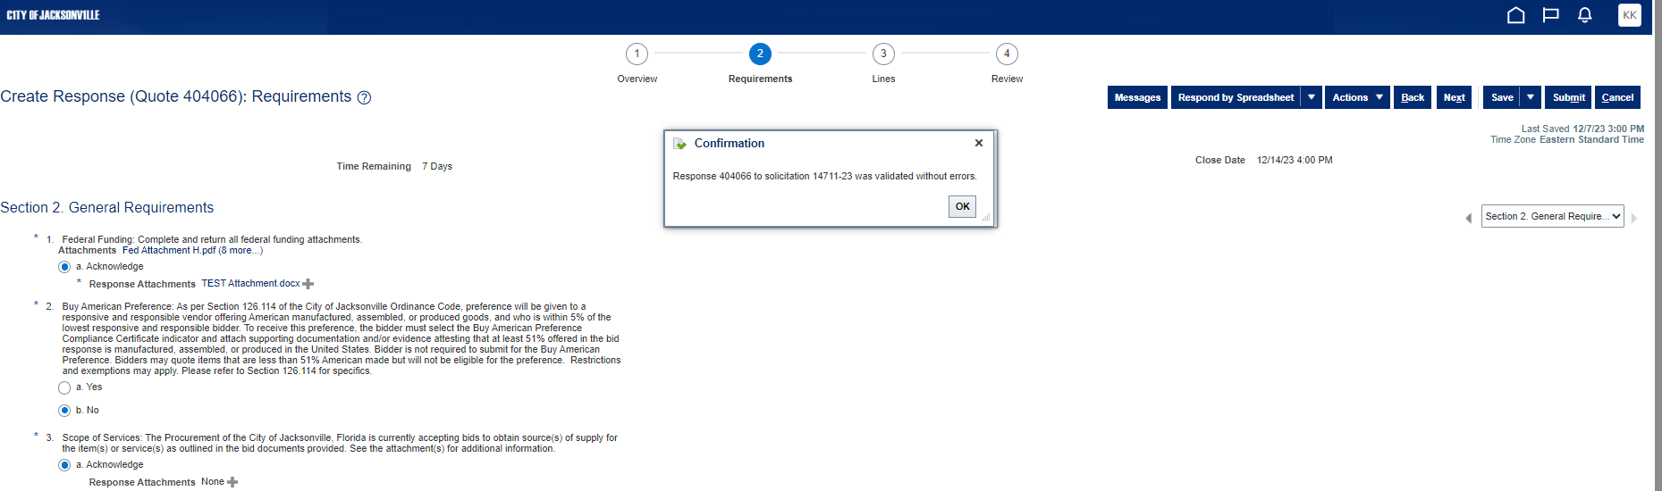
After selecting Validate, you will receive a Confirmation about possible errors.

Slide 15
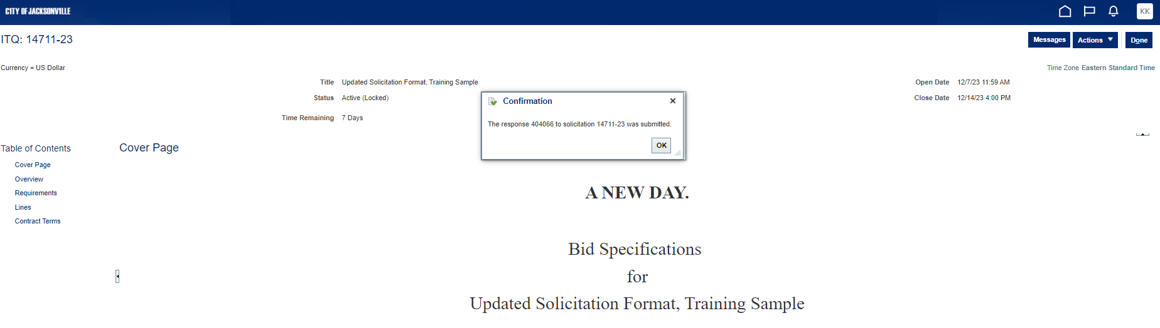
After Submitting, you will receive a confirmation notice that your response was submitted.

Slide 16
We encourage all suppliers to regularly review their contact information in 1Cloud to ensure at least one email address is provided and remove or edit any emails and phone numbers that are no longer valid. We also recommend using a generic email monitored by a sales team rather than an email used by an individual. For example, insidesalesteam@company.com.
If you have any questions, please contact us at SupplierRegistration@coj.net or (904) 255-8800.

