Slide 1

Tangible Personal Property
Filing, Assessment and Taxes
Everything You’ve Always Wanted
to Know… but were Afraid to Ask

Slide 2

What is
Tangible Personal Property (TPP)?
FL Statutes (§192.001(11)(d)), says:
All goods, chattels, and other articles of value (excluding some vehicular items) capable of manual possession and whose chief value is intrinsic to the article itself
Inventory is excluded
1

Slide 3
Who Files?
Anyone who owns TPP on January 1 and who has a proprietorship, partnership, corporation, or is a self-employed agent or a contractor…
Property owners who lease, lend or rent property
Deadline to file is April 1 (Return must be postmarked by 4/1)
  Others preparing returns (ex. accountants) should make sure clients are aware of deadline
2

Slide 4

What to Report
Business Assets
    Furniture, computers, manufacturing
    equipment, signs, office items
Supplies
    Give average cost of supplies on hand
    Include supplies, such as stationery and janitorial supplies and linens
3

Slide 5
What to Report
Household Goods (in Hotels, Motels, Apts./Rental Units):
    Furniture
    Appliances
    Other assets such as mini-blinds, fans, artwork
Property Owned but Rented to Another:
    Any equipment the property owner owns that is on a loan, rental, or lease basis to others
    And other items…
4

Slide 6
What to Report
  Attached Vehicle Equipment
  Tagged vehicles are not considered TPP
  However, equipment attached to the vehicle to perform a service is considered Tangible Personal Property
  Examples include: generators, water tanks, tool boxes, ladder racks, GPS trackers, additional gas tanks, storage tanks
  Motor vehicles and vessels employed primarily as a “work platform” for equipment are not exempt
  Example: barges (without motor)
5

Slide 7
Leased Property
LESSOR:
Rule of thumb: Property owner with title reports tangible personal property and pays taxes on it.
LESSEE:
Should report leased equipment on the return under “Leased Loaned or Rented Equipment,” but typically does not pay the taxes on them.
May be exceptions depending on conditions of the lease.
6

Slide 8
Leased Property
True Lease:
An agreement between parties where the lessee is only “renting” the equipment for a predetermined amount of time.
Ownership is not being transferred at the end of the lease, instead the equipment is returned to the lessor.
7

Slide 9
Leased Property
Conditional Sales Agreement:
An agreement between two parties where the lessee may or may not purchase the equipment after the lease is over. The buyout price could be a percentage of the cost, a dollar, or a set price determined by the lease agreement.
The lessee is under no obligation to purchase the asset at the end of the lease, therefore title typically remains with the lessor and they should be filing on the equipment. However, checking the lease agreement to see who should file on the asset is recommended.
8

Slide 10
Leased Property
Capital Sales Agreement:
An agreement between two parties where the owner of the property is primarily selling the equipment to the lessee. At the end of the agreement the lessee becomes the owner.
During this agreement, the title will remain with the lessor until the end of the agreement when it is transferred. Typically though, these agreements will state that the lessee is responsible for filing on and paying the property tax during the lease agreement.
9

Slide 11
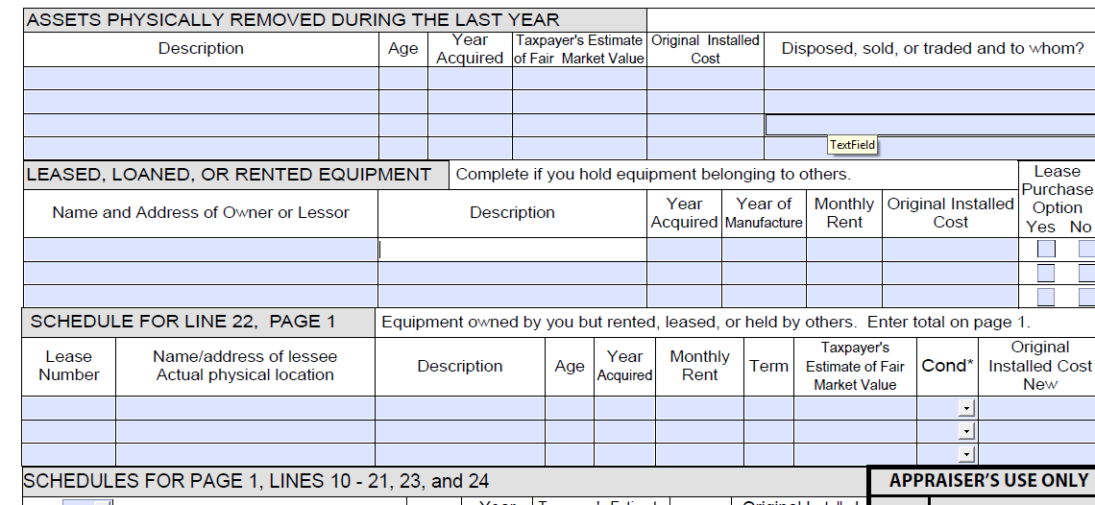
Leased Property
Typically Filer would NOT Pay Taxes on
(LESSEE)
Typically Filer Would Pay Taxes on
(LESSOR)
10

Slide 12
Leased Property
If a business owner abandons equipment in a building after vacating, the real estate owner is responsible for filing and paying taxes on the equipment if no business is operating there on Jan. 1.
The real estate owner must file a return on the items by the April 1 deadline or they will not receive the $25,000 exemption.
If a tenant is leasing the space the following year on January 1, the landlord should notify our office in writing.
11

Slide 13
Things to Remember
Returns with pre-printed business name and account number are mailed to property owners on file in January (excludes those below $25,000 threshold who received exemption in prior year).
If not using our form with the personalized information, please make sure the account number is on the return.
12

Slide 14
Things to Remember
Removals/Deletions
If an asset is removed which was previously reported, the owner must notify the Property Appraiser that the asset is gone and how it was removed.
Report it on page 2 of return: “Assets physically removed during the last year.”
13

Slide 15
Things to Remember
Original Costs:
  Report year of manufacture and 100% of original cost including sales tax, transportation, handling and installation. This is before any allowance for depreciation. (§195.027, FL Statutes)
  This is NOT the book value or the purchase price at the time of transfer.
14

Slide 16
Things to Remember
Federal v. State Reporting
Just because the item is no longer being reported on the Federal Income Tax return, doesn’t mean it comes off the TPP return. If it is there, it is considered to have value and must be listed.
Include fully depreciated items at original cost.
All items must be reported.
15

Slide 17
Property at Various Locations
There must be a separate return listing property for each location of a business because assets must be in the correct taxing districts.
…that is, unless the equipment is freestanding (i.e. an ATM, vending machines, etc.) whether owned or leased. Freestanding assets must be listed on one return.
16

Slide 18
Proper Classification of Equipment
Provide detailed descriptions. More is better.
(Attach a detailed spreadsheet whenever possible.)
Computer-assisted mechanisms
including medical equipment, copiers,
and other technological equipment
are often misclassified as computers.
Misclassification can result in equipment being assigned an improper life and depreciation rate and create an incorrect assessment.
17

Slide 19
How TPP Values are Determined
The assessment of TPP is based upon the cost approach.
The original installed cost reported on the TPP return will be indexed up to determine the current replacement cost new.
Depreciation is applied to the replacement cost new to determine the assessment for that particular asset. (Replacement cost new less depreciation.)
The index factor and depreciation applied is based upon the age of the asset and the economic life assigned.
18

Slide 20
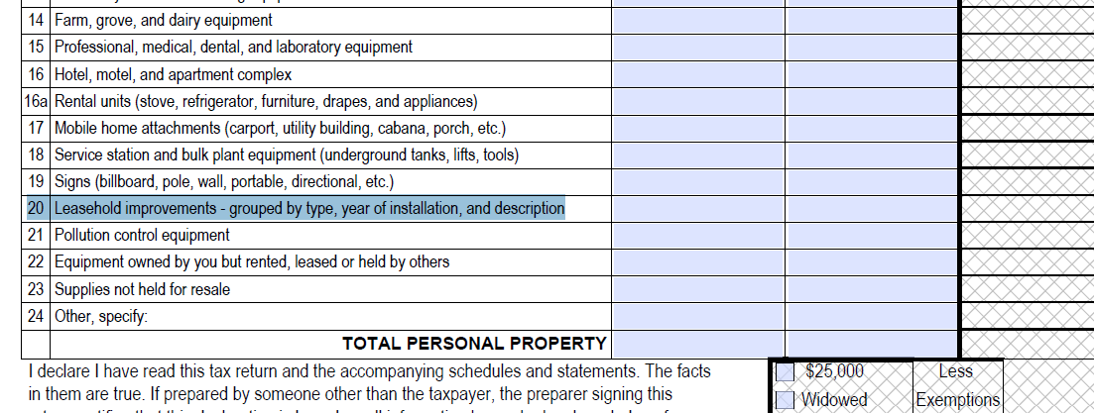
Leasehold Improvements
  One of the most frequently misunderstood areas of tangible personal property reporting
19

Slide 21
Leasehold Improvements
Property added to leased property relating to your business
    Examples: booths, bars, seating, special heating and air equipment, lighting, partitions, raised flooring, built-in front desks or counters . . .
“Any improvements, including modifications and additions, to leased property.” FL Administrative Code (FAC) 12D-8.011(2)(h)
    Detailed descriptions are important to ensure accurate assessment and avoid double taxation.
20

Slide 22
TPP Exemption
Passed by voters in 2008
$25,000 reduction in value
Must File Timely (by April 1) to receive the exemption
21

Slide 23

TPP Exemption
Businesses at or below the $25,000 threshold must file an INITIAL return ONLY
    They will receive a blue post card waiving the requirement to file each year until the value exceeds the threshold
      Those who receive a waiver and remain at or under $25,000 threshold, DO NOT FILE a return
    If having another person (ex. accountant) prepare the return, tangible property owners should let the preparer know if they receive a card
    Once value exceeds $25,000, property owner MUST notify PAO and file a return
22

Slide 24
New Ownership
If business is sold, new owner is responsible for unpaid taxes – even those going back several years.
“Bill stays with the equipment.” Even if most of the equipment is gone, the new owner is still responsible for taxes if some assets still exist.
Make sure there are no taxes due before closing.
It is critically important that the prior owner notifies the PAO that the business is closed or sold.
23

Slide 25
Deadline Extension
TPP Returns are due April 1.
§193.063, FL Statutes allows the Property Appraiser to grant an extension of up to 30 days. (Request must be made in writing prior to the April 1 deadline.)
24

Slide 26
Important Dates
January Jan. 1 - Appraisal Date
Pre-Printed TPP Returns (DR-405) Mailed
Return Waivers/Exemption Receipts mailed to property owners with TPP value $25,000 or less
April 1 Deadline to file TPP Return
Mid-August Notices of Proposed Property Taxes (TRIM notices) mailed
September Deadline to File Petition with Value
(date varies) Adjustment Board (VAB)
October VAB Hearings Begin
Oct. 31 - Tax Bills Mailed
25

Slide 27

Contact Us
For information, forms or to inquire about tangible personal property reporting, contact:
Tangible Personal Property Division
231 East Forsyth Street, Room 330
(904) 630-1964
(904) 630-5918 fax
or
Visit Us On the Web at
www.duvalpa.com

Slide 28

Tax Collector Contacts
For payment information regarding Tangible Personal Property Taxes, contact:
Tammy Hall, TammyH@coj.net
Deputy Director of Tax Operations
Cindy Raley, craley@coj.net
Director of Tax Operations
(904) 630-1916, option 4

