Slide 1
City of Jacksonville Police & Fire Pension Fund
Private Market Education
July 2015

Slide 2

PRIVATE EQUITY EDUCATION & MARKET UPDATES

Slide 3

What is private equity?
Limited Partner
Limited Partner
Limited Partner
Limited Partner
Private equity commonly refers to any equity investment that is not freely tradable on an exchange. Private equity can refer to multiple sub-strategies including non-core real estate, energy, infrastructure, corporate buyout, private lending and venture capital.
Private equity investments are made by partnerships that involve three main constituents:
Limited Partner: Institutions or individuals who contribute capital to a private equity fund.
General Partner: The managing partner in a private equity management company who has the right to participate in its management.
Portfolio Companies: Investee firms or companies backed by private equity firms.
A typical private equity firm will raise a new fund from investors every 3-4 years.
Fund of Funds
Direct Investment
Co-Investment
Private Equity Fund
Private Equity Fund
Private Equity Fund
Company
Company
Company
Company
Company
Company
Company
Company
Company
Company
Company
Company
Notes:
http://www.bnet.com/2403-13241_23-55860.html

Slide 4

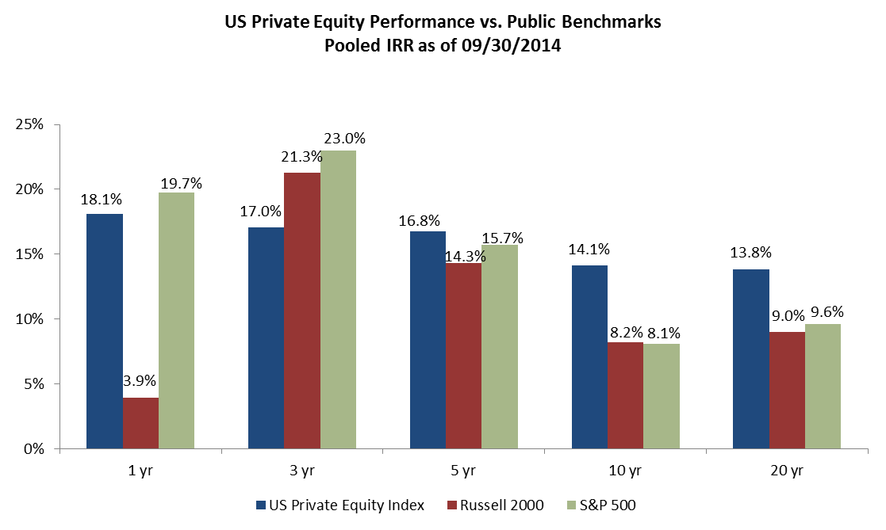
WHY INVEST IN private equity?
returns have outperformed public equity benchmarks over longer timeframe
Private equity is moderately correlated to the bond and stock markets and can provide diversification benefits.
Source: Cambridge Associates US Private Equity Index 09/30/14. Returns are net to investors after management fees and carried interest. Pooled IRR is calculated by treating all funds as a single "fund" by summing their monthly cash flows together.
Notes:
1
http://www.nvca.org/ffax.html
The excel spreadsheet is at:
F:\MANAGER RESEARCH\Private Equity\General Research\Intern Project\Excel Spreadsheets\PE_Correlations

Slide 5

Why Private Equity Earns a Premium Return?
Inefficient Markets – In the US alone, there are over 125,000 privately owned businesses with revenues >$10m. Investment opportunities are more difficult to identify.
Negotiated Transactions – Private transactions often involve prolonged negotiations between buyers and sellers. A seller’s decision can be influenced by relationships, deal structure or other non-economic considerations.
Governance & Control – The best private equity firms get intimately involved in the strategic and financial decisions at portfolio companies, providing a level of oversight not typical of public investments.
Alignment – General Partners often make substantial personal investments in their funds, which creates strong alignment with Limited Partners.
Financial Risk Premium – Private equity buyouts can involve substantial amounts of leverage which increases returns and risk.
Liquidity Premium – A private equity fund’s life is generally 8 to 10 years with limited liquidity for investors. Limited Partners demand higher returns to compensate them for the longer lock-up period.
Notes:
1

Slide 6

considerations before committing to Private equity
Lack of Liquidity – Funds are typically structured with a 10-year life. Selling fund positions in the secondary market can entail substantial transaction costs and discounts to Net Asset Value.
Fees – Fund fees are more expensive than traditional asset classes and range from 1.5 - 2.5% on committed capital with managers keeping 20% of profits (carried interest).
Investment Risk – Underlying investments will typically be made in companies that are substantially smaller, at an earlier stage of development or whose balance sheets are highly levered. Depending on the underlying fund strategy, Summit estimates that a fund can expect to lose 10-40% of invested capital with the expectation that winners make up for those losses.
Over-Commitment Required – Because of the cash flow dynamics of funds, LPs must “over-commit” in order to reach and maintain their target allocation. As a rule of thumb, LPs should expect to commit 40-60% more than their target allocation.
Administration – The private portfolio will consist of more funds which implies additional administrative time in vetting, approving, closing and monitoring the portfolio.
Governance & Decision Making – Fundraising by managers can move quickly. Securing access to the highest quality funds or taking advantage of opportunistic situations may require a different approval process than traditional managers.
Reporting Lag & Performance Measurement – Financial reporting by fund managers can take 30-120 days depending on the fund strategy and time of year. Because of the drawdown nature of funds, time weighted performance measurement is not appropriate. Dollar weighted measurement is recommended and reduces the accuracy of custodial reports. Summit recommends separate reporting based on manager cash flows and reported NAV.
Notes:
1

Slide 7
considerations before committing to Private equity:
The fund lifecycle
Fundraising (6-18 months) Time period when the fund is marketed to investors. Capital is committed to the fund by Limited Partners. The commitments are legal obligations to fund future capital calls as the fund manager identifies investment opportunities.
Investment Period (Years 0-5) Typically an investment period will last for 5 years, with additional time allowed for follow-on investments in portfolio companies. Investments are funded by drawing down the capital from Limited Partners.
Realization Period (Up thru Year 10) The manager sells assets and returns capital to investors during this phase. Realizations may occur at any time during the fund, but will predominately happen after year 5.
100%
Net Capital Called Peaks at 60-80% of Commitment
Net Capital Called as % of Commitment
50%
LP Cash Flow
Realization Period
Investment Period
Fundraising Period
Year 0
Year 5
Year 10
Fund Inception
Life of a Private Equity Fund
Fund Termination

Slide 8
considerations before committing to Private equity:
The “J-Curve” effect on returns
Private equity returns are generally negative during the first few years of an investment – because of the realization of early losses and fee payments – though the degree varies by asset type. As investments mature and are realized, returns become positive, resulting in the “J-Curve” Effect.
Venture
Buyout
Mezzanine

Slide 9

considerations before committing to Private equity: Structuring Your Portfolio
Private Equity
Be comfortable with the asset class and understand the long-term nature of private equity
Be patient and choose investments carefully
Because of the legal structures of these investments, one can’t just “undo” this decision
Make the allocation meaningful (greater than or equal to 5% of your total assets)
From an administrative standpoint, these are labor-intensive investments, so make it worth your time
A caveat: due to the historical characteristics of these investments, the application of traditional portfolio optimization techniques must be tempered by a heavy dose of common sense
Balance the benefits of diversification with the consequences of over-diversification.
Elements of diversification include: time, geography, sector, manager, style, fund size, source of return.
Based on Summit’s experience and analysis of private benchmarks we believe ~5 funds per year is optimum.
It’s not critical to cover every dimension because private equity should be alpha focused – “best ideas only.”

Slide 10
HOW TO INVEST IN private equity?
Implementation Considerations
Fund of Funds vs. Direct Partnerships – decision driven by size of allocation, fee savings and administrative burden
Number of Partnerships – Avoid over-diversification. Summit recommends 5-6 direct partnerships per year
Strategy Allocation – balancing higher risk strategies like venture with lower risk and j-curve mitigating strategies like debt

Slide 11

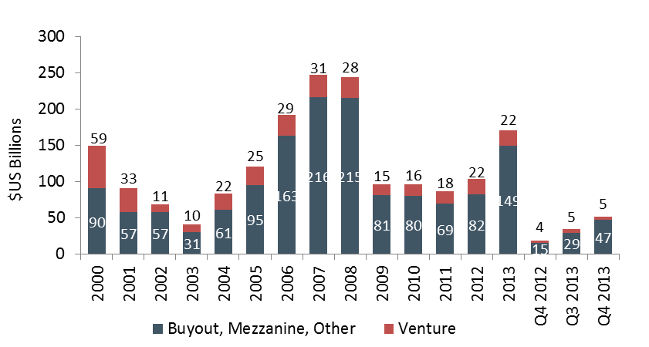
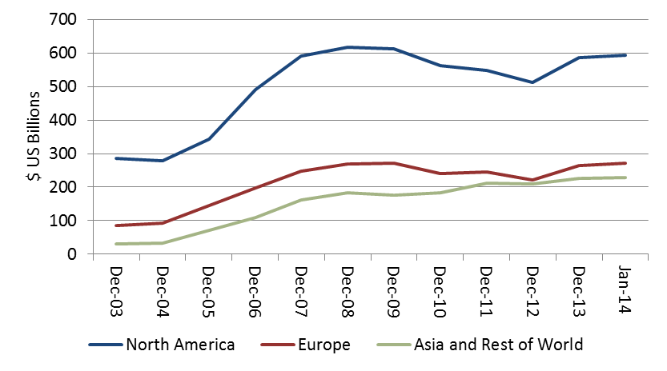
PRIVATE EQUITY: Market observations
US Fundraising
Fundraising has picked up the last couple of years.
Prices are high and managers report challenging environment and light deal volume, which has led to sustained high levels of un-invested capital.
Against this backdrop, Summit believes several themes are critical to investor success
Specialization – focus on managers who have better access to deals, judgment, and post-investment value add due to their industry knowledge
Manage Price Risk – various strategies such as growth capital and structured equity invest thru preferred securities that have liquidation preferences and sit above common equity allowing for down-side protection
Opportunistic Late Closings – Fundraising timelines remain elevated, allowing LPs the option to wait until final closings for many fund managers.
Patience & Selectivity – This is true across any private market cycle, but takes on a greater sense of importance today.
Source: Preqin
Dry Powder
Source: Preqin

Slide 12

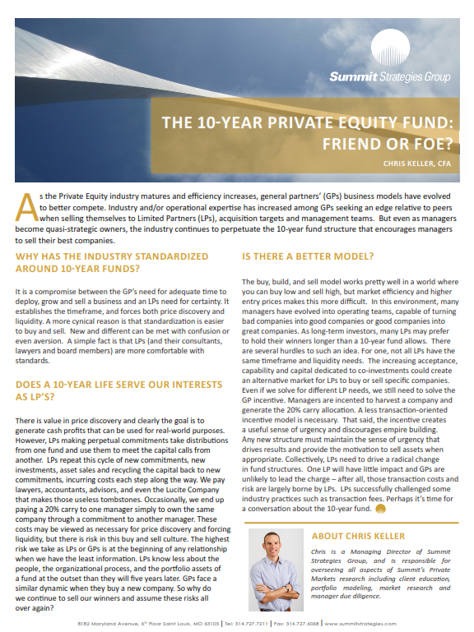
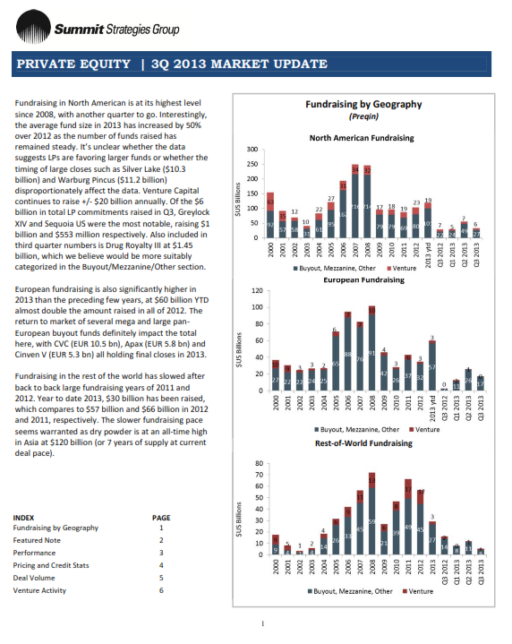
Market research helps focus due diligence efforts
Manager selection begins with fundamental market research.
Staying current on trends in the market place.
Understanding the supply/demand dynamics.
Historical perspective of sub-asset class performance.
Data Sources:
Preqin
Private Equity International
S&P LCD
Bloomberg
Networking
Notes:
11
11

Slide 13
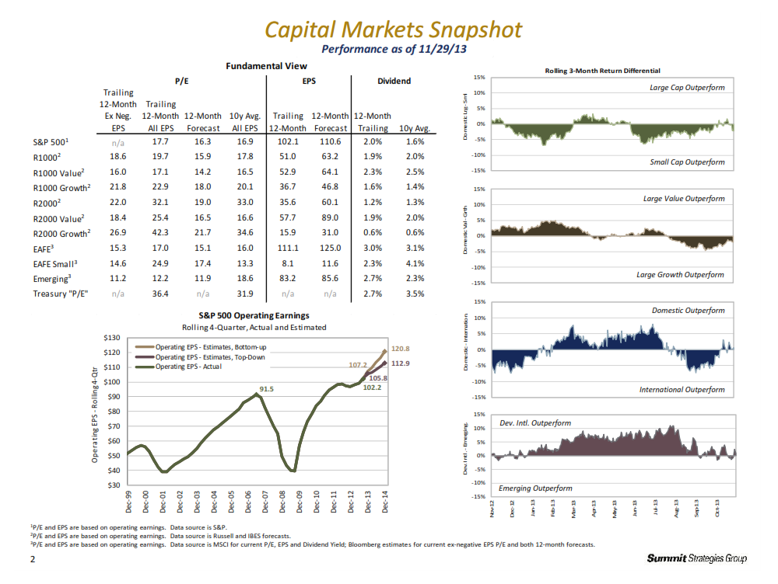
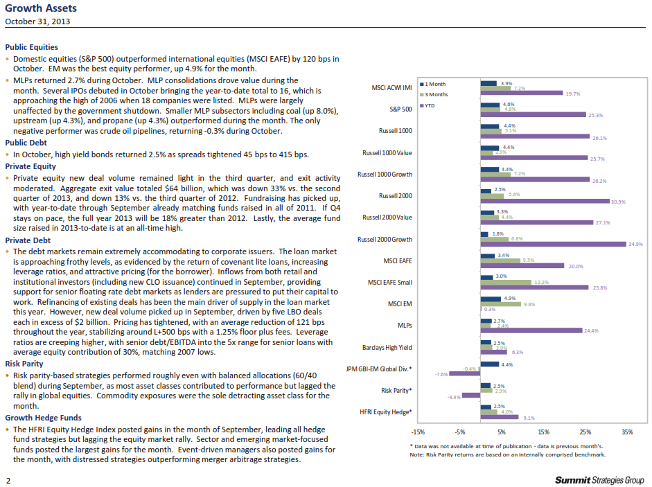
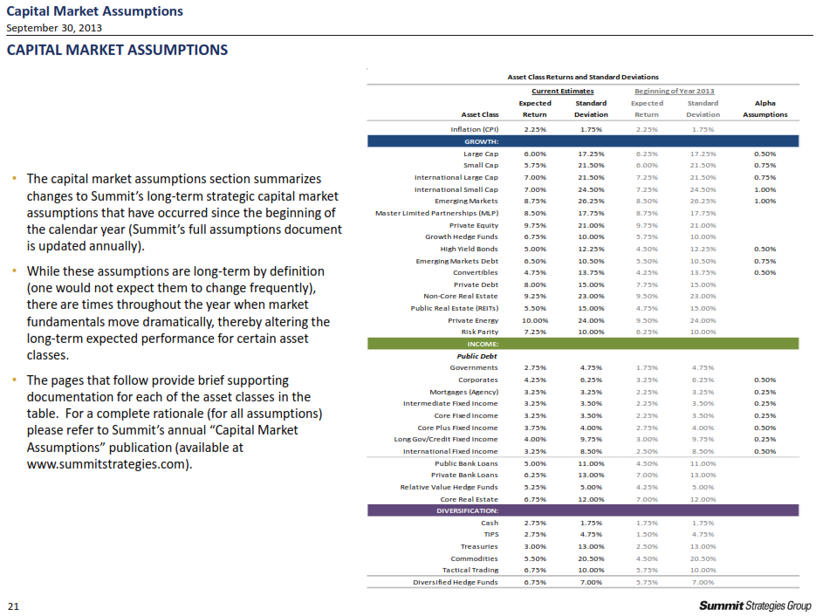
Capital markets context
Capital markets inform our private investment process.
Examples of Capital markets content;
Weekly Capital Markets Snapshot
Monthly Market Review
Monthly Index Reports
Quarterly Market Review and Asset Class Assumptions
Quarterly Fixed Income and Global Equity Review
Notes:
12
12

Slide 14

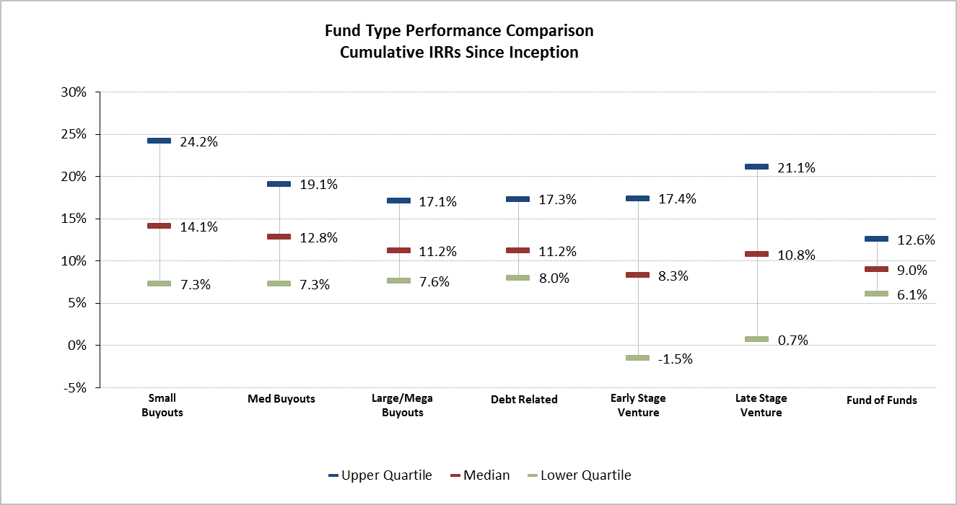
VALUE OF TACTICAL ALLOCATION
Tactical investment decisions have a meaningful impact on absolute and relative performance.
Investors should not simply buy the market.
Source: Preqin Cumulative sub-strategy IRRs since inception thru 6/30/2014

Slide 15
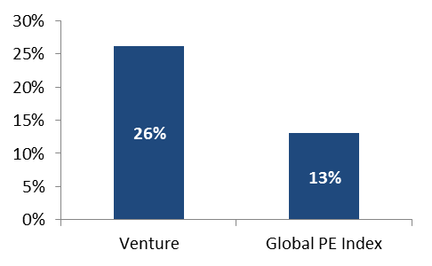
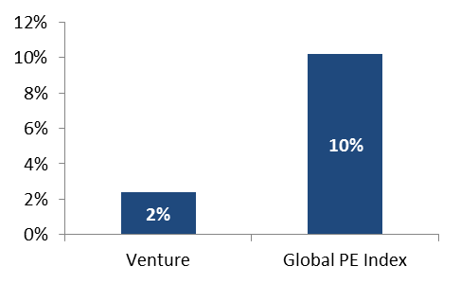
VALUE OF TACTICAL ALLOCATION
Tactical investment decisions have a meaningful impact on absolute and relative performance.
Investors should pay attention to signals for specific sub-asset classes as certain strategies go in and out of fashion.
Venture Capital
1993-1997
1998-2006
After strong performance in the 1990s, venture fundraising picked up substantially and subsequent returns suffered.

Slide 16
Value of manager selection
Manager selection matters and gets rewarded.
The performance dispersion between the best and worst performing private equity managers is high and more stable than other asset classes.
While traditional asset class managers tend to revert to the mean, private equity manager performance tends to persist.
Core real estate return dispersion and persistence resemble traditional asset classes – the allocation decision is more important.
Manager selection is critical for a successful private equity program.
Focus on the most compelling opportunities.
Better to wait for the best partners.
Remain flexible; never be in the position where you must invest just to reach an allocation.
Fundraising schedules of managers will dictate near-term commitment decisions.
Asset Class Performance Relative to Benchmark Median
Source: Preqin Cumulative Vintage Year Composite performance for PE funds from 2001 to 2011 as of 6/30/2014. Returns measure spread between median and the respective quartile. Core fixed income, large cap equity and small cap equity returns are for 10 year investment horizons ending 6/30/2014.
Notes:
Traditional data is outdated

Slide 17



Tactical allocation + manager selection
1. Market Theme
2. Idea Generation
3. Implementation
Diminished venture fundraising
Longer exit timeframe
Inefficient valuations
Identify manager universe
Interviews & manager analysis
Direct vs. Fund of Funds
Healthcare vs. Technology
High profile vs. Low profile companies
Closed:
Omega +82% IRR
HighBAR +47% IRR
Greenspring Secondary +71% IRR Top Tier VV +47% IRR
Be Early.
Be Disciplined.
Be Right.

Slide 18
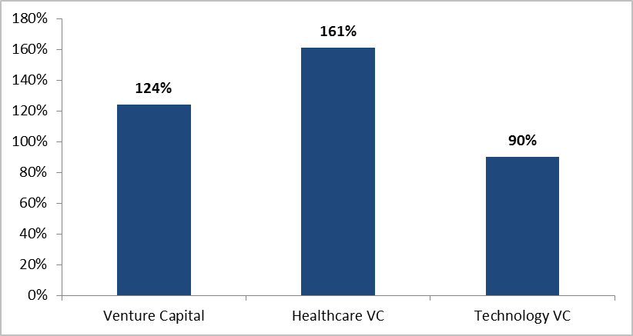
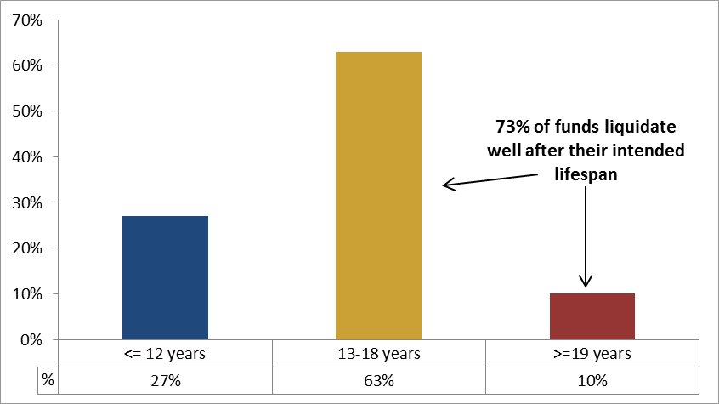
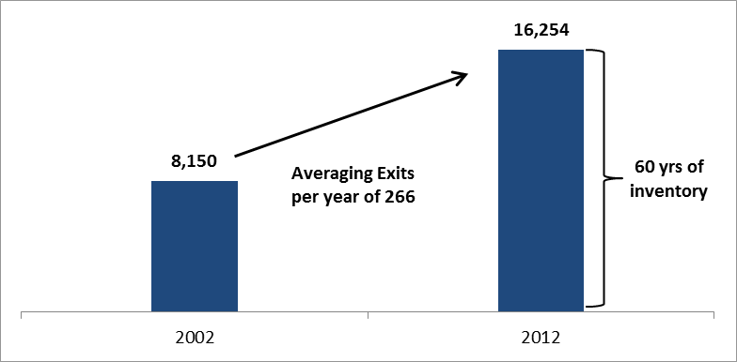
Venture capital secondary opportunity
Market Dynamics Driving Venture Secondary
Median Uplift to NAV at Exit Compared to Prior Quarter
A difficult exit environment since 2001 has led to an increase in the time to exit for venture-backed companies.
As the time to exit has increased, the inventory of venture-backed companies has grown significantly.
Due to the lack of exits and the increased level of inventory, venture capital funds are being forced beyond their anticipated fund lives as they work to liquidate investments.
When investors’ need for liquidity is coupled with excess inventory, it presents an opportunity to purchase valuable assets at attractive prices.
Venture Capital Fund Lifespans
Inventory of Venture-Backed Companies

Slide 19
PRIVATE EQUITY COMMITMENT MODEL &
MANAGER RECOMMENDATIONS

Slide 20
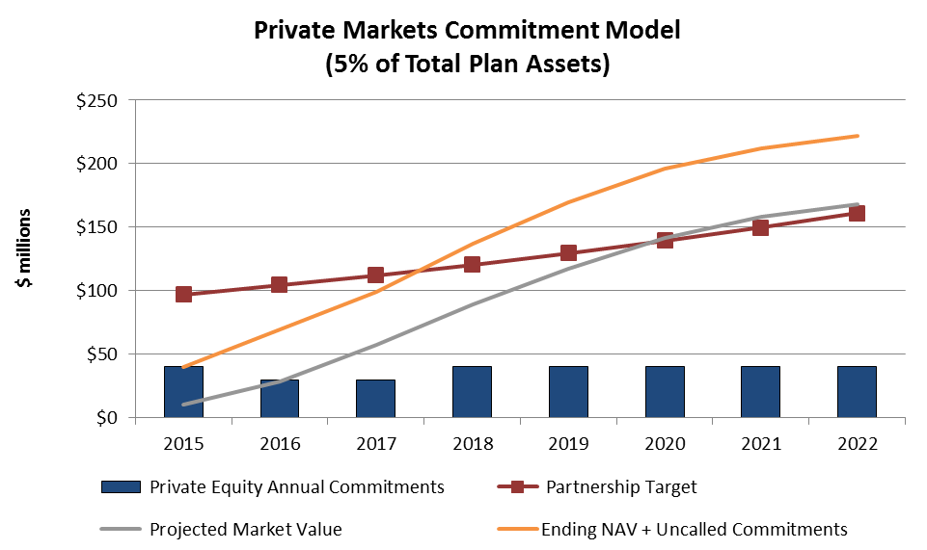
Private equity: Commitment model
The Commitment Model attempts to predict how much capital will actually be in private equity funds at a given point in time.
Estimates the commitments needed to reach and maintain the allocation target.
Diversifies the portfolio by reducing:
Vintage year risk;
Strategy and sector risk; and
Individual general partner risk.
The model is monitored and adjusted over time by Summit Strategies Group.
This example is based on the following inputs:
$1.6 billion of plan assets
7.5% expected growth in assets
5% target allocation to Private Markets

Slide 21
Example pipeline ideas - approved
Additional Summit-only relationships that have announced or will likely announce 2015 fundraises for existing or new products:
Manager | Fund Size, Final Close | Description of Manager
AE Industrial Partners I | $600m. Final close expected in Fall 2015. | Formed in 1998 to invest in Aerospace, Power Generation and Specialty Industrial businesses. The firm has a track record of investing as a fund-less sponsor with capital from the Carlyle Group. The fund also has a sizable GP commitment of 4%.
AKKR V | $1.2 billion, Final close expected in September 2015. | AKKR specializes in software and software-enabled service companies. Historical return are excellent and the manager is committing 7% of the fund.
Garrison IV | $800m, Final close expected in October 2015. | Multi-strategy distressed strategy. Fund has already invested 41% called and held slightly above cost which eliminates the j-curve for new investors.
Catalyst Capital V | $1.25 billion. Final close in September. | Canadian distressed firm raising fifth fund with a strong track record and a unique mechanism to mitigate J-curve.
*indicates that a particular product has already been approved at Summit’s Investment Committee.

Slide 22
Example pipeline ideas - Forward
Additional Summit-only relationships that have announced or will likely announce 2015 fundraises for existing or new products:
Manager | Fund Size, Final Close | Description of Manager
JF Lehman IV | $800m, final close expected in late 2015 | Defense and transportation focused small buyout firm; the strategy is relatively concentrated and the firm has had strong performance. Capacity constraints could be an issue as there will only be a $250 million increase in fund size from the last fund.
Greenspring Secondary II | Size TBD, expected to begin fundraising in Q4 2015 | Fund will invest in venture companies and venture funds on a secondary basis by leveraging Greenspring fund of fund platform.
Cattterton VIII | Size TBD, expected to begin fundraising in Q4 2015 | Catterton specializes in consumer companies. Notable deals include Restoration Hardware, Noodles & Co., and PetVet. Industry expertise is the core differentiator.
Cartesian Capital III | Size TBD, expected to begin fundraising in Q1 2016 | Cartesian is a globally focused emerging market manager. In addition to the global mandate, Cartesian is unique for it’s idiosyncratic and special situation deals.
*indicates that a particular product has already been approved at Summit’s Investment Committee.

Slide 23
appendix

Slide 24
PRIVATE EQUITY: The “Waterfall”
A “Waterfall” describes how the GP agrees to split profits with the LP.
Assume a $10 Million commitment. The Limited Partnership Agreement states that after the LP is returned of all contributions, the GP will not receive a share in profits until the LP receives an 8% annual preferred return. The GP then receives 100% of profits until they reach 20% of all profits (a.k.a. “catch up”). Once they have made their 20%, they will split the profits 80/20. Assume the partnership made 2.5X the money on a gross basis. How much of that is yours?
This chart illustrates how each bucket must be full before moving to the next. Money to the LP is blue, and to the GP is grey.

Slide 25
PRIVATE EQUITY: Commonly Used Terms
IRR: The discount rate that equates the net present value of an investment’s cash inflows and outflows.
MOI (Multiple of Invested Capital): Calculation performed by adding the residual value and the distributions received (cash out) and dividing that amount by the total capital contributed (cash in).
LP (Limited Partner): Institutions or individuals who contribute capital to a private equity fund.
GP (General Partner): The managing partner in a private equity management company who has unlimited personal liability for the debts and obligations of the Limited Partnership and the right to participate in its management.
Committed Capital: A Limited Partner’s obligation to provide a certain amount of capital to a private equity fund for investments.
Invested Capital: Amount of committed capital drawn and invested in deals.
Preferred Return: Minimum annual internal rate of return promised to limited partners before the general partner shares in profits.
Carried Interest: Mechanism by which a private equity manager shares in the profits achieved in a private equity fund or investment. Typically accounts for 20% of the net gains achieved.
Clawback: To the extent that the general partner receives more than its fair share of profits, as determined by the carried interest, the general partner clawback holds the individual partners responsible for paying back the limited partners what they are owed.
Fund of funds: A pooled vehicle that invests in a number of other funds or partnerships.
Co-Investment: Directly investing in an operating company, rather than investing through a partnership or fund vehicle.

Slide 26
PRIVATE EQUITY: Commonly Used Terms
Key Person: Identifies who the key players are at the fund. Upon departure of these key persons, the LP will have the right to stop investing (if the LP feels that key person is crucial to their investment’s performance).
Most Favored Nations: Enables the LP to ensure they receive all rights that any subsequent investors may negotiate.
Unrelated Business Taxable Income (UBTI): UBIT may compromise an investor’s tax-exempt status. Therefore, fund selection is biased toward those who work to minimize UBIT.
Clawback: Ensures that the GP does not receive more than its fair share of profits over the life of the fund. For example, If the LPA states the GP should receive a total of 20% but instead they actually received 21%, the LPs can “claw back” the extra 1%.
Conflicts of Interest: Identifies the areas in which the GP sees a possible conflict of interest and promises to avoid altogether or at the least obtain majority approval prior to moving forward.
Waterfall: Describes in detail how the profits will be split among the GP and LP. It varies from fund to fund, but an example has been provided on the following page.

