Slide 1

Commission Updates
Safety and Crime Reduction commission meeting
june 24, 2022
Dr. Nicoa garrett

Slide 2
Mental Health Awareness Campaign philippian community church
Saturday, may 21, 2022
Mental Health Awareness Campaign Philippian Community Church Saturday, May 21, 2022 (Community Vendors and Partners)
Jacksonville Transportation Authority (JTA) | Northwest Behavioral Health Services, Inc. | Jacksonville Sheriff Office (JSO) | Icy Spot
Florida Blue | Hubbard House Outreach Service | Girls Inc. of Jacksonville | My Season Chicken and Ribs
Kids Hope Alliance | Partnership for Child Health | Dedicated Senior Medical Center | Wystonian Health Advocates
Raines High School | Ribault High School | Philippian Community Church | Partnership for Child Health
African American Mental Health Initiative | Men Against Destruction – Defending Against Drugs and Social Disorder | Hershey Treats | City Leaders: City Council President Sam Newby, Councilman Reggie Gaffney, Chiquita Moore, and Tanya Washington
Community Mental Health Walk w/Partners | Temple Gym & Fitness Center
NOTE: We are starting the process of planning the Back-to-School Mental Health Awareness event.
Community Mental Health Walk JTA
Community Mental Health Experts
Jacksonville Transportation Authority
Jean Ribault High School
Raines High School
Community Pastors and Leaders

Slide 3
Jacksonville rise-up mini grants
Tentative Scoring Process
Initial Review – July 6th thru July 13th
Up to 20 applications per person
Three scorers per application
Drop box link for score submission and calculations
Filing Date – July 20th
Bill Effective Date – September 2nd
Notice of Award – Mid to late August 2022
Notice of Release - TBD

Slide 4
Jacksonville Homicide Murder Stats for 2022 as compared to the same time in 2021.
As of MAY 2022, there have been 12 murders in Jacksonville, FL as compared to 9 murders as of 2021. Below are comparisons broken down by month.
 | 2021 | 2022
Month
January | 9 | 13
February | 14 | 10
March | 5 | 9
April | 9 | 14
May | 9 | 12
June
July
August
September
October
November
December
Total | 46 | 58

Slide 5
Crime mapping information gathering
(Vice Chair – Ronnie King)
examples only

Slide 6
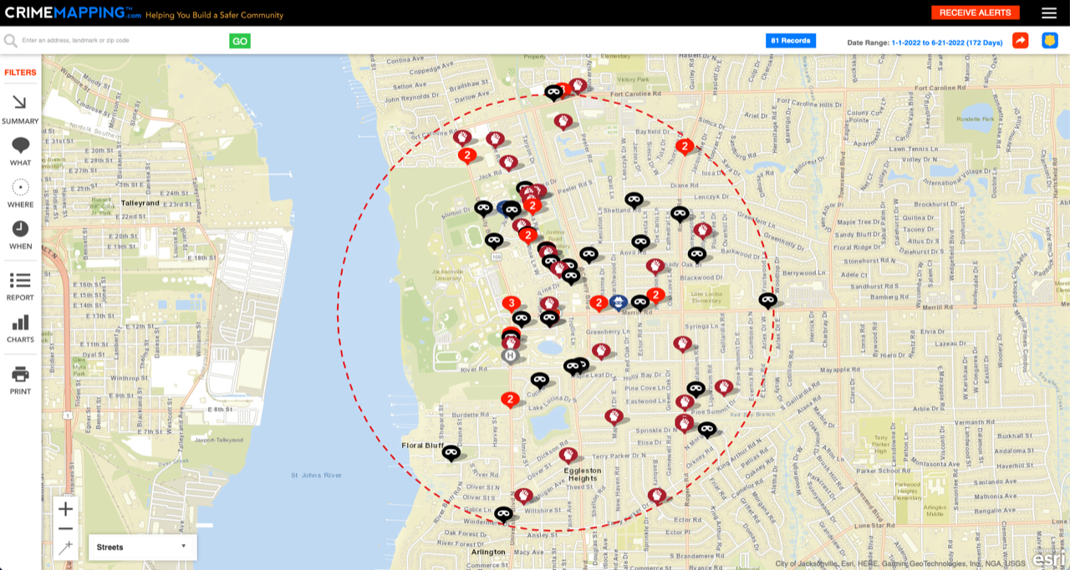

Slide 7
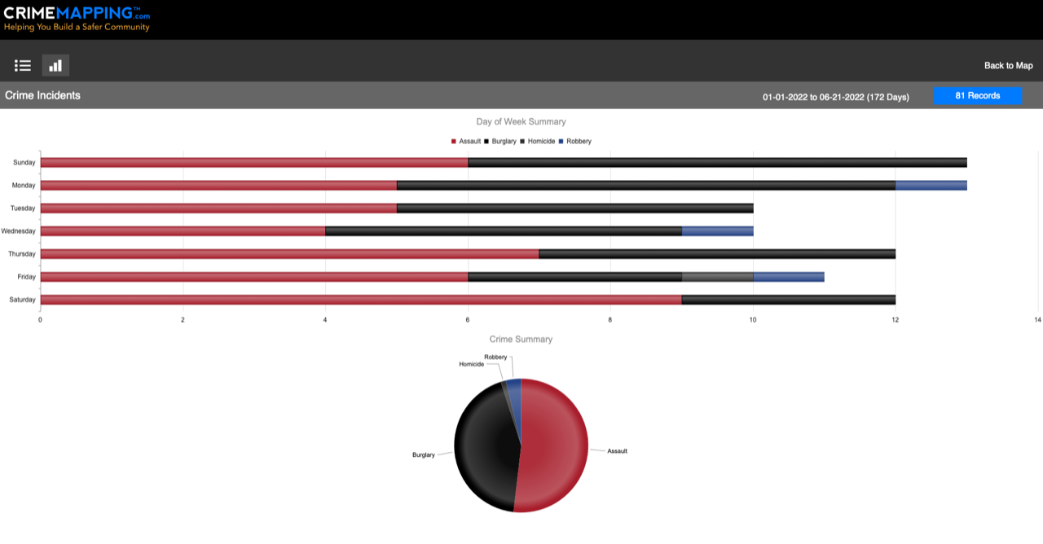

Slide 8
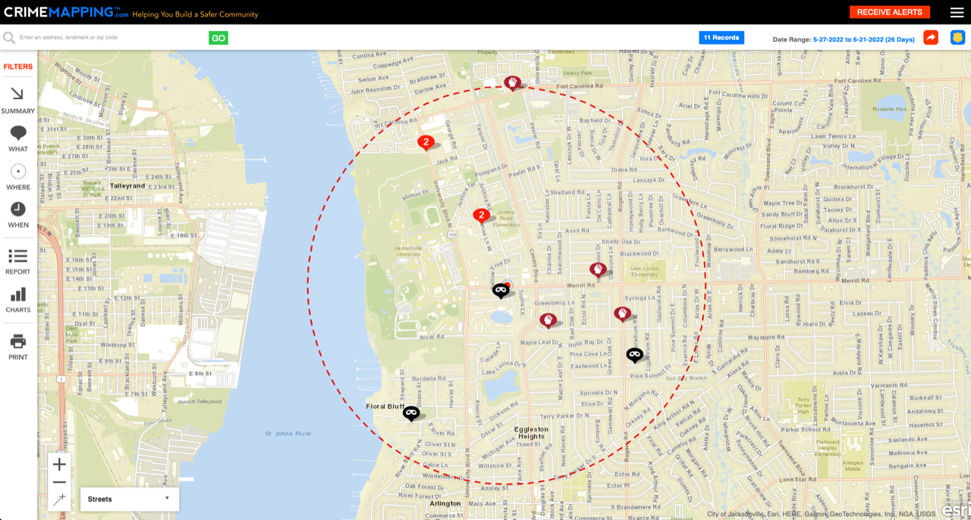

Slide 9
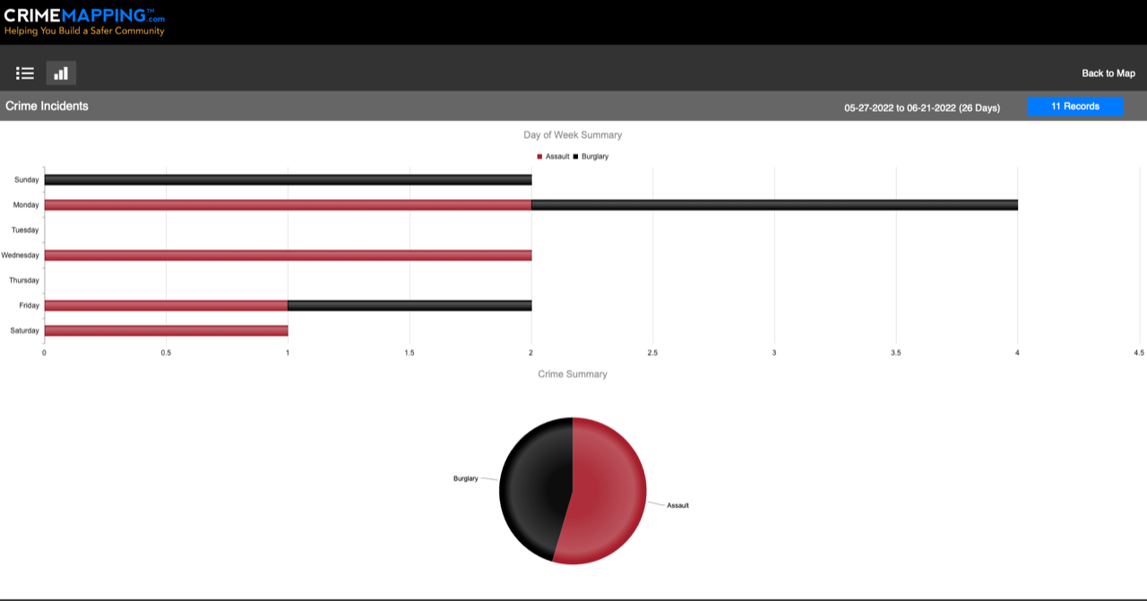

Slide 10
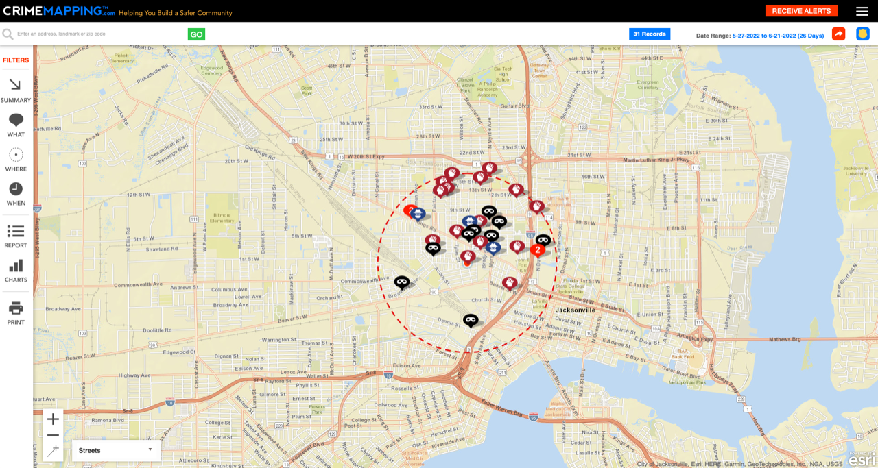

Slide 11
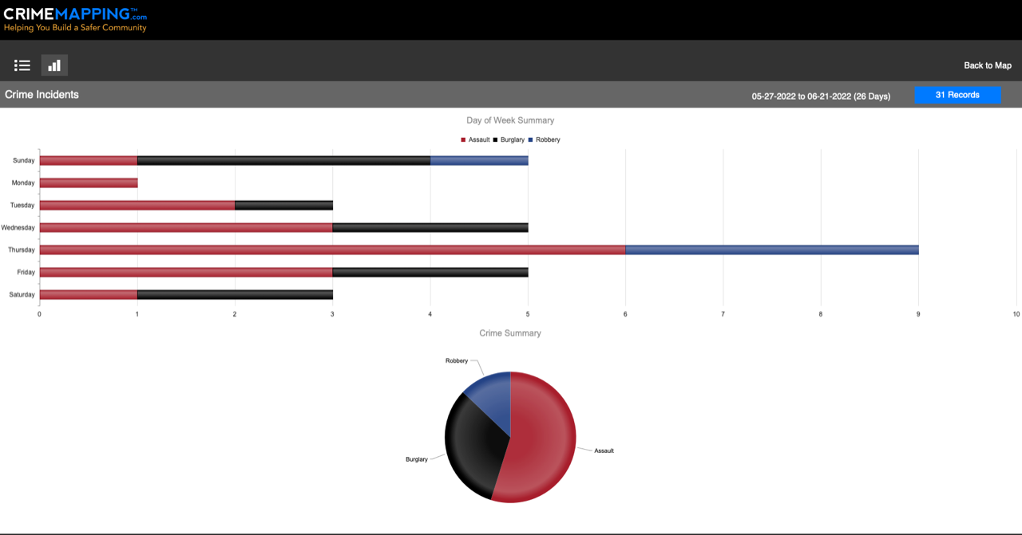

Slide 12
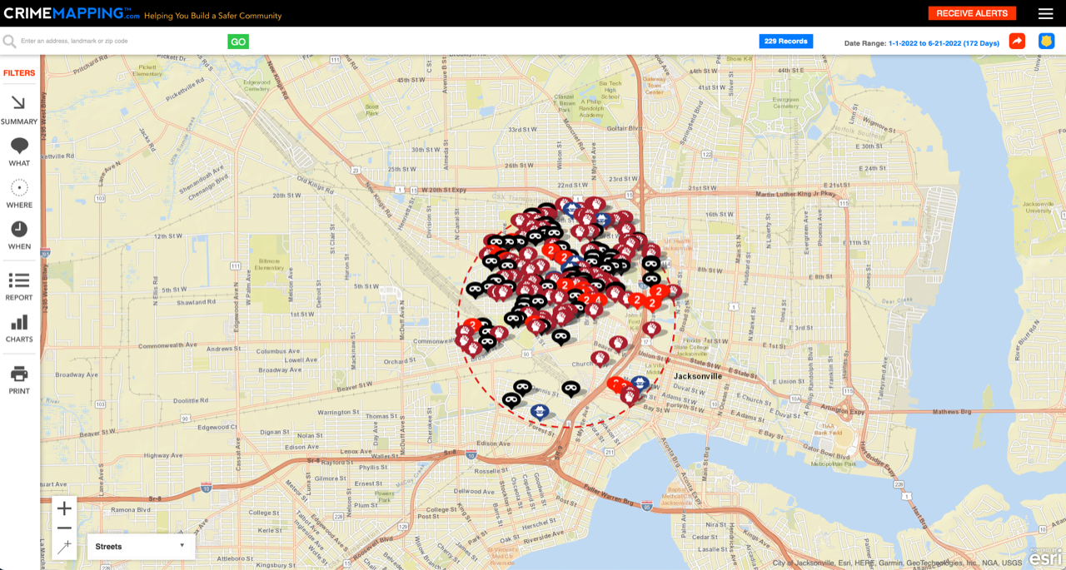

Slide 13
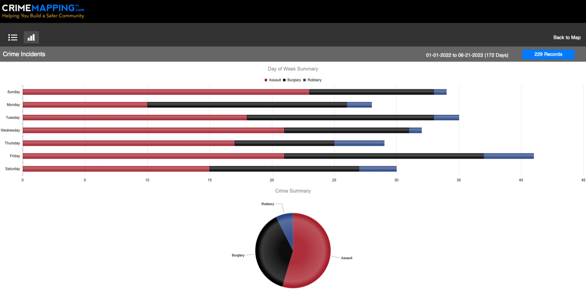

Slide 14
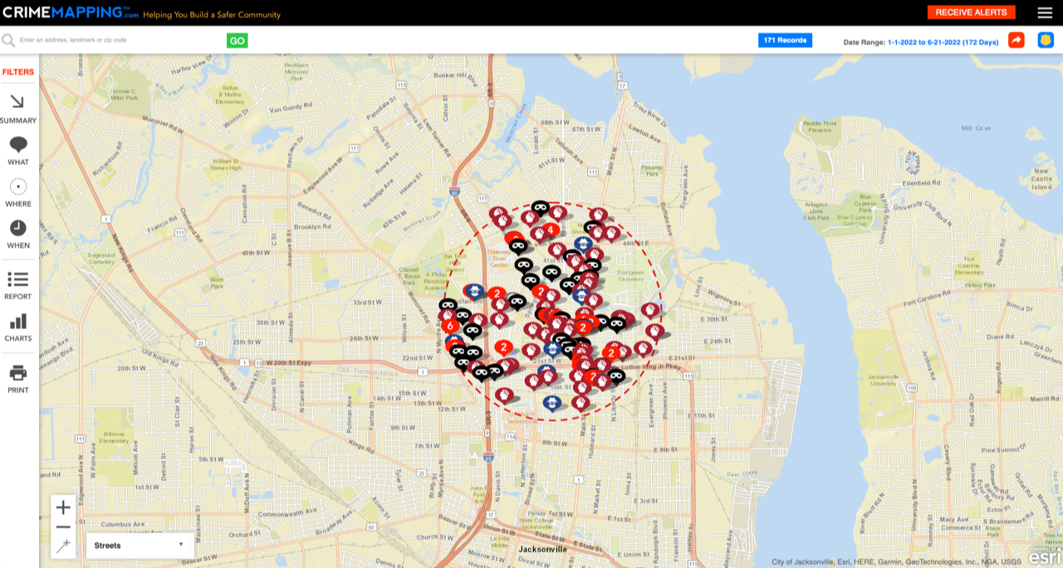

Slide 15
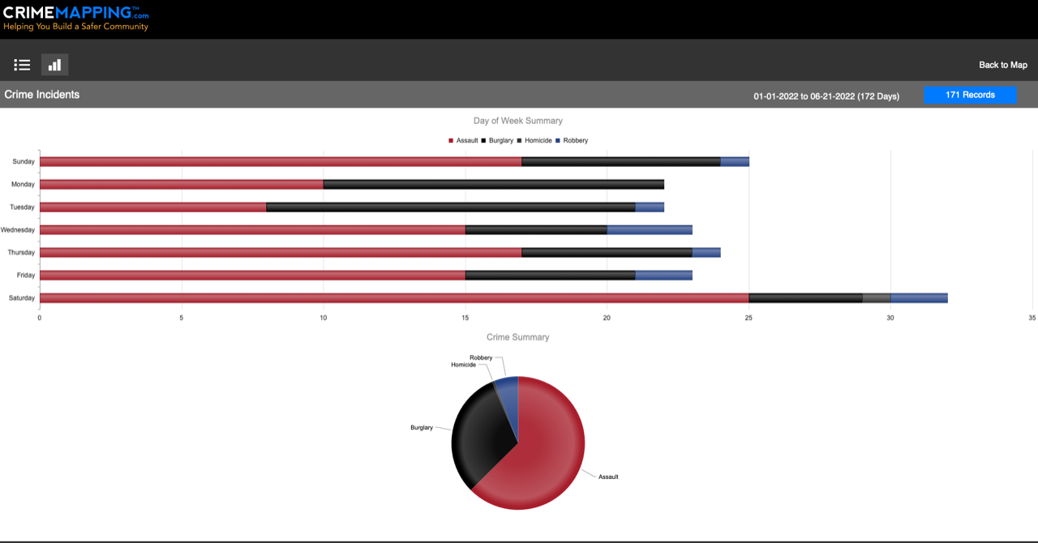

Slide 16
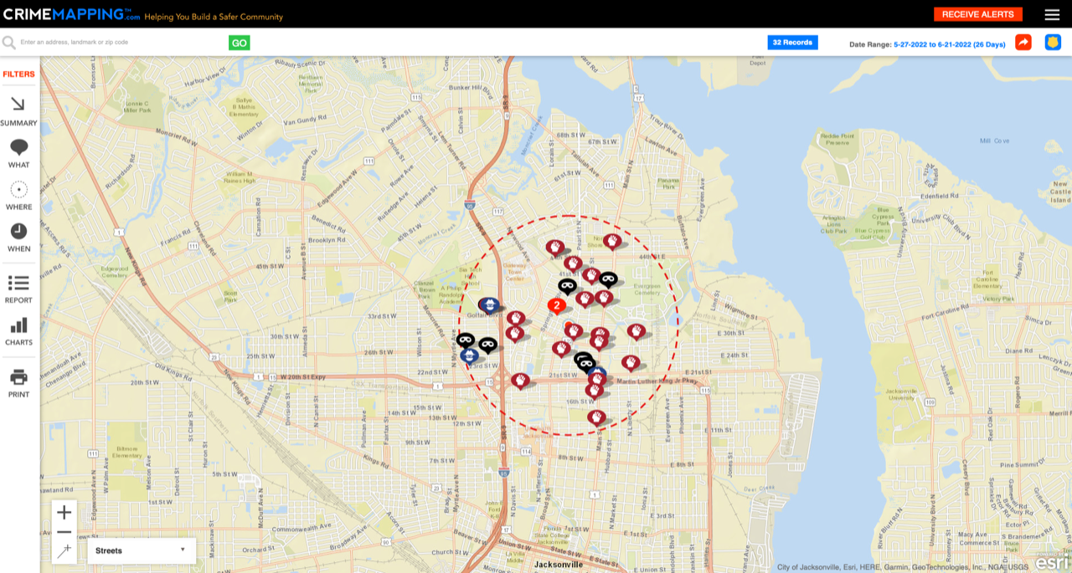

Slide 17
