Slide 1


OFFICE OF
INSPECTOR GENERAL
“Enhancing Public Trust in Government”
  ACTIVITIES UPDATE
  April 14, 2015

Slide 2


CHAPTER 602; PART 3
INSPECTOR GENERAL
Sec. 602.303. Duties and Functions.
(n) Issue an annual report to the Ethics Commission, Mayor, the Council and deliver to the full City Council a verbal briefing on activities of the Office every six months.
Enacted October 14, 2014

Slide 3

BUILDING THE FOUNDATION
OFFICE OF INSPECTOR GENERAL (OIG)
POLICY MANUALS WRITTEN:
  OIG Administrative
  OIG Employee Orientation
  OIG Code of Conduct
  OIG Investigations
  OIG Contract Oversight
  OIG Accreditation
CREATED THE FOLLOWING:
  Mission Statement, OIG Core Values, OIG Code of Ethics and OIG Independence Attestation
  Over 100 Forms, Letters and Templates

Slide 4
BUILDING THE FOUNDATION
CREATED POSITION DESCRIPTIONS AND JOB ADVERTISEMENTS (Worked with Employee Services)
    Contract Oversight Specialist II (Hired January 12, 2015)
    Investigator II (Hired February 9, 2015)
    Inspector General (Anticipated start date July 6, 2015)
    Auditor (Anticipated start date September 7, 2015)
CREATED PERFORMANCE EVALUATIONS FOR CURRENT STAFF
CREATED RISK MODELS FOR PRIORITIZING AND ASSIGNMENT OIG WORK
STATE ATTORNEY/OFFICE OF INSPECTOR GENERAL WRITTEN PROTOCOL

Slide 5
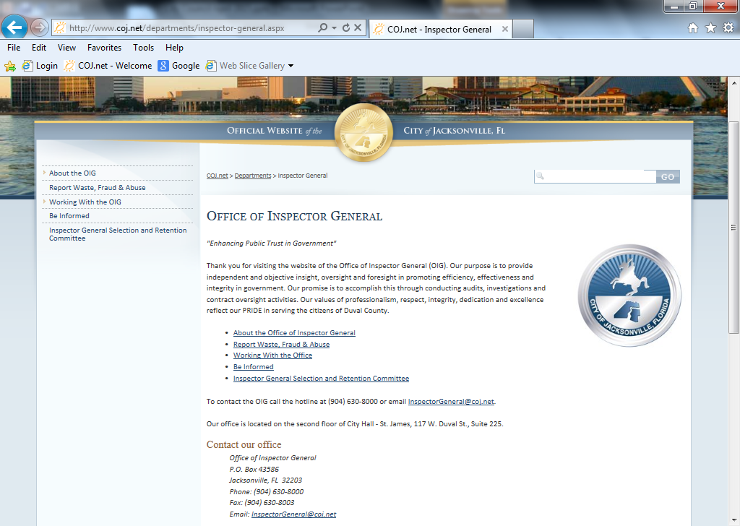
BUILDING THE FOUNDATION
Established a Hotline, P. O. Box and OIG email address for reporting.
Created website with information about the Office; How to Report Waste, Fraud & Abuse; Complaint forms for Employees, Contractors and Citizens; What to Expect when Contacted by the OIG; Be Informed section; and the Inspector General Selection and Retention Committee to include agendas, audio and minutes.

Slide 6
BUILDING THE FOUNDATION
Provide Monthly OIG On-Boarding Training in the City of Jacksonville New Employee Orientation Program.
On-going briefings with Departments on Overview and What to Expect when Working with the OIG.
Wrote OIG Segment for Contracting Administration Manual and the future Procurement Training Program.
OIG Ordinance language added in the General Conditions of the COJ contract template.
Created multiple power point presentations and handouts about the OIG for Outreach.

Slide 7
WORK LOAD
RECEIVED 34 WRITTEN CORRESPONDENCES SINCE OCTOBER 18, 2014
  23 CORRESPONDENCES Handled and Closed
  15 Recommended CORRECTIVE ACTIONS Issued; 12 Pending
  11 OPEN Intake/Investigations/Reviews/Contract Oversight Projects
  ***CRIMINAL INVESTIGATIONS HAVE BEEN COORDINATED WITH STATE ATTORNEY’S OFFICE
CORRECTIVE ACTION HIGHLIGHTS:
MOSQUITO CONTROL – Cancelled lease February 2015: COST AVOIDANCE $42,000; $2,000 per month thru November 30, 2016. Helicopter certification pending.
MILITARY AFFAIRS – Policy for Employees/Family implemented – Raffles.
EMPLOYEE SERVICES – Procedures enhanced for verifying and handling of confidential records prior to release of public records requests.

Slide 8
OIG MANAGEMENT REVIEW 2015-0004
HIGHLIGHTS
CITY OF JACKSONVILLE OFFICE OF PUBLIC PARKING
Identified Costs $45,164.70; Questioned Costs $2,000
4 Findings; 11 Recommendations
1. OPP failed to bill Everbank Center in the amount of $45,164.70 (including sales tax) for parking usage at the Water Street Garage since September 2014.
2. OPP is not following established procedures specified in Section 122.202, City of Jacksonville Code of Ordinances as prescribed when placing special event rates into effect.
3. Billing and collection of parking revenues are inconsistent, not in compliance with the City’s Standard Operating Procedures (SOPs), and lacks appropriate internal controls to prevent waste, fraud and/or abuse.
4. OPP has not processed Rental Car agencies’ declarations of non-liability and penalty disputes for citations issued as far back as November 2013.

Slide 9
Future Funding from Contract Activity
Pursuant to 2014-519, creation of the Inspector General (Section 6): Within six months of the date of enactment, there shall be a review of the contract activities of the City of Jacksonville to determine the feasibility of a vendor contract fee.
FINDING: Insufficient processes in place to implement this fee and it is not cost effective at this time.
ETHICS COMMISSION RECOMMENDATON: The City Council ensure that the IT Department's Request for Proposal (RFP) for a new computer system (Enterprise Resource Planning [ERP]) include the capacity for billing and collecting an Inspector General Contract Fee. The issue should be re-visited in one year.

Slide 10
HIRING THE
INSPECTOR GENERAL
IN PROCESS
Sec. 602.305. Selection, Term, Contract, Removal and Vacancy
(a)Selection. The responsibility for selecting the inspector general shall be vested with the Inspector General Selection and Retention Committee, hereinafter, the "Committee."
The Committee shall be composed of seven members selected as follows:
(1) The President of the Jacksonville City Council or his or her designee – (CHAIR);
(2) The State Attorney of the Fourth Judicial Circuit or his or her designee;
(3) The Chair of the Jacksonville Ethics Commission or his or her designee – (VICE CHAIR);
(4) The Chair of the Jacksonville TRUE Commission or his or her designee;
(5) The Public Defender of the Fourth Judicial Circuit or his or her designee;
(6) The Chief Judge of the Fourth Judicial Circuit or his or her designee; and
(7) The Mayor of the City of Jacksonville or his or her designee.
***The Committee's selection is subject to confirmation by City Council.

Slide 11
PENDING
MANDATORY REPORTING TO OIG POLICY – WITH MAYOR’S OFFICE
OIG ENTERPRISE CASE MANAGEMENT SYSTEM
BUDGET – NEEDS TO ADDRESS RESOURCES FOR 15+JURISDICITONS:
      Effective January 2016, jurisdiction shall include, but not be limited to the following: The Mayor, the Sheriff, the Supervisor of Elections, the Property Appraiser, the Clerk of the Courts, the Tax Collector, City Council, JEA, the Police and Fire Pension Fund, Jacksonville Aviation Authority, Jacksonville Port Authority, Jacksonville Housing Authority, Jacksonville Housing Finance Authority, Jacksonville Transportation Authority, and the Jacksonville Health Facilities Authority. Original ordinance includes School Board.

Slide 12
QUESTIONS?

Slide 13
THANK YOU
Sheryl Steckler
Inspector General Advisor
State Attorney & City of Jacksonville
http://www.coj.net/oig
Email: inspector@coj.net
(904) 630-8000

