Slide 1
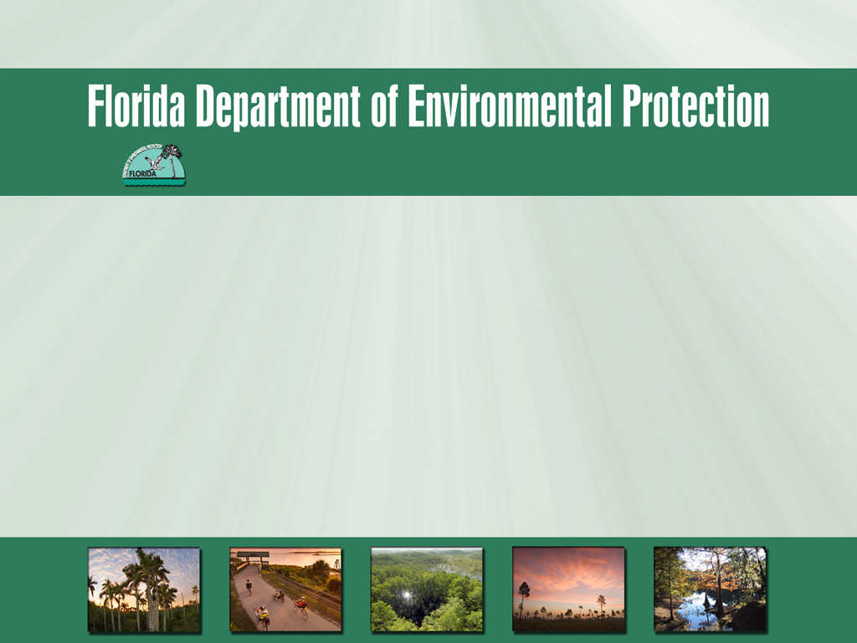
Northeast District
Jacksonville’s Environmental Symposium
Notes:
The City of Jacksonville's Environmental Protection Board and the Environmental Center will present the 2012 Jacksonville Environmental Symposium, "Greening in a Tough Economy." Too often, community leaders focus on the issues of today, instead of clearly visioning the future. As an aid to seeing the path to the future, this symposium will bring together residents, government agencies, utilities and innovators in a forum designed to foster an atmosphere of cooperation in environmental achievement.

Slide 2

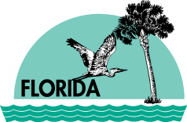
Key Priorities
As the state’s lead environmental agency, DEP is focusing on three key priorities:
ensuring a more efficient regulatory process that’s applied consistently across the state, and is protective of the environment;
“getting the water right” in Florida; and
giving Floridians and visitors more opportunities to enjoy Florida’s award-winning state parks.
Notes:
Last year Sec Vinyard laid out 3 bold, important and clear priorities for our agency.

Slide 3
Environment and Economy
During these challenging times, it’s easy to see that the goals of environmental protection and economic growth are not just compatible – they’re complementary.
Florida’s economy depends on a healthy, sustainable environment.
Two of our largest economic drivers – tourism and agriculture – are highly dependent on clean water, land and air.
Tourism → brings in 85 million people/year, approx $60 billion/year to the state;
agriculture → approx. $100 billion/year.
Notes:
Locally, our efforts to restore and protect the St. Johns River (SJR) will positively impact NE FL – as so much of our regional economy depends on a healthy SJR.

Slide 4
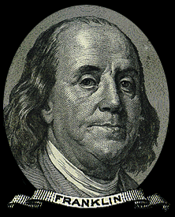
It’s a wise investment!
Investments in environmental protection create substantial long-term assets: a healthier, cleaner and more sustainable environment.
This can also be an important factor in attracting the new "high tech" firms and other businesses—as well as new residents, tourists, high-profile events, and investors.
Notes:
Many firms are now developing successful green business strategies to drive innovation and sustainable environmental solutions.

Slide 5
So, how are we helping?
First, we are fostering a culture of exceptional customer service and greater regulatory efficiency.
Yet, we’re not relaxing our standards!
Instead, we’re taking a closer look at how we do things, improving our processes, and ensuring that they make sense for both the environment and for the people of Florida.
Notes:
It’s about raising the accountability bar.

Slide 6

Adjusting our focus
Efficiency, effectiveness and service
How can we best deploy our limited resources?
“Doing more with less”
Cutting costs
Measuring our performance
Notes:
Our slice of the resource pie is getting smaller and smaller!

Slide 7
New approaches
Efficiency
Streamlining our processes
Effectiveness
Focus on driving beneficial outcomes
Using new strategies
Service
Providing more compliance assistance
Delivering highest level of service
Bringing a “sense of urgency”

Slide 8
Compliance Assistance
Some regulations can be complicated and confusing!
DEP is helping the regulated community avoid violations and minimize risk, by providing several types of outreach and compliance assistance:
Partnering efforts
Internal & external training workshops
Compliance manuals and handouts
On-site Compliance Assistance Site Visits
Notes:
Re-thinking how we get from A → B. So, we’re reaching out to businesses, trade groups, homeowners associations, contractors, local governments and other organizations – and providing continuing education meetings, Q&A sessions, and targeted compliance workshops.

Slide 9
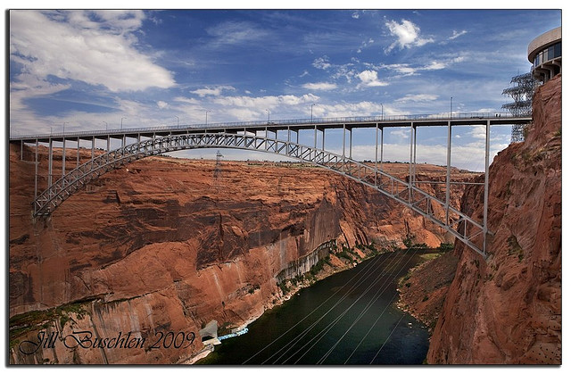
Closing the knowledge gap
Notes:
Not too many years ago, what would happen is that regulators would identify a problem, develop a “solution”—a new regulations or a new requirement, and toss it over the fence to the regulated community and say “here it is, good luck with that.” “We’ll check back with you in a few months, to see how you’re doing!” Fortunately, that’s not the approach we’re taking in Florida!

Slide 10
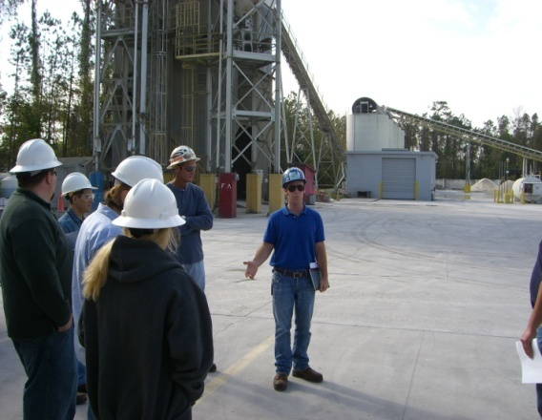
Targeted Training
Taking a proactive approach to compliance
Aligning expectations
Improving compliance rates
Optimizing resources
Saving money
Notes:
We’re looking more closely at our data to see where the critical needs are or where we’re seeing repetitive problems and dispatching our resources to those areas of need.

Slide 11

Building Trust
Compliance assistance can be challenging and it takes time.
However, day-to-day, informal encounters are some of the best opportunities to establish goodwill, trust and clear expectations – all of which can help improve compliance and environmental stewardship.
Notes:
It comes down to communications, b/c with a dialogue, you can begin to build trust, and from there, you can have an open exchange of ideas, and perspectives and begin to find solutions.
We see each phone call, drop-in visitor, inspection, interaction—as an opportunity for increasing trust and understanding.

Slide 12

“Moving the needle”
Notes:
Now, and perhaps more than ever, we are focusing on driving beneficial outcomes!

Slide 13
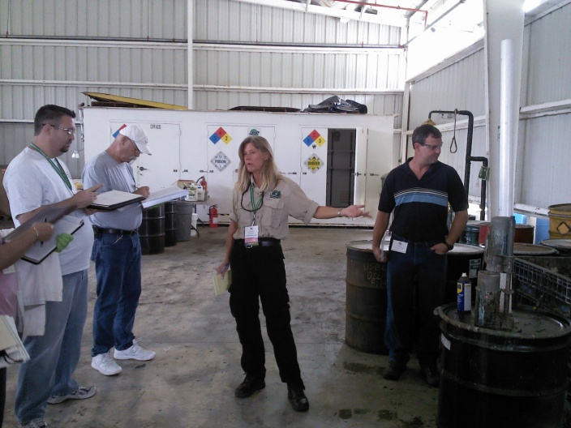
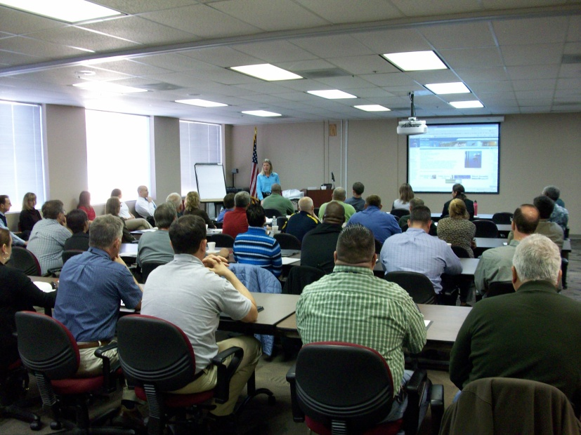
Improving Compliance
Last year, NED’s HW team provided training to more than 800 external customers.
25 meetings, classes and workshops
NE FL Safety Council, JAA, Camp Blanding, FCMA
This helped to achieve a 99% compliance rate!

Slide 14
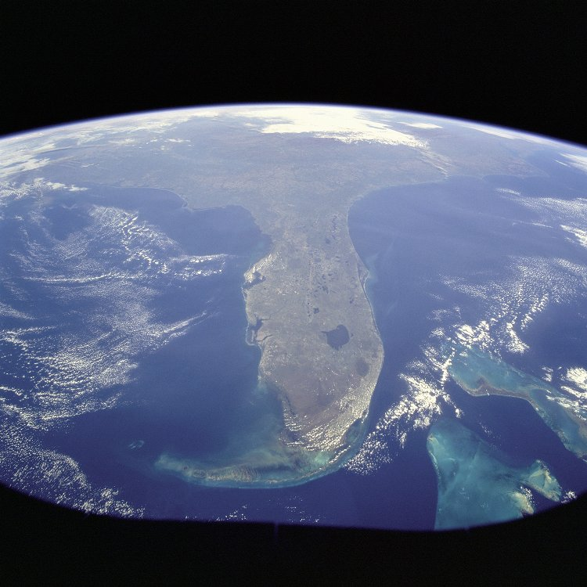
Leveraging our resources
Our partnerships with key stakeholders enable us to:
Share information and intel
Collaborate
Connect with more people
Deliver better environmental outcomes!

Slide 15
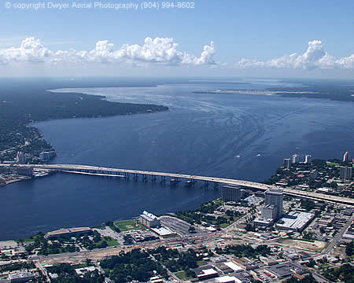
Benefits of collaboration
Development/implementation of LSJR BMAPs
Significant, multi-year effort
Numerous stakeholders
Substantial nutrient reductions
SJR is responding positively!
Notes:
While I see many people in this room who are “strategic partners,” the fact is that everyone in this room is a stakeholder in our plans to restore & improve the river.

Slide 16

Conclusion
We understand the importance of jobs and the economy.
Yet, we also recognize the close connection between economic and environmental concerns.
With a variety of new approaches, DEP is responding to new challenges while accomplishing our primary mission—protecting and preserving the environment for all of us.
Notes:
With greater efficiency and effectiveness, a new focus on compliance assistance, and the use of different strategies, DEP is responding to new challenges while accomplishing our primary mission—protecting and preserving the environment for all of us.

Slide 17
Thank you!
Greg Strong
Northeast District Director
Greg.Strong@dep.state.fl.us
904.256.1504

Slide 19

Navy Partnering
Goals…
Success…
Identify and implement innovative solutions to:
  Improve compliance
  Protect public health
  Improve Florida’s environment
  Aid in assigning EPA identification numbers
Reduced violations
Improved environmental compliance
Improved communication and trust
Statistics…
Four Military Bases
Three Government Agencies
Quarterly Meetings

