Slide 1
Jacksonville Zoo Living Shoreline Project
(JZLSP) update: August 16, 2012
Project Partners
Jacksonville Zoo & Gardens
Onsite Environmental Consulting, LLC
DHF Consulting, Inc
Florida Dept. of Environmental Protection
Jacksonville University
Terry Parker A.C.E.S. Program
US Fish & Wildlife Service
St. Johns Riverkeeper

Slide 2
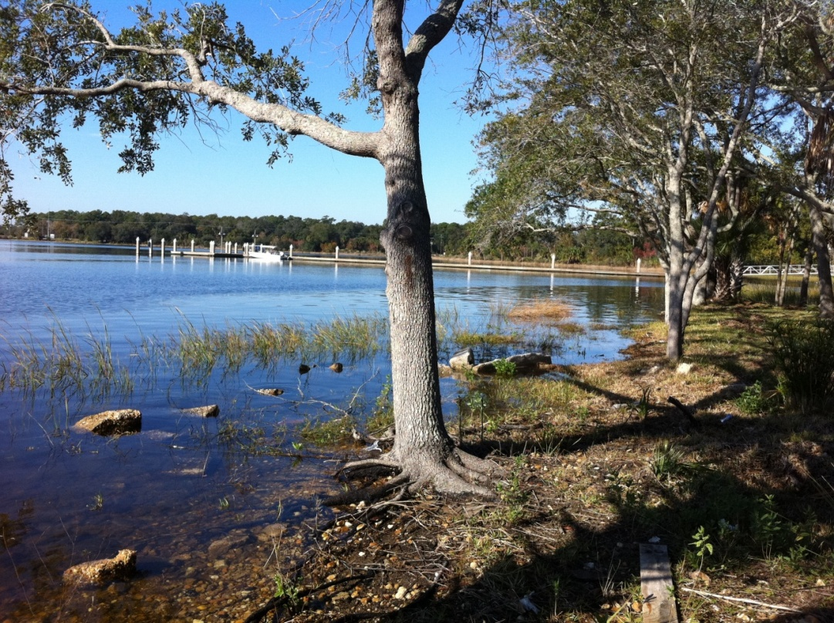
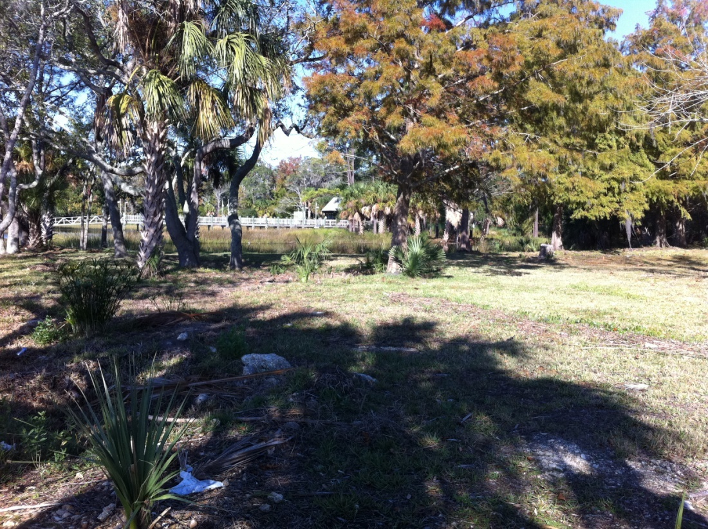
Where is the Project?
Jacksonville Zoo & Gardens
  Trout River opposite the new Asian Garden
  Filled open water basin (circa 1959-1969)

Slide 3
Why a “Living Shoreline” as opposed to “Vertical Wall”?
Traditionally, property owners have installed seawalls or bulkheads: vertical concrete, wooden, or other structures to prevent their property from eroding further.
While these “hardscapes” can serve to protect one piece of property, they can result in increased erosion on adjacent or opposite properties, because wave energy becomes reflected off the hard walls.
Seawalls also can become undermined from below or behind, causing them to fail and collapse (McGuire).

Slide 4
Why a “Living Shoreline”
Living Shorelines use natural shoreline ecosystems to absorb wave energy without causing erosion.
Living Shorelines extend from the upper bank of the property to below the water level.
They typically include a variety of plants, including salt marsh grasses and/or mangroves as well as structural elements such as oyster shell, or even riprap.
The overall concept of Living Shorelines is to provide habitat which will grow and change as water levels change (unlike seawalls which are a fixed height) (McGuire).

Slide 5
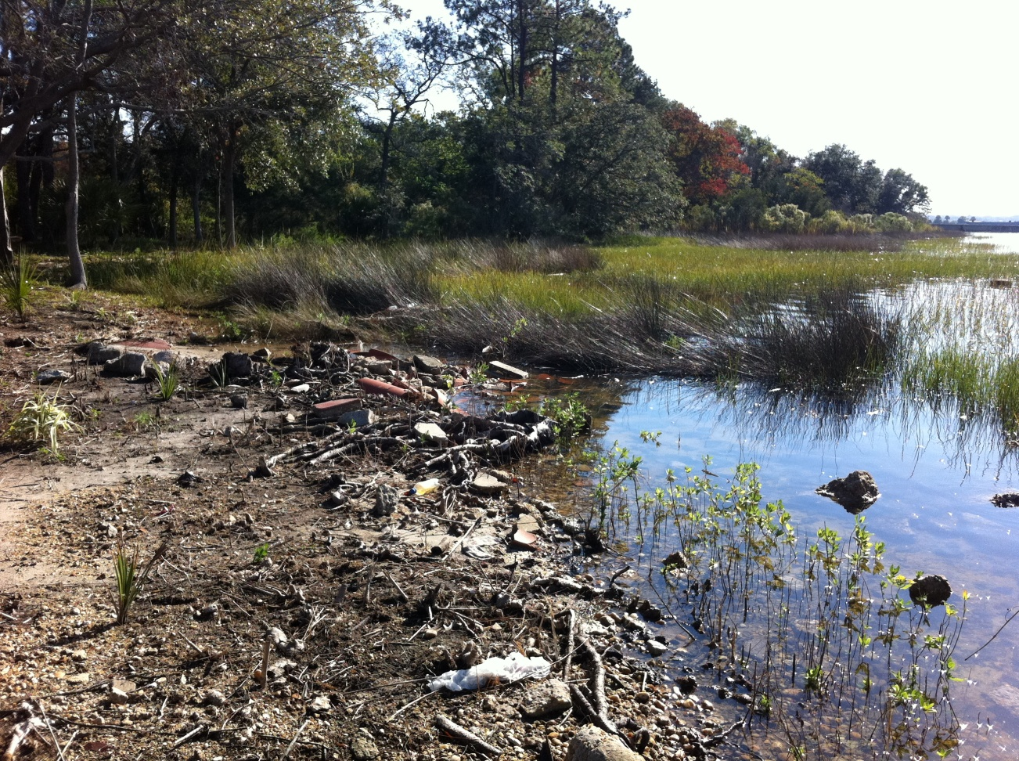
What are the Goals?
  Prevent shoreline erosion
  Create intertidal habitat
  Educate the public / Interact with JU MSI & Terry Parker High School’s ACES program
  Establish Jacksonville presence in this discussion

Slide 6
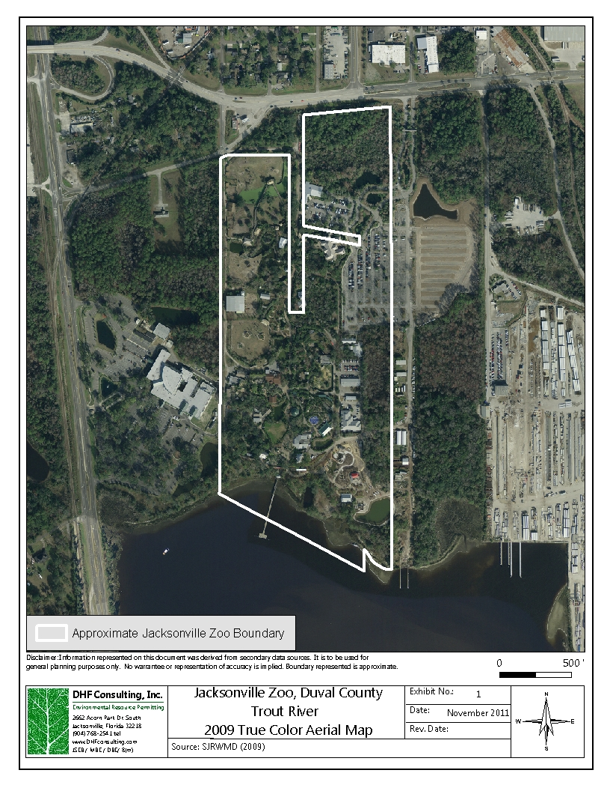
Location of JZLSP
demonstration
project

Slide 7
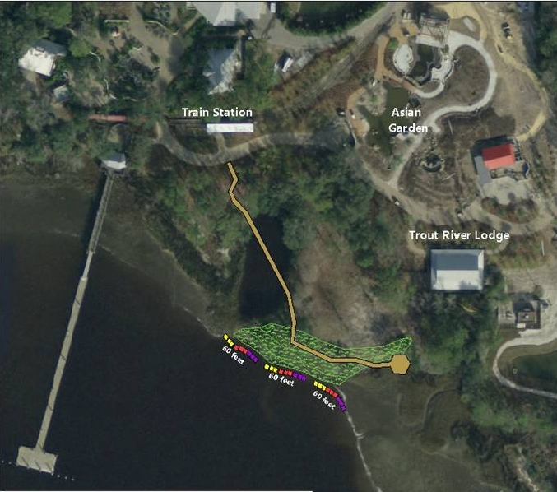
Close-up view

Slide 8
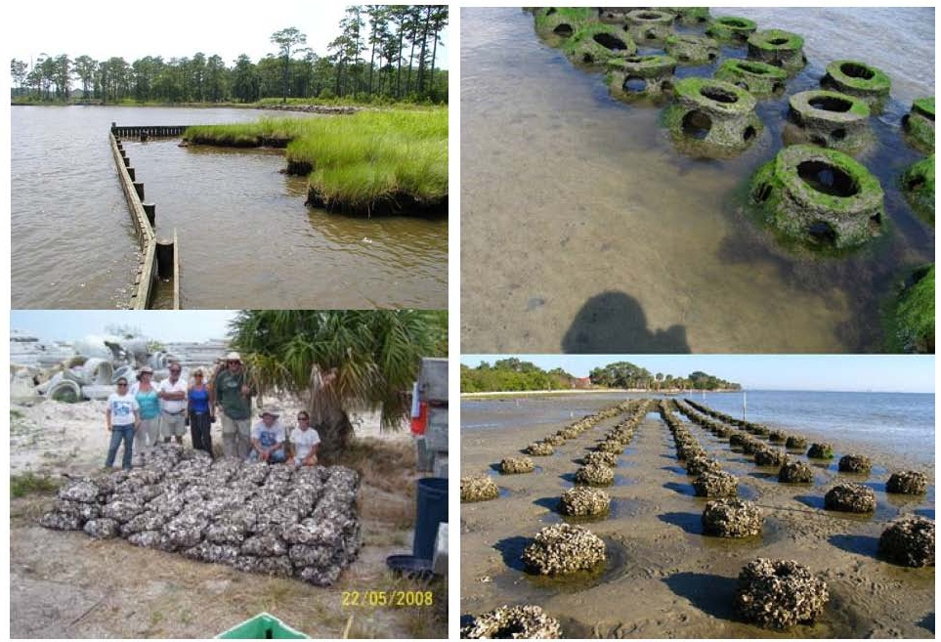
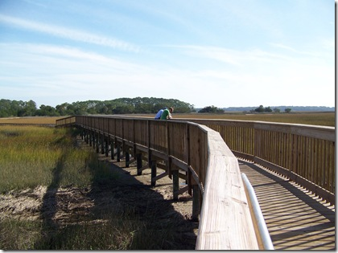
How do we get there?
Plant appropriate native vegetation buffer
Install a wave attenuation device offshore
Construct a nature boardwalk
Monitor various metrics for success
Implement an education plan

Slide 9
Wave attenuation devices

Slide 10
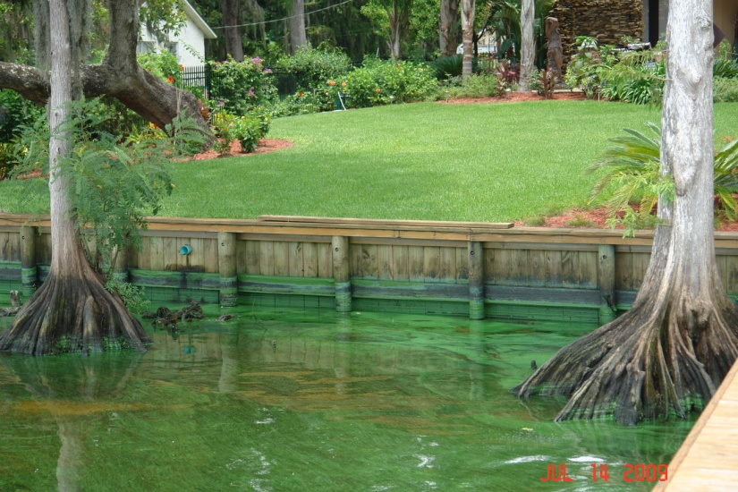
Why is it needed?
Reduce impacts associated with shorelines hardened for erosion protection
  Loss of habitat/flood protection
  Downstream erosion from reflected wave energy
  Poor water Quality
Public Education on alternatives

Slide 11
METRICS
• # of adult volunteers in project
• # of children/students involved
• # of total participants/volunteers in project
• Acres/Square feet of riparian buffer planted
• # of individual plants/trees planted
• % coverage of the installed wetland plant species
• % coverage of invasive plant species – eradicate/come up with a maintenance plan if invasive
species becomes greater than 10%
• Documentation of predation of/on the installed wetland plants – geese & other waterfowl
• Grain size analysis of existing sediment at the project site
• Wave energy (Claude Cards) and local documentation of the general wave conditions that
impact the project site and adjacent shoreline(s) – as appropriate
• Description and observational documentation of the ship/boat traffic in the vicinity of the
project
• Shoreline erosion – relative historic rates at the site and at adjacent property(s) – as appropriate
• Document impacts of the Living Shoreline project on adjacent shoreline(s) – as appropriate
• % cover sessile/motile species on WADS
• Water Quality – Dissolved oxygen, temperature, pH, salinity, turbidity (tubes/meter)
• Photo and video documentation of the site over the duration of the monitoring efforts
• Weather log of the local conditions – documentation of any storms that impact the site –
document safely the flooding conditions

Slide 12
COST and NEEDS
Project cost – estimated
  ~ $320,000.00
In-Kind donations raised
  ~ $220,000.00
Cash needs:
  ~ $160,000

Slide 13
COST and NEEDS
Monies raised so far:
EPB - $25,000 proposed award. Matches donations 1:1.
Grants
Cash money donations

Slide 14
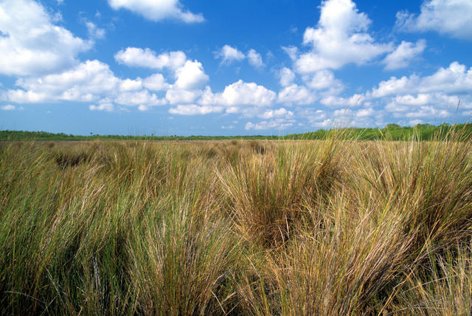

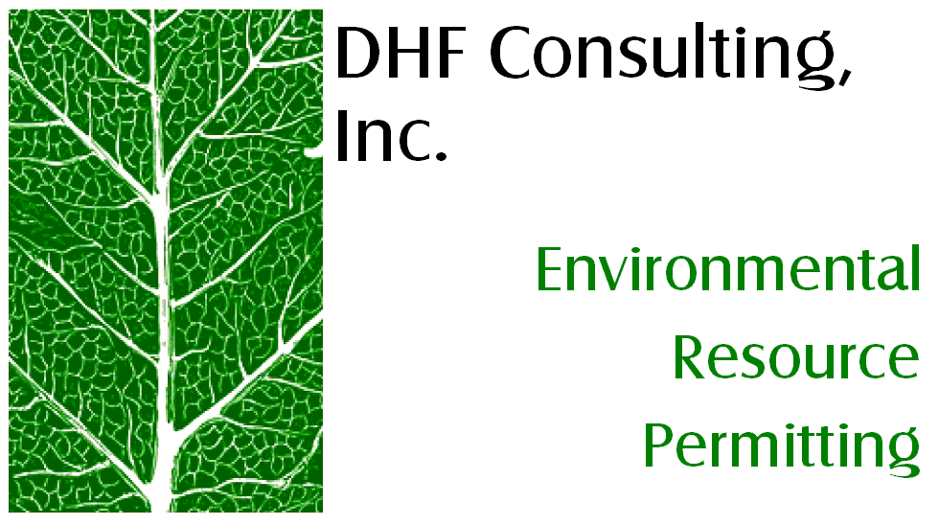
THANK YOU!
Janet Herrick
Living Shoreline Project Manager
oecjanet@onsiteec.com
(wk) 904-384-7020 / (cell) 904-662-1954
  Onsite Environmental Consulting, LLC ~ CEO/President

