Slide 1
BMAP Forward & Septic Tanks 2012 Environmental Symposium
John P. Pappas, P.E.
Department of Public Works

Slide 2
Presentation Overview
Review of Total Maximum Daily Loads (TMDL) and Basin Management Action Plans (BMAP)
Project Development
Septic Tank Phase-Out Program
Project Selection Process
Geographic Information Systems (GIS)
Project Summary

Slide 3
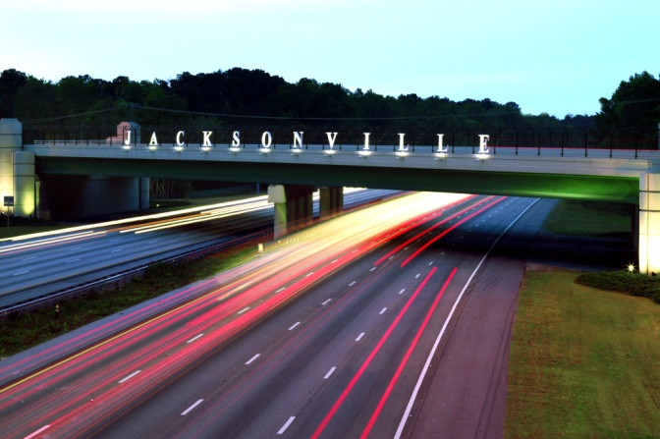
Total Maximum Daily Loads & Basin Management Action Plans
Within the City of Jacksonville

Slide 4
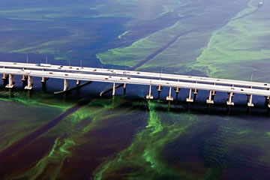
2005 St. Johns River Algae Bloom

Slide 5
Total Maximum Daily Load- TMDL
Clean Water Act requires a TMDL to be developed when a water is impaired (not meeting designated uses of swimmable and fishable).
TMDL
Adopted into State Rule
Calculates the improvement (pollutant load reduction) necessary to obtain designated uses, and expressed as:
Pound Reduction – Target concentration
Percent Reduction – Level of Effort
Allocation (amount of pollutant reduction) assigned to MS4 and enforceable in the City’s NPDES MS4 Permit

Slide 6
Basin Management Action Plan -BMAP
The plan to meet the pollutant load reduction detailed in the TMDL.
BMAP Overview
Adopted by FDEP Secretarial Order
Lists Water Quality Projects to Meet Allocated Reduction
Structural
Non- Structural
Provides Timelines for Project Completion
Enforceable by FDEP

Slide 7
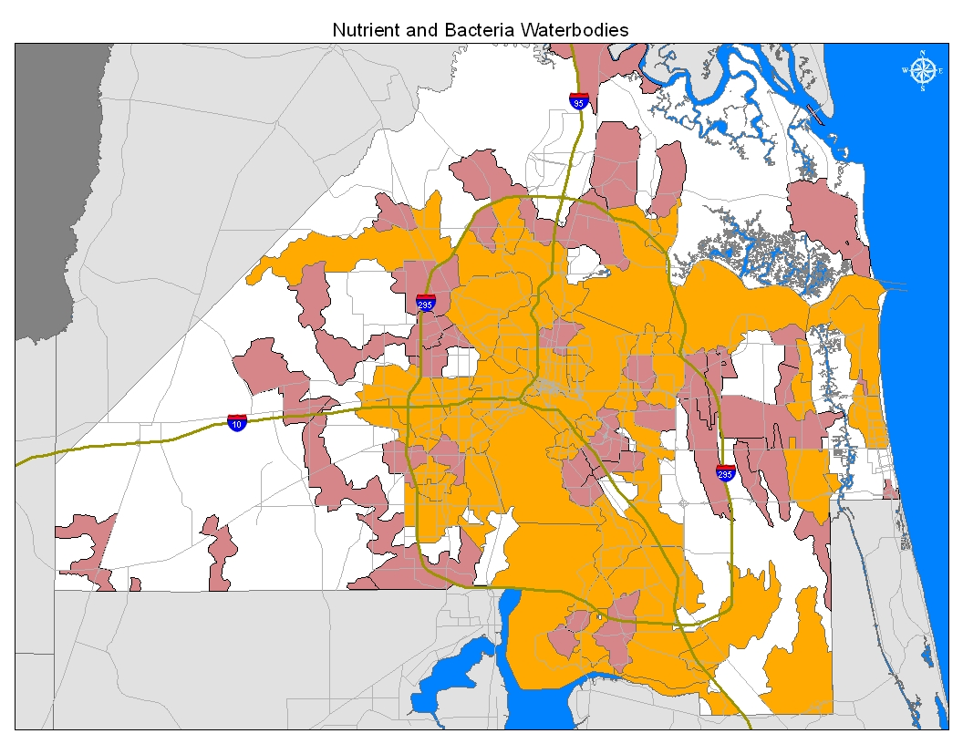
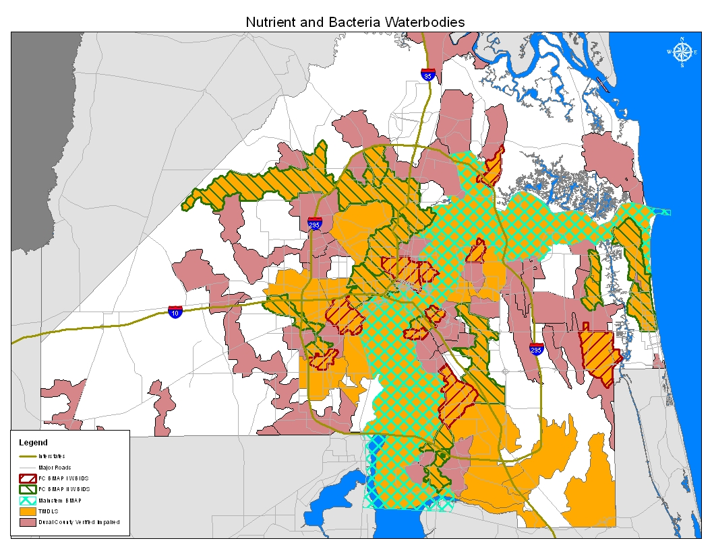
Impaired Waters,
TMDLs,
& BMAPs

Slide 8
Adopted TMDLs in Duval County
Name | Parameter | Adopted BMAP | Name | Parameter | Adopted BMAP
Trout River Middle | Fecal Coliform | Tributaries II | Goodbys Creek | Fecal Coliform | Tributaries I
Trout River Lower | Fecal Coliform | Tributaries II | Butcher Pen Creek | Fecal Coliform | Tributaries I
Terrapin Creek | Fecal Coliform | Tributaries I | Fishing Creek | Fecal Coliform | Tributaries II
Blockhouse Creek | Fecal Coliform | Tributaries II | Deep Bottom Creek | Fecal Coliform | Tributaries II
Hogan Creek | Fecal Coliform | Tributaries I | SJR Abv Doctors Lake | Nitrogen | LSJRB Main Stem
Wills Branch | Fecal Coliform | Tributaries II | SJR Above Piney Point | Nitrogen | LSJRB Main Stem
Sherman Creek | Fecal Coliform | Tributaries II | SJR Above Mouth | Nitrogen | LSJRB Main Stem
Moncrief Creek | Fecal Coliform | Tributaries II | SJR Above ICW | Nitrogen | LSJRB Main Stem
Newcastle Creek | Fecal Coliform | Tributaries I | SJR Above Dames Pt | Nitrogen | LSJRB Main Stem
Williamson Creek | Fecal Coliform | Tributaries II | SJR Above Trout | Nitrogen | LSJRB Main Stem
Greenfield Creek | Fecal Coliform | Tributaries II | SJR Warren Bridge | Nitrogen | LSJRB Main Stem
Deer Creek | Fecal Coliform | Tributaries I | Red Cell Indicates No Adopted BMAP
McCoy Creek | Fecal Coliform | Tributaries II | Arlington River | Nitrogen | N/A
Cormorant Branch | Fecal Coliform | Tributaries II | Julington Creek | Fecal Coliform | N/A
Pottsburg Creek | Fecal Coliform | Tributaries II | Little Black Creek | Fecal Coliform | N/A
Hopkins Creek | Fecal Coliform | Tributaries II | Ribault River | Fecal Coliform | N/A
Big Fishweir Creek | Fecal Coliform | Tributaries I | Strawberry Creek | Fecal Coliform | N/A
Miller Creek | Fecal Coliform | Tributaries I | Cedar River | Fecal Coliform | N/A
Craig Creek | Fecal Coliform | Tributaries II | Big Davis Creek | Fecal Coliform | N/A
Open Creek | Fecal Coliform | Tributaries I | Ortega River | Fecal Coliform | N/A
Miramar Creek | Fecal Coliform | Tributaries I | Durbin Creek | Fecal Coliform | N/A

Slide 9
City of Jacksonville BMAPs
Main Stem
Total Nitrogen
Adopted, October 2008
Tributaries I
Fecal Coliform
Ten Waterbodies
Adopted, December 2009
Tributaries II
Fecal Coliform
Fifteen Waterbodies
Adopted, August 2010
Middle Trout River
Total Nitrogen
Total Phosphorus
Not Adopted, Studies Underway

Slide 10
St Johns River Nutrient BMAP
Commitments
One Metric Ton of Nitrogen Gas
Requires the City to Reduce 117.96 Metric Tons of Nitrogen to the River.
Reductions need to be completed by 2023.
Completed 50% reduction required by 2015.
http://www.sustainablemilton.org

Slide 11
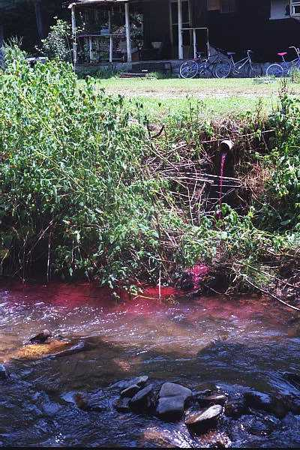
BMAPs & Septic Tanks
In the BMAPs, the phase out of approximately 16,000 tanks, is a project to reduce nitrogen and fecal coliform.
FDEP partnered with FSU to
develop Septic Tank Model
Determine Nitrogen Removal Credit
GIS Based Platform
Factors Denitrification
Model is still under Development Incorporating Refinements for Nitrogen Removal Calculations
Removing failing septic tanks eliminates sources of fecal coliform bacteria in surface waters.

Slide 12
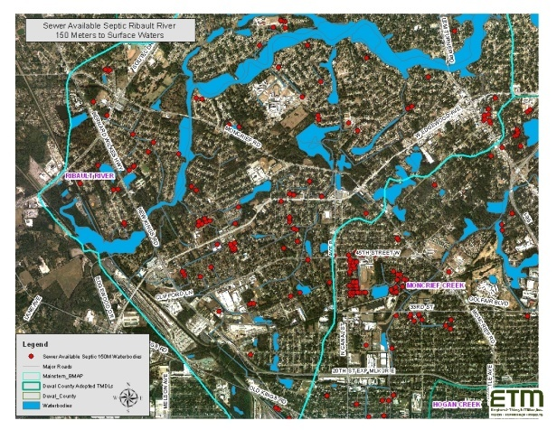
Project Development
Septic Tank Phase-Out Program

Slide 13
Project Development
Funded by City’s Stormwater Utility
Allocating funding annually thru Budget CIP Process
Inadequate funding identified to meet obligation
Need for Funding Partnerships – Grants
The Stormwater Utility funding is limited to:
TMDL and BMAP Areas
300 Meters Proximity to Surface Waters
This Program is a partnership effort with the JEA
Identified 2 Project Components of the Program

Slide 14
COJ & JEA Partnership Agreement

Slide 15
Septic Tank Phase-Out Program Component 1 – Expanded Infrastructure
Identified TMDL credit areas with high density of septic tanks that have no available sewer infrastructure in which to connect.
Final project selection are those areas with the Highest Benefit and most effective investment.
Generally, a dense population of septic tanks in a project area creates a favorable benefit-to-cost ratio.

Slide 16
Elements of Evaluation
Focused on Areas with Available Plant Capacity.
Potential for other infrastructure improvements as a partnership project (potable water, drainage, etc.).
Potential for funding partnerships.

Slide 17
Septic Tank Phase-Out Program Component 2 – Lateral Only Connections
Project Areas:
Identified TMDL areas with clustered septic tanks that have available sewer infrastructure in which to connect.
Refined to Areas with Available Transmission and Plant Capacity.
JEA’s significant participation is necessary to accurately define potential phase-out areas under this component.

Slide 18
Elements of Evaluation
Leverages available wastewater transmission capacity which limits capital expenditure.
Making lateral only connections is less resource intensive than installing new infrastructure.
Significant field evaluation required by JEA

Slide 19
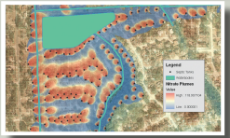
Selection Process
Geographic Information Systems
To Identify Project Areas

Slide 20
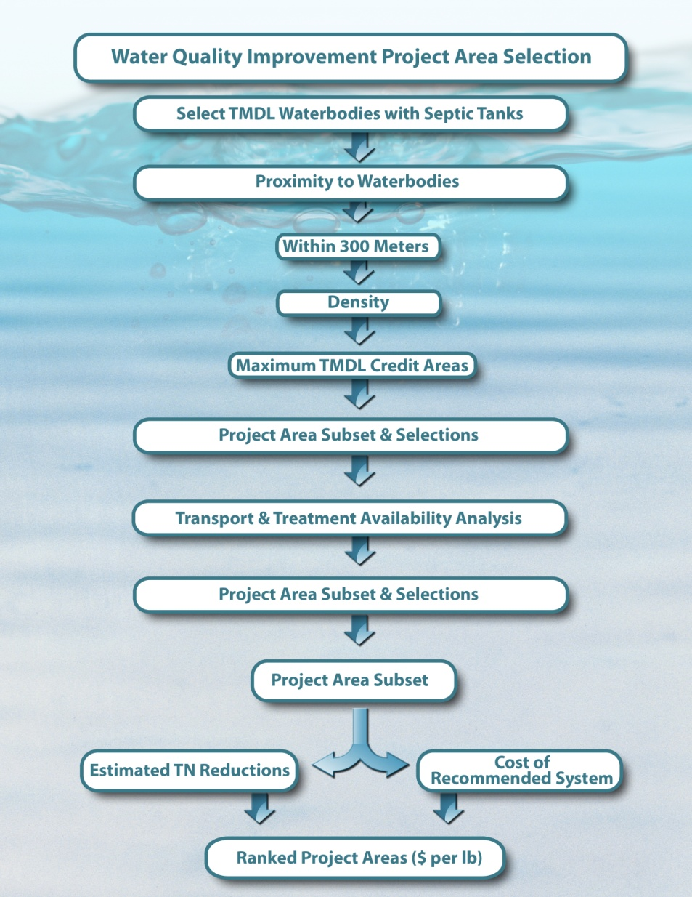
Septic Tank Phase-Out Component 1 – Expanded Infrastructure Decision Tree

Slide 21
Septic Tank Phase-Out Component 2 – Lateral Only Connection Decision Tree

Slide 22
Project Area Selection
Using GIS the Criteria Evaluated includes:
TMDL Waterbodies with Septic Tanks
Proximity of Septic Tanks to Surface Waters
Within 300 Meters
Surface Waters are defined as:
Creeks
Ditches
Rivers
Wetlands

Slide 23
Tanks within 300 Meters of TMDL Waterbodies

Slide 24
Project Area Selection Cont.
Calculate Density of Septic Tanks within TMDL Project Areas.
Rank Project Areas Septic Tank Density Highest to Lowest.
Maximum TMDL Credit Areas are those with Highest Density of Septic Tanks.

Slide 25
300 Meter Septic Tank Density

Slide 26
Project Summary
Septic Tank Phase Out is a Stormwater Utility Project and partnership with JEA to improve water quality.
The phase out project meets multiple regulatory obligations to eliminate sources of Nitrogen and Bacteria to Duval County’s Waterways.
Contributes to a healthier community by reducing algal blooms and exposure to human pathogens.

Slide 27
BMAP Forward & Septic Tanks 2012 Environmental Symposium
John P. Pappas, P.E.
Department of Public Works

