Slide 1

City of Jacksonville Environmental Symposium August 17, 2012
St. Johns River Water Supply Impact Study
Environmental Analysis
Ed Lowe, Ph. D.
Director, Bureau of Environmental Sciences
St. Johns River Water Management District

Slide 2

Hydroecology Methods
Photograph: R. Burks

Slide 3
Changes in hydrology can affect all components of the riverine ecosystem. We used separate workgroups to examine the potential effects on each component.
Wetland Vegetation
Floodplain Wildlife
Water Quality
Plankton
Submersed Aquatic Vegetation
Biogeochemistry of Wetland Soils
Nekton (Fish)
Benthos

Slide 4
The WSIS evaluated the potential effects on each ecosystem component along the river’s length, from the mouth to the headwaters. For this aspect of the work, the river was divided into segments.

Slide 5
Major Hydrologic and Hydrodynamic Drivers
Driver | Definition | Key Ecological Attributes Potentially Affected
Discharge | Flow rate as volume per unit time; e.g. millions of gallons per day (mgd) | Populations of fish, benthic macroinvertebrates, and wildlife in the estuary
Residence Time | Days required for a parcel of water to traverse a portion of the river | Phytoplankton blooms – longer residence time increases blooms by increasing the growing time
Water Level | Elevation of the water surface (as feet or meters above sea level) | Wetland vegetation and wildlife, submersed aquatic vegetation, benthic macroinvertebrates, nutrient releases from floodplain soils
Salinity | Concentration of dissolved salts as practical salinity units (psu) – roughly, parts per thousand | Populations of fish, benthic macroinvertebrates, and wildlife in the estuary; submersed aquatic vegetation in the estuary

Slide 6
We assessed forcings for the major hydrologic and hydrodynamic (H&H) drivers by modeling deviations from the baseline condition caused by a water withdrawal (top panel). The forcings became inputs to hydroecological (HE) models that assessed the potential ecological effects as deviations in ecological attributes from the baseline condition (bottom panel).
Deviation in H&H Driver (Forcing)
Forcings – deviations from the baseline condition in hydrologic and hydrodynamic (H&H) drivers
Exceedance Frequency →
Baseline
Withdrawal
Hydrologic/Hydrodynamic models
Hydroecological models
Effects – deviations from the baseline condition in ecological attributes
Deviation in Attribute (Effect)
Level of Ecological Attribute →
Deviation in H&H Driver (Forcing)
Level of Hydrologic or Hydrodynamic Driver →
Notes:
Because the purpose of the WSIS study was to evaluate the effects of a reduction in flow caused by water withdrawals, scenarios other than the baseline that had no withdrawal need not be evaluated for environmental effects. Also, scenarios where the flow rate was above the baseline flow rate will not be evaluated since any effects would be due to flow augmentation rather than flow reduction.

Slide 7
In the modeling framework, forcings were outputs from Hydrologic and Hydrodynamic models that became inputs to hydroecological models.
Water Withdrawal
Hydrologic Models
Hydrodynamic Models
Water Residence Time (Water Age) Forcings
Discharge and Level Forcings
Salinity Forcings
Hydroecological Models
Hydroecological Effects

Slide 8
Levels of Effects – WSIS scientists evaluated the importance of potential hydroecological effects using five categories based on the strength, persistence, and diversity (breadth) of ecological effects.
Level of Effect | Criteria
Extreme | Effect is persistent, strong, & highly diverse; significant change in natural resource values
Major | Effect is persistent & strong, but not highly diverse; significant change in natural resource values
Moderate | Effect is ephemeral or weak or is limited to minor species, no significant change in natural resource values
Minor | Effect is ephemeral & weak; no significant change in any ecosystem attribute
Negligible | No appreciable change in any ecological attribute

Slide 9

Results
Photograph: Dean Campbell

Slide 10
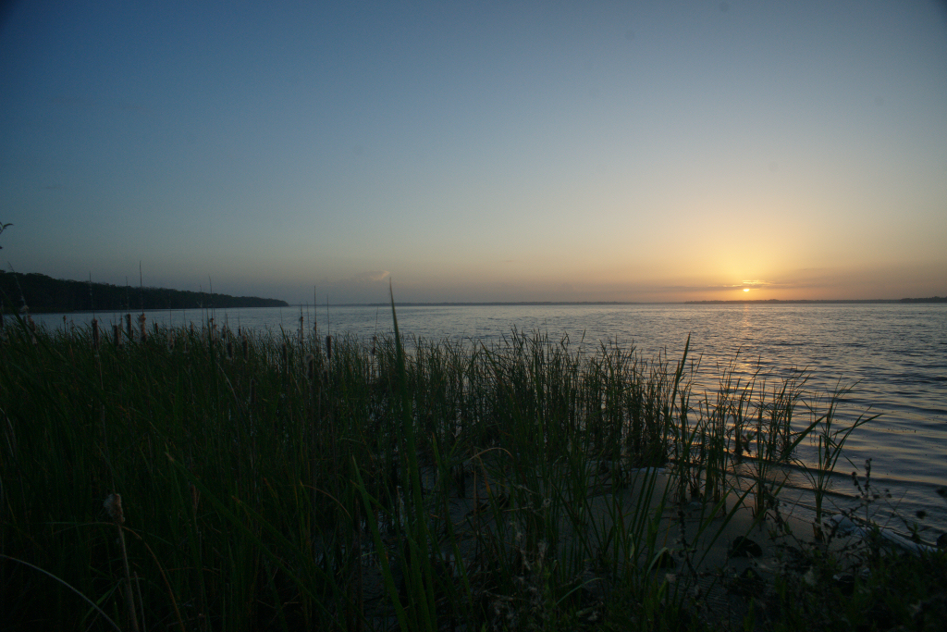
1. In forecast scenarios, increased runoff, higher sea level, and completed upper basin projects reduce or eliminate hydroecological effects.
Photograph: Dean Campbell

Slide 11
Under forecast conditions, H&H models predicted increases in river discharge – even when withdrawals were imposed. These augmentation effects cannot be attributed to withdrawals.
Augmentation effect
Baseline
Exceedance Frequency →
Reduction effect
Water Level or Flow Rate →

Slide 12
Example: Percent change in relative abundance in the estuary for size classes of select species with strong flow response. Flow reduction effects in red, flow augmentation effects in black.
Species | Length (mm) | Spatial Extent of Effect | Hindcast 77.5 mgd | Hindcast 155 mgd | Forecast 77.5 mgd | Forecast 155 mgd | Forecast 262 mgd
Channel catfish | 50-100 | Broad | -7.8 | -17.4 | 29.9 | 17.2 | -0.9
Channel catfish | 150-275 | Narrow | -28.5 | -52.1 | 7.0 | -21.9 | -63.8
Spotted seatrout | 31-50 | Broad | 10.7 | 42.4 | -34.3 | -14.9 | 23.1
Spotted seatrout | 51-110 | Broad | 16.5 | 36.9 | -27.6 | -12.5 | 17.3
Spotted seatrout | 201-325 | Narrow | -1.8 | -3.0 | 4.7 | 4.2 | 1.7
Striped mullet | 31-45 | Broad | 11.5 | 25.3 | -19.9 | -9.1 | 8.6
Narrow- effect confined to area of shifting salinity isopleths (≤ 2/8 sampling zones)
Broad - effect predicted for > 50% of the entire estuary (≥ 4/8 sampling zones)

Slide 13
Hydroecological effects were reduced or eliminated in forecast scenarios.
River Segment | Hindcast 155 mgd | Hindcast 77.5 mgd | Forecast 262 mgd | Forecast 155 mgd | Forecast 77.5 mgd
1
2
3
4
5
6
7
8
 | Negligible effect
 | Minor effect
 | Moderate effect
 | Major effect
 | Extreme effect

Slide 14
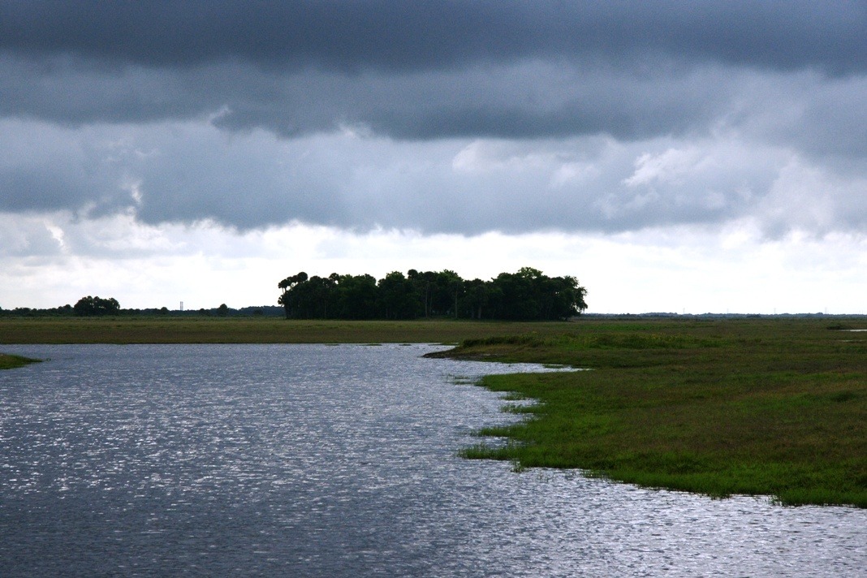
2. Under forecast conditions, appreciable amounts of surface water can be withdrawn with negligible or minor ecological effects.
Photograph: Dean Campbell

Slide 15
For three ecosystem components all hydroecological effects were negligible or minor for all conditions and areas examined.
Water quality
Loading rates and concentrations of carbon, nitrogen, and phosphorus
Dissolved oxygen concentrations
Submersed Aquatic Vegetation
Levels of salinity stress
Depth distributions
Plankton
Intensity and duration of phytoplankton blooms
Species structure of zooplankton communities

Slide 16
Under the modeled conditions, hydroecological effects were no more than moderate in both hindcast and forecast scenarios and no more than minor in forecast scenarios with up to 155 mgd withdrawals.
River Segment | Hindcast 155 mgd | Hindcast 77.5 mgd | Forecast 262 mgd | Forecast 155 mgd | Forecast 77.5 mgd
1
2
3
4
5
6
7
8
 | Negligible effect
 | Minor effect
 | Moderate effect
 | Major effect
 | Extreme effect

Slide 17
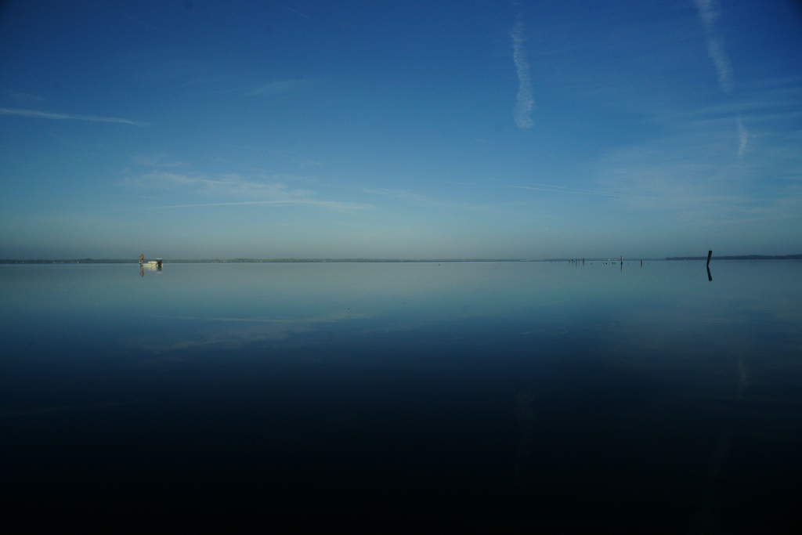
3. The potential for ecological effects varies significantly along the river’s length.
Photograph: Dean Campbell

Slide 18
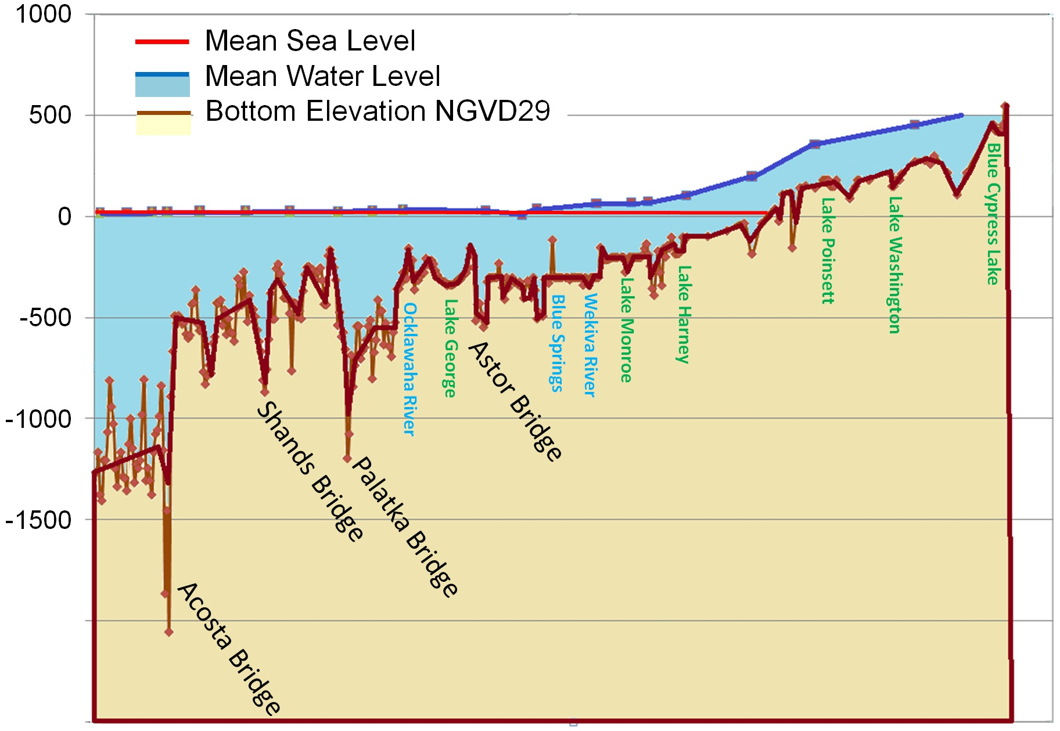
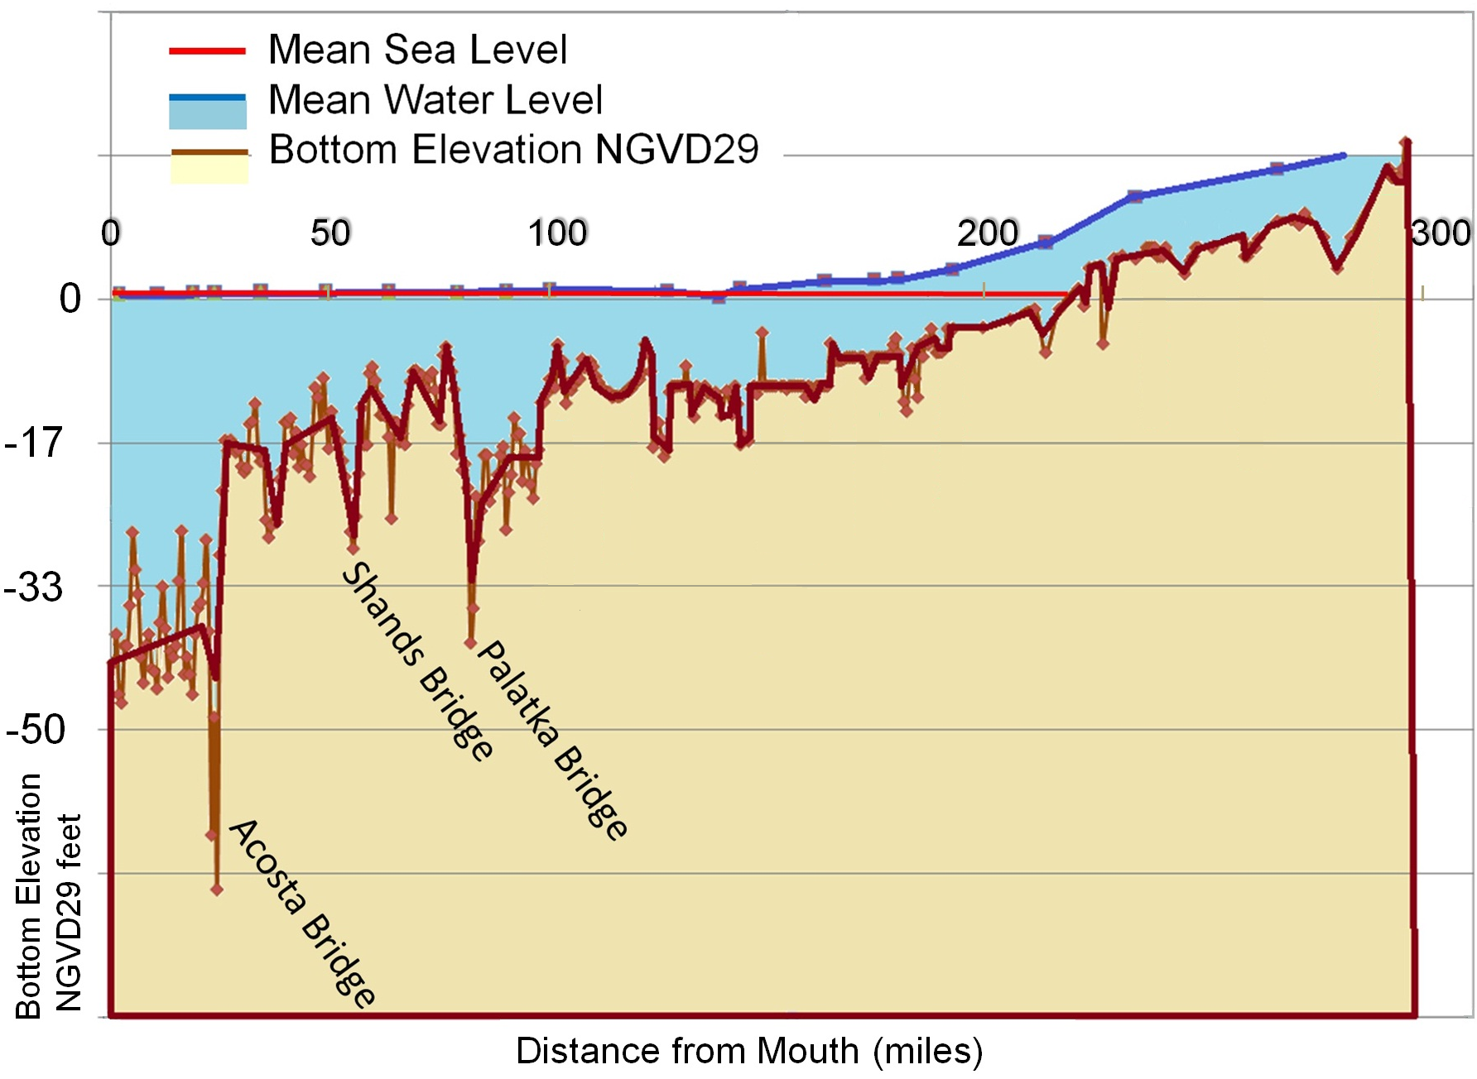
SJR Transect Bottom Elevations
0
50
100
200
300
0
Blue Cypress Lake
Lake Poinsett
Lake Washington
-17
Lake Harney
Lake Monroe
Lake George
-33
-50
Bottom Elevation
NGVD29 feet
Distance from Mouth (miles)

Slide 19
Hydroecological effects due to changes in water levels could only occur in the upper segments of the river. Under forecast conditions, water level effects in these segments would be negligible or minor.
Residence time effects would be negligible or minor in all areas.

Slide 20
Hydroecological effects due to reduced freshwater discharge and increased salinity would only occur in the lower segments of the river to approximately the Shands Bridge (river mile 50). Under forecast conditions, these effects would be negligible or minor except at the highest level of water withdrawal modeled (262 mgd).

Slide 21
The middle reach of the river will be relatively insensitive to hydrologic and hydrodynamic effects of water withdrawals. Salinity and water level will not be appreciably affected. Increases in retention time will not materially increase the potential for phytoplankton blooms.
Notes:
Approximately from the Shands bridge to the south end of Lake Harney – about 142 miles (229 km)

Slide 22
The middle reaches of the river (segments 4&5) were relatively insensitive to all potential changes in H&H drivers.
River Segment | Hindcast 155 mgd | Hindcast 77.5 mgd | Forecast 262 mgd | Forecast 155 mgd | Forecast 77.5 mgd
1
2
3
4
5
6
7
8
 | Negligible effect
 | Minor effect
 | Moderate effect
 | Major effect
 | Extreme effect

Slide 23
4. The only potential major effect is entrainment and impingement of planktonic life stages of river herrings at the water intakes.
Photograph: Dean Campbell

Slide 24
The density of planktonic life stages of river herrings peaks in the upper segments (6& 7) near SR 46 and SR 50. Seasonally, the peak abundance is in winter and early spring. E&I can be avoided through suitable location, design, and operation of water intake structures.

Slide 25
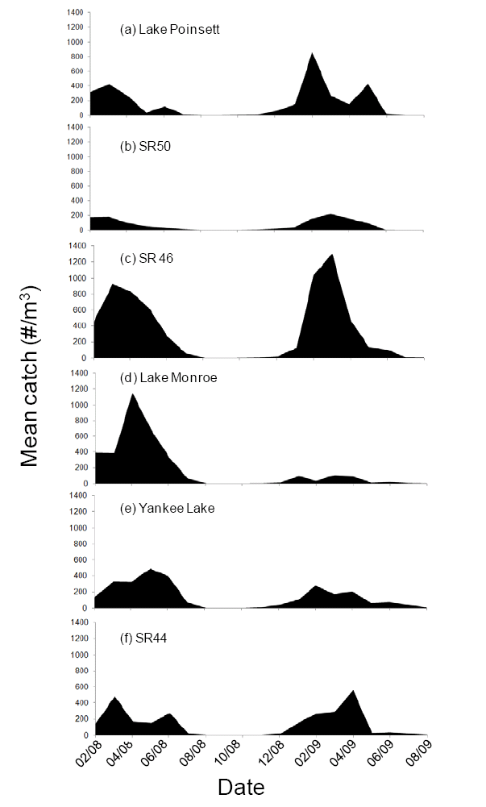
Results – Attributes - Fishes – Potential for E&I - Monthly variation in larval fish density at various locations in the St. Johns River.

Slide 26

Discussion
Photograph: R. S. Burks

Slide 27

Responses to forcings were often mixed – i.e. positive, negative, and neutral.
Photograph: Dean Campbell

Slide 28

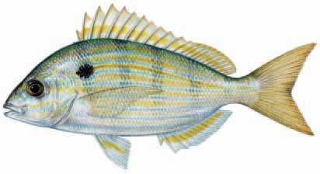
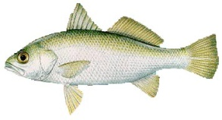
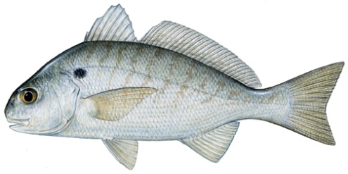
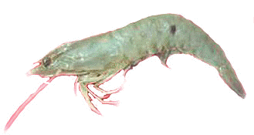
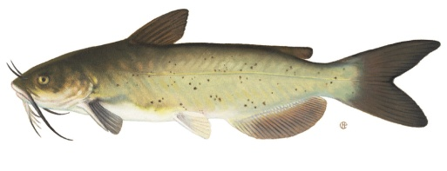
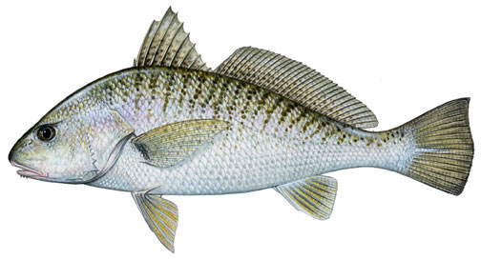
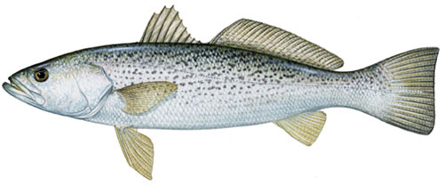
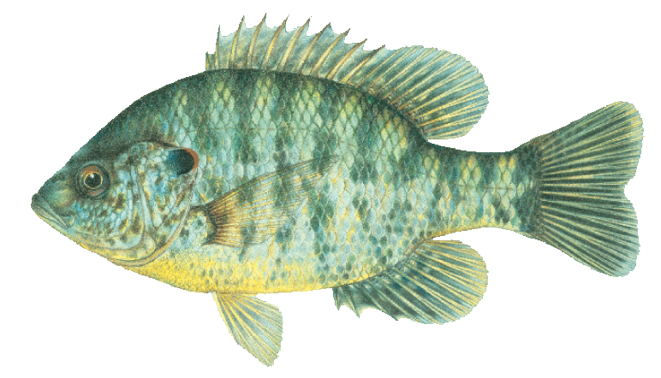

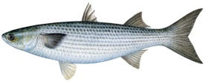

Juvenile Fish Movement in Response to Freshwater Inflow
Fish Size to Scale
Spot
Pinfish
Silver Perch
Channel Catfish
Weakfish
White Shrimp
Croaker
Salinity
Striped Mullet
Redear Sunfish
Declining Freshwater Inflow
Upstream Movement
Notes:
Opposite shifts occurred with increasing inflow. Center of Abundance shifts under all scenarios were small; all were less than 1.9 miles

Slide 29
Depending upon the species (and size), abundances of fish and invertebrates can be positively correlated, negatively correlated, or uncorrelated with freshwater inflow to the LSJR.
Species | Correlation | Size Range (mm) | Best Fit Inflow Lag Period (days)
Atlantic croaker | negative | 130-170 | 120
Atlantic menhaden | uncorrelated | 20-40 | 30-360
Atlantic weakfish | negative | 70-110 | 60
Blue crab | negative | 91-180 | 180
Southern flounder | positive | 0-100 | 30, 210
Southern flounder | negative | 126-325 | 150
Spotted seatrout | negative | 31-110 | 150, 300
Spotted seatrout | positive | 210-325 | 60
Channel catfish | positive | 50-275 | 150, 180
Striped mullet | uncorrelated | 0-30 | 30-360
Striped mullet | positive | 31-45 | 210
White shrimp | uncorrelated | 18-25 | 30 - 360

Slide 30
Although salinity isopleths move with variation in freshwater inflows, the mean annual areas of salinity zones varied little among withdrawal scenarios.

Slide 31
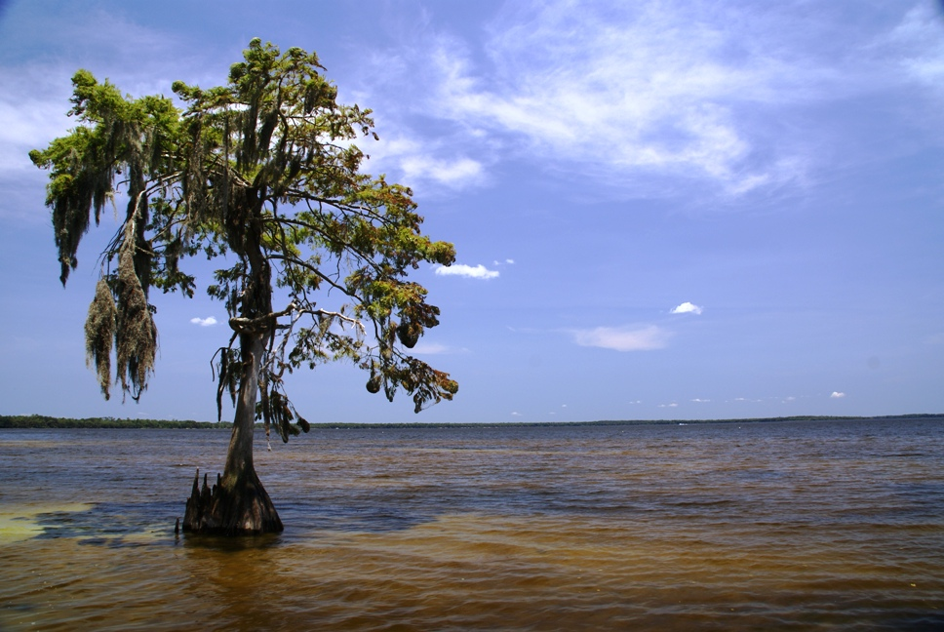
Ecosystems are complex.
Photograph: Dean Campbell

Slide 32
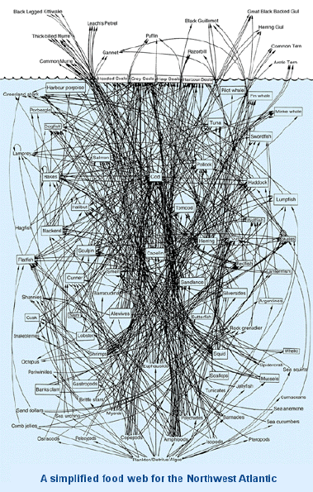
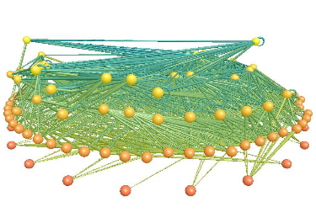
Complexity and Scientific Uncertainty - Ecosystems are extraordinarily complex. Predictions for such complex systems will always have an associated level of scientific uncertainty.
Food web of Little Rock Lake, Wisconsin
Yoon et al., 2005.
These food webs illustrate the trophic complexity of ecosystems. The complexity would increase considerably if interactions with physical and chemical variables were included.
Lavigne & Fink, 2001.

Slide 33
Δ Estuary benthos –diversity, density
The hydroecology of the St. Johns River is complex as illustrated by this simplified conceptual model. This complexity and natural variability lead to varying levels of scientific uncertainty for predictions
Legend
HYDROLOGY
↓Shrimp, crab populations
BIOGEOCHEMISTRY
PHYTOPLANKTON
Δ Estuary fish species distributions
SAV
BENTHOS
FISH
↑SAV mortality
↓SAV abundance and distribution
WETLANDS & WETLAND – DEPENDENT SPECIES
↓Flow rate
↑Upstream isohalines
↓SAV growth
Key Effect
↓SAV reproduction
Causal Linkage
↑SAV epiphytes
↑ Shading of SAV
Increase ↑
↑C,N,P Release
↑ Nutrient Loading
Decrease ↓
↓Water level
↑ Oxidation Soil Organic Matter
Change Δ
↑CDOM/DOM Release
↓ Respiration - inhibition
↓NPP – shading, inhibition
↓Dis. Oxygen
↓Flow rate
↑Salinity/Water age
↑Withdrawal
↑Phytoplankton growing time
↑Phytoplankton Blooms
↓Crustacean zooplankton
Δ Wetland Vegetation/ Wetland acreage
↑N fixation
Δ FW benthos – diversity, density
↑Phyto toxins
↓Water level
↓ Stage-frequency distribution
↑C,N,P Release – gaseous, dissolved
↓Wetland Soil Accretion Rate
↓Populations of wetland-dependent fauna
↑ Oxidation Soil Organic Matter
Δ Wetland Vegetation/ Wetland Acreage
↓ Depth
↓FW Fish Spawning/nursery habitat
↓Populations of native FW fish
Δ FW benthos – diversity, density
↑Entrainment/ Impingement
↓FW Fish reproductive success
Notes:
Draft – subject to change.

Slide 34

“Prediction is difficult, especially about the future.” Yogi Berra & Niels Bohr
Photograph: Dean Campbell

Slide 35
Managing Complexity and Uncertainty- Perhaps, the most appropriate strategy for managing a complex system and scientific uncertainty is adaptive management.
Water Supply Impact Study
Predict effects of potential management action(s)
Develop/revise predictive mechanistic and empirical models
Implement selected action(s)
Prediction & Action
Monitoring & Verification
Monitor key effects
NO
Responses fit predictions?
YES

Slide 36

"When we try to pick out anything by itself, we find it hitched to everything else in the Universe." John Muir
End
Photograph: Dean Campbell

