Slide 1
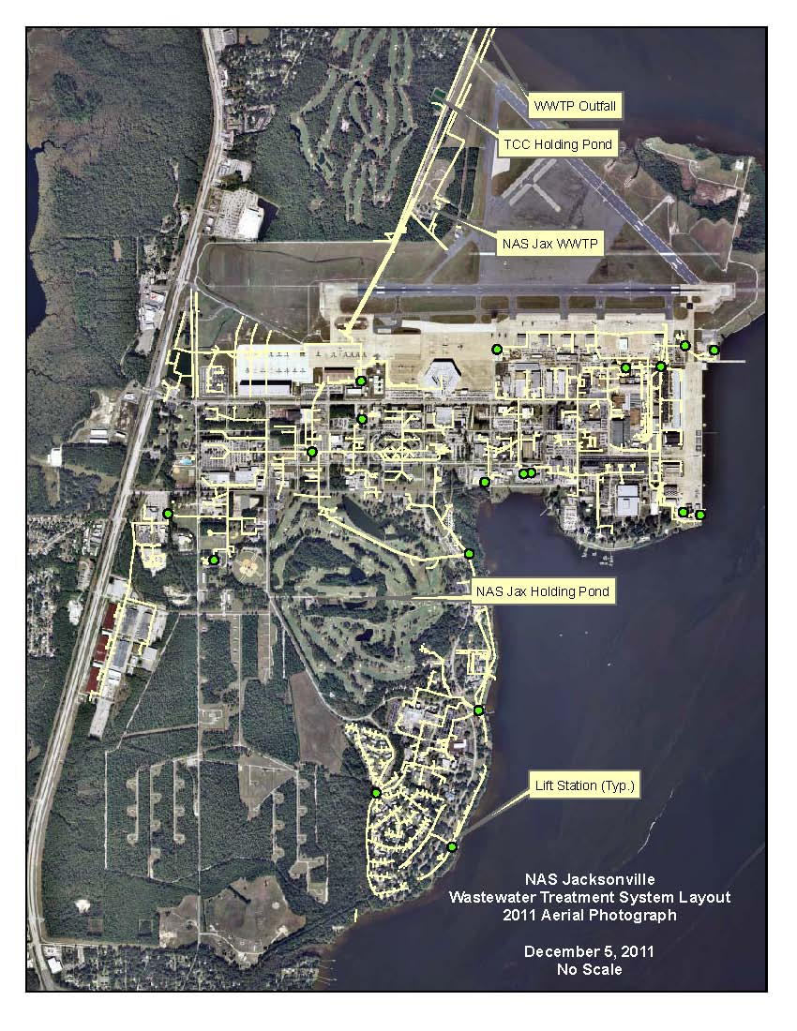
NAS JACKSONVILLE WASTEWATER REUSE PROJECT
1997
2011
2013
2014

Slide 2
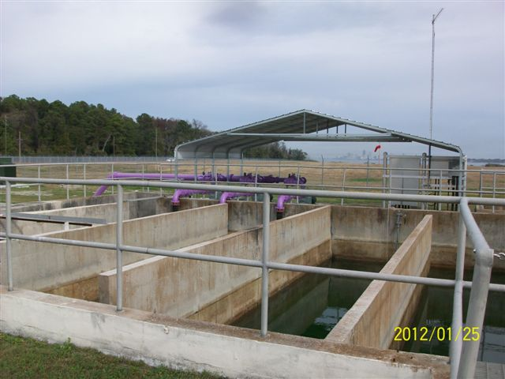
NAS JACKSONVILLE WASTEWATER REUSE PROJECT
PURPLE PIPE FROM DECHLORINATION CHAMBER

Slide 3
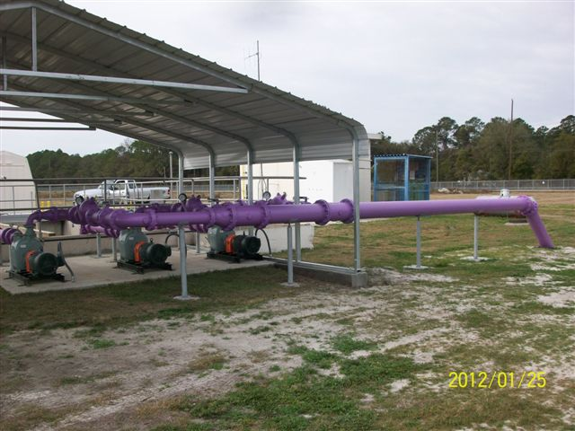
NAS JACKSONVILLE WASTEWATER REUSE PROJECT
PURPLE PIPE FROM DECHLORINATION CHAMBER

Slide 4
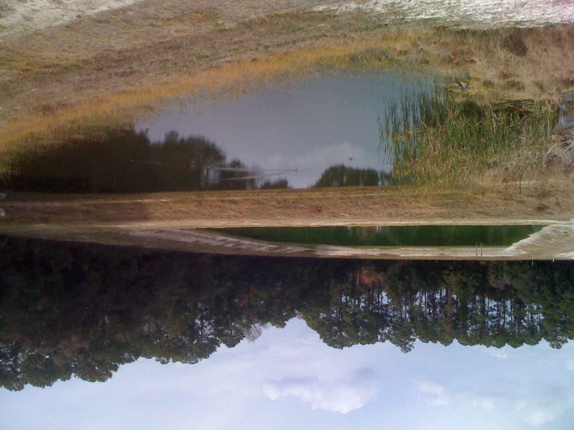
NAS JACKSONVILLE WASTEWATER REUSE PROJECT
REUSE POND / STORMWATER POND
GATOR COUNTRY

Slide 5
NAS JACKSONVILLE WASTEWATER REUSE PROJECT
NAS Jacksonville wastewater treatment plant designed to treat 3 MGPD. Current flow less than .6 MGPD
Wastewater currently discharges to St. Johns River, Timuquana Country Club golf course for irrigation (.2 MGPD since 1997) and Station reuse pond (since 2011)
100% wastewater reuse project with zero discharge to St Johns River using Navy funding ($2.2M) and St Johns River Water Management District grants to City of Jacksonville ($2M) to connect to golf course irrigation in 2013 and to construct south antenna farm spray field in 2014. Project to eliminate 315 MGY discharge to river and 48 MGY withdrawal from Floridian Aquifer currently used for golf course irrigation.
Station to connect to City JEA treated wastewater discharge line to reuse .5 MGPD to stabilize plant operations
Florida Aggregate Permit for NAS Jacksonville and NS Mayport reduced nitrogen discharge from 92,464 lb/yr to 25,705 lb/yr by Oct 2015. NAS JAX reuse to eliminate 54,412 lb/yr. NS Mayport to reduce 12,347 lb/yr.
Contact Kevin Gartland at (904) 542-5789 or Jay Caddy at (904) 542-6440 if questions.

