Slide 1
St. Johns River Water Supply Impact Study (WSIS)
Michael G. Cullum, P.E.
Director, Bureau of Engineering

Slide 2
The Water Supply Impact study is the most comprehensive and rigorous investigation of the St. Johns River ever conducted.
Notes:
I want to briefly talk about the peer review process with NRC. First, our approach was unusual in that we collaborated with NRC from the start of the analysis. Normally, peer review is performed on a completed draft document and then revised to consider the peer review comments. We did not want to spend years performing our analyses and find out at the end that the NRC committee had major issues with our approach or analyses. So we interacted from the beginning with the NRC and I believe in the long term it resulted in a better report as we able to explore many approaches and issues regarding the engineering and science work efforts.
We also conducted a series of six face-to-face meetings with the NRC
Were able to take them on field trips to see the resources
Able to build professional relationships of mutual respect and understanding
Bottom line for me and I think our team that the interaction and input from NRC was very useful.

Slide 3
Major Conclusions
The St. Johns River can be used as an alternative water supply source with no more than negligible or minor effects.
Future land use changes, completion of the Upper St. Johns River Basin Project, and sea level rise reduce the effects of water withdrawals.
Potential for environmental effects varies along the river’s length.
The study provides peer-reviewed tools for use by the District and others.

Slide 4
National Academy of Sciences National Research Council (NRC) Peer Review
Three-year process working with the NRC peer review committee.
Committee consisted of nine experts.
Six multi-day meetings, field trips and numerous teleconferences.
NRC ̶ 105 page report, December 2011

Slide 5
NRC Concluding Comment
“The overall strategy of the study and the way it was implemented were appropriate and adequate to address the goals that the District established for the WSIS.”

Slide 6
The first step: - Understand hydrology and hydraulics and predict the changes - Resulting from potential water withdrawals.
Watershed hydrology models predict inflows into the river.
River hydrodynamic model predicts river flow, level, and salinity.

Slide 7
Baseline Scenario
1995 Landuse
Water Supply Planning Base Year
Good Data set 1995-2006
Stable USJ Project Conditions
Use for Calibration of Models

Slide 8
Forecast Scenarios
2030 Land-Use
Complete Upper SJR Projects
Fellsmere,
C1- Sawgrass Lakes
Three Forks Marsh
Conservative Sea Level Rise (14 cm)
Withdrawal Scenarios - 77.5 mgd, 155 mgd, & 262 mgd

Slide 9
Watershed Models
Hydrologic Simulation Program – Fortran (HSPF)
90 separate models
11 in-house modelers
External Peer Review
Model for Upper SJR Basin
55 mgd - near Lake Poinsett

Slide 10
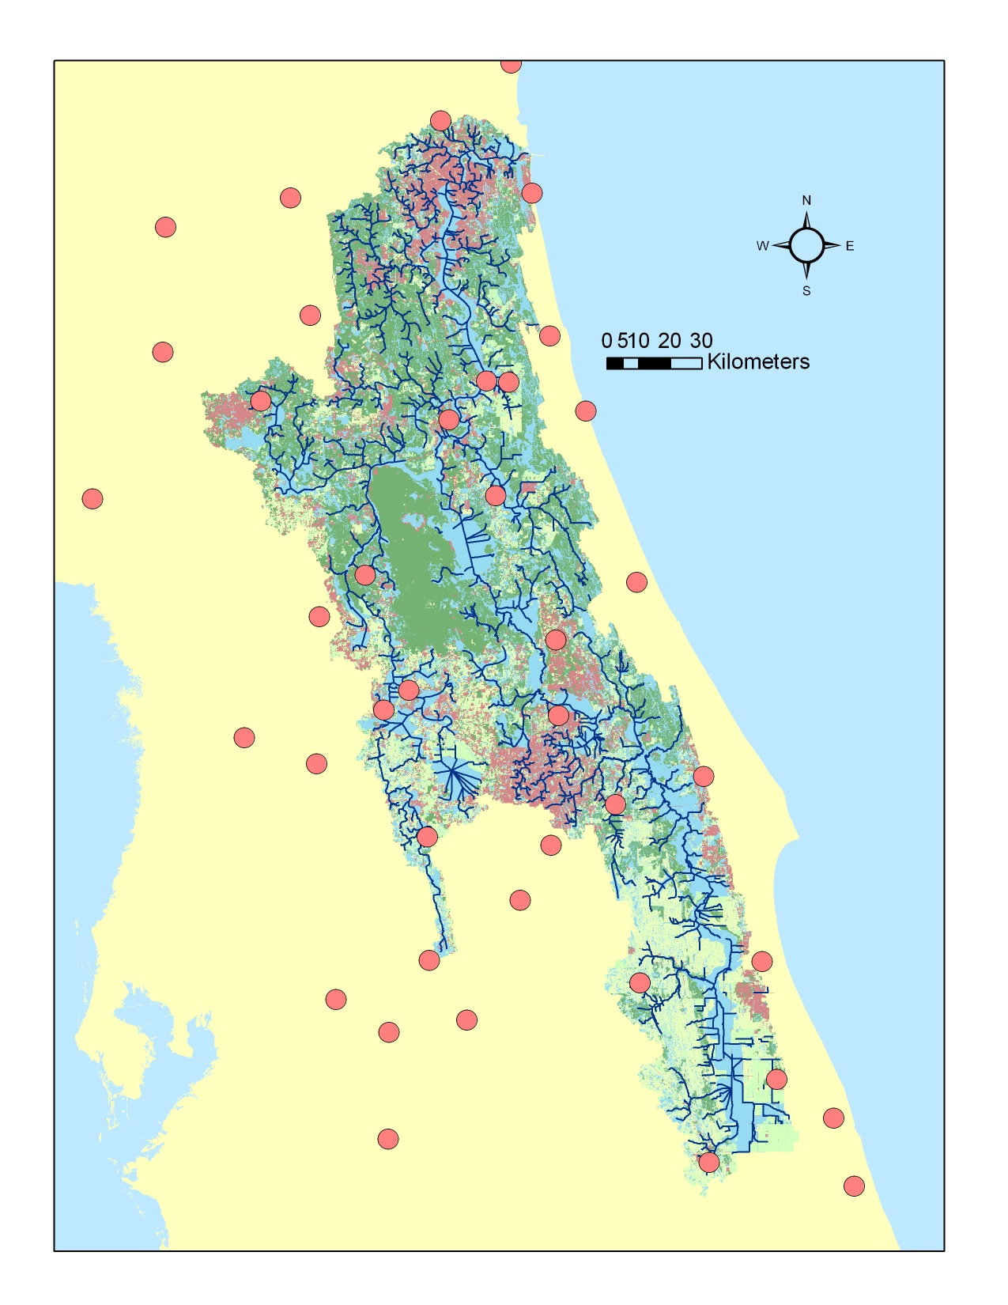
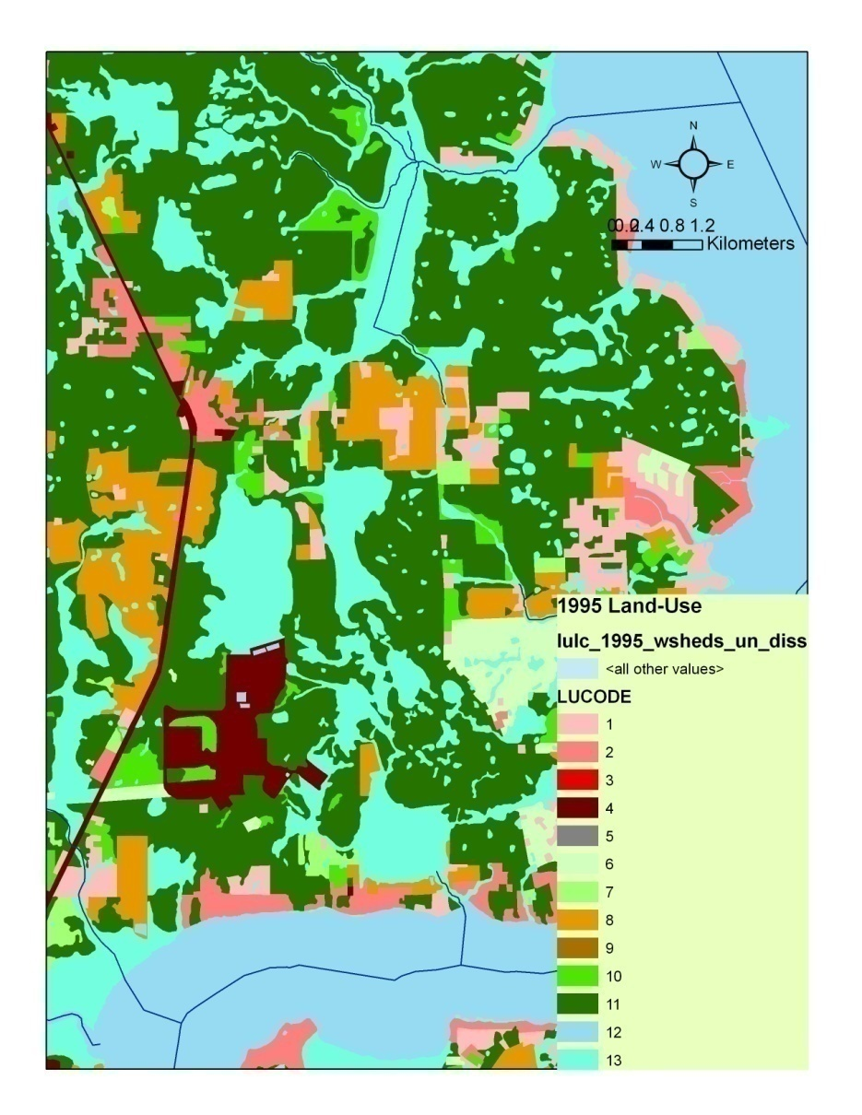
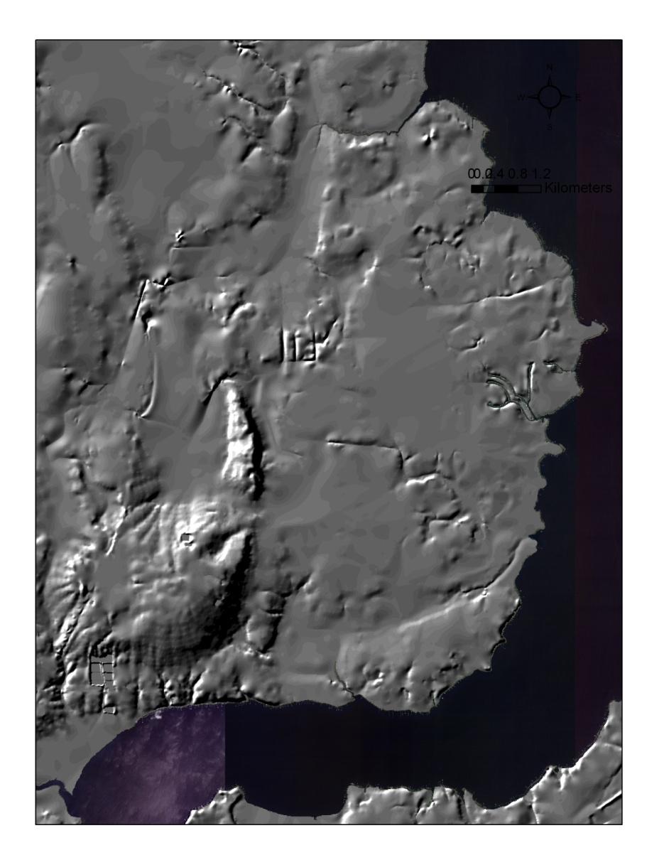
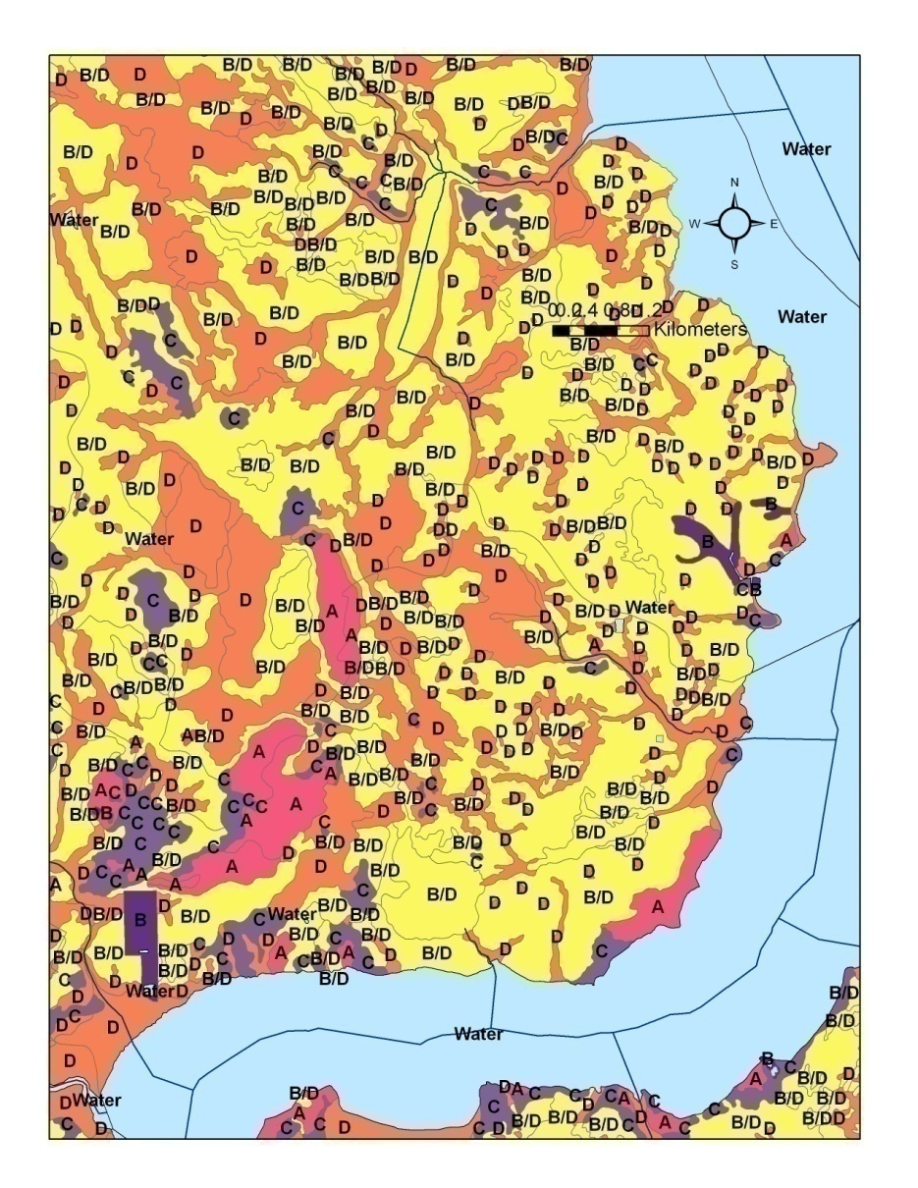
HSPF Modeling
LULC
DEM
Soils
D.E.M.
Land Cover
Soils
Land-use, reaches, and rainfall gauges

Slide 11
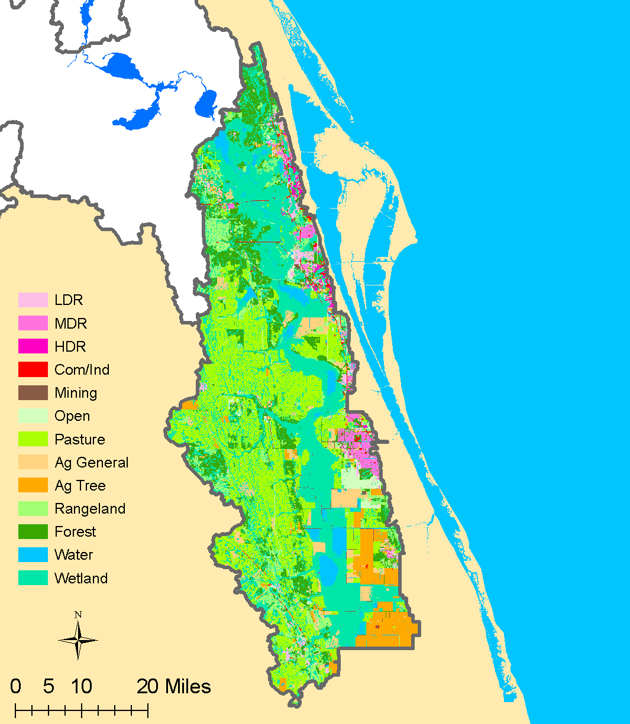
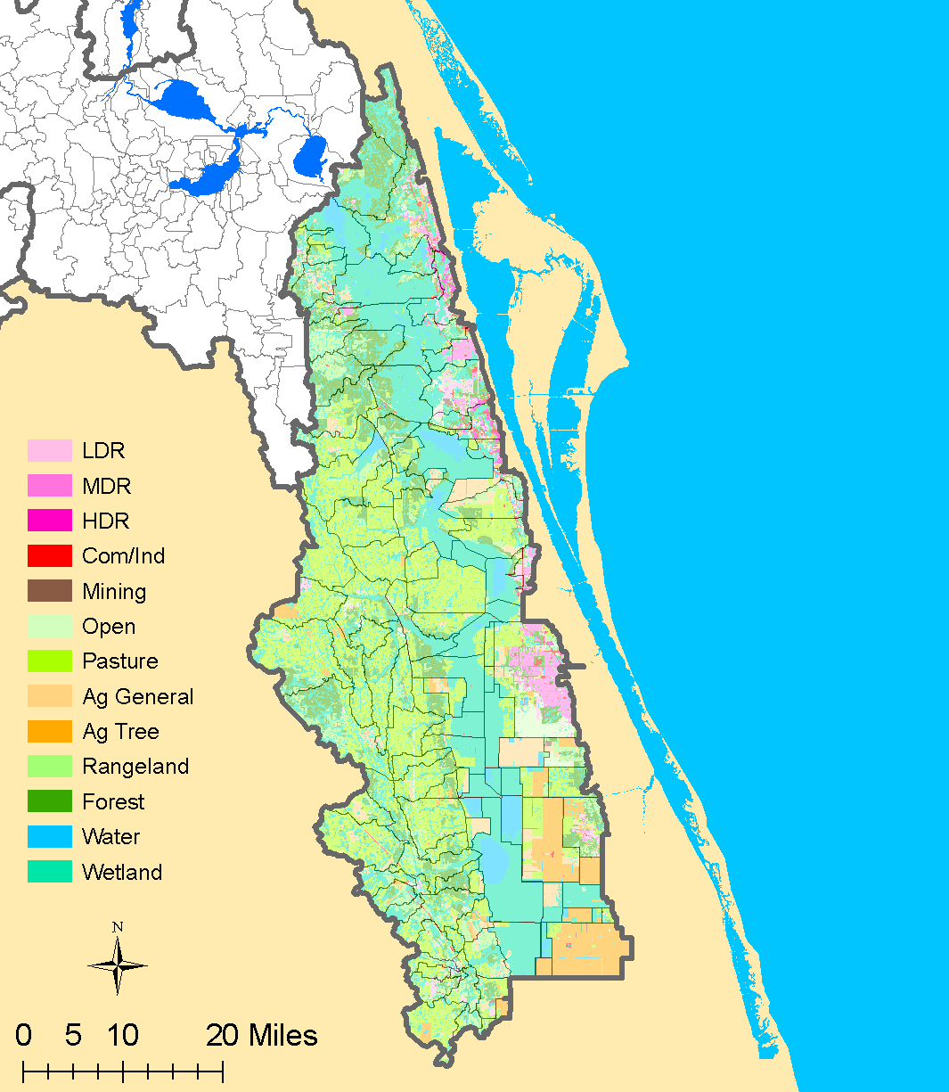
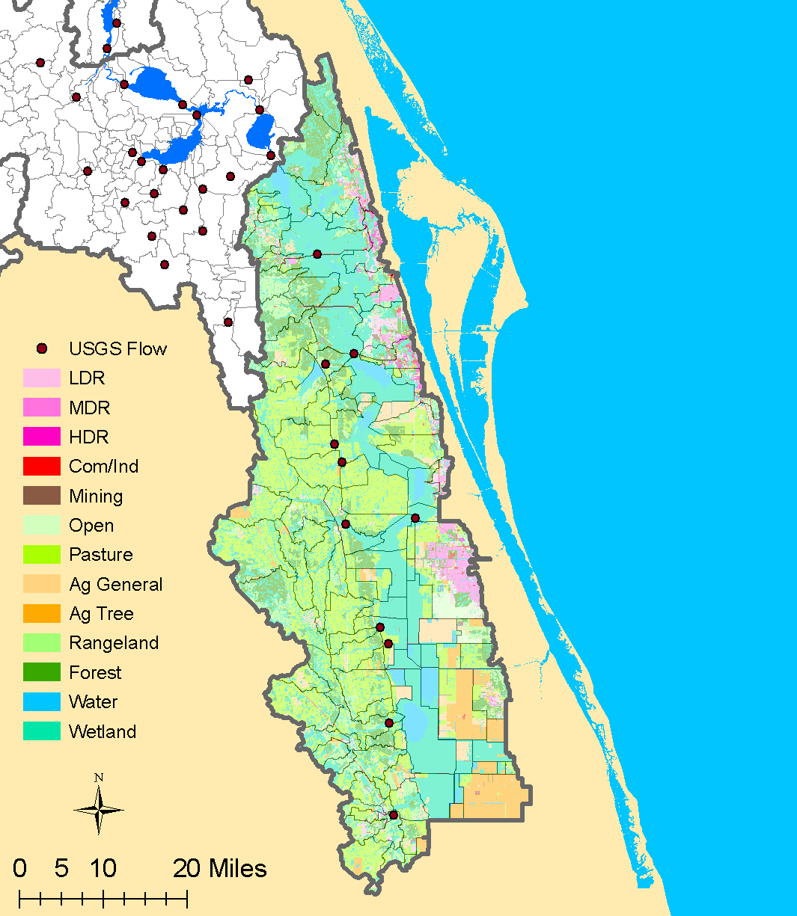
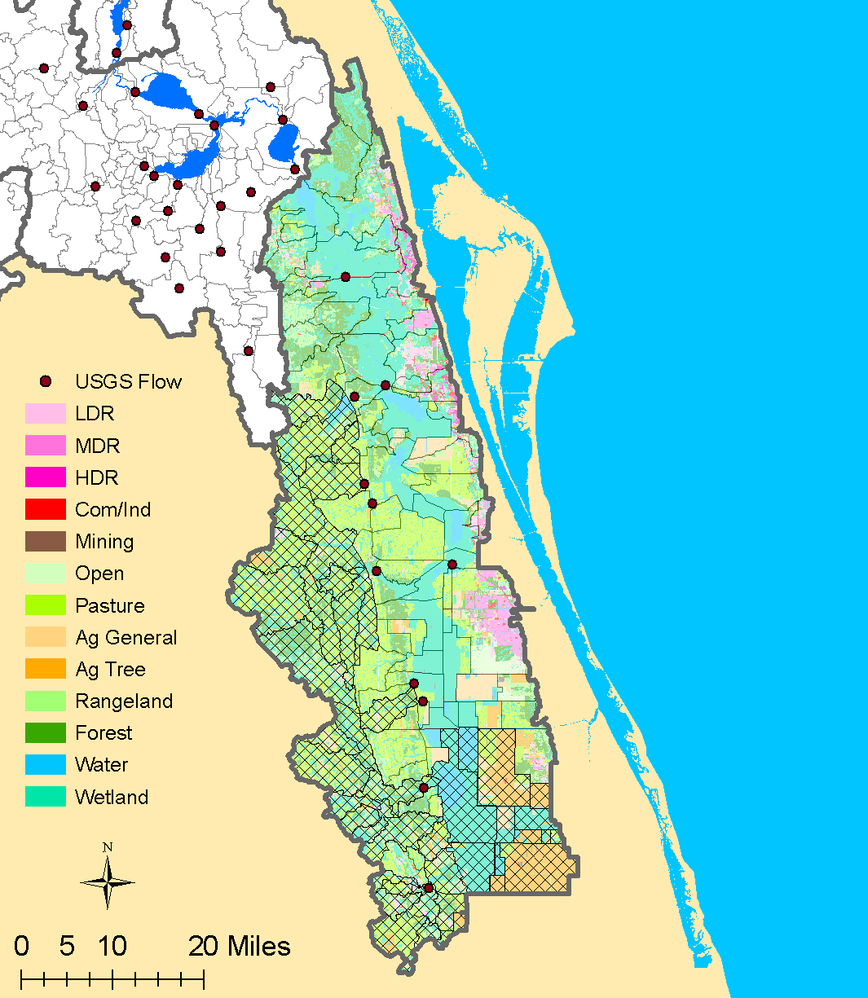
Upper
St. Johns River Basin
1,780 square miles
Average 663 mgd
Sub-watersheds
USGS flow gages
Calibrated tributaries

Slide 12
River Hydrodynamics
Environmental Fluid Dynamics Code (EFDC)
3,000 horizontal x 6 vert. grids
7 in-house modelers,6 outside experts
55 mgd Lake Poinsett
50 mgd Yankee Lake
50 mgd Lake Jesup
107 mgd Ocklawaha River

Slide 13
Withdrawal and Grid

Slide 14
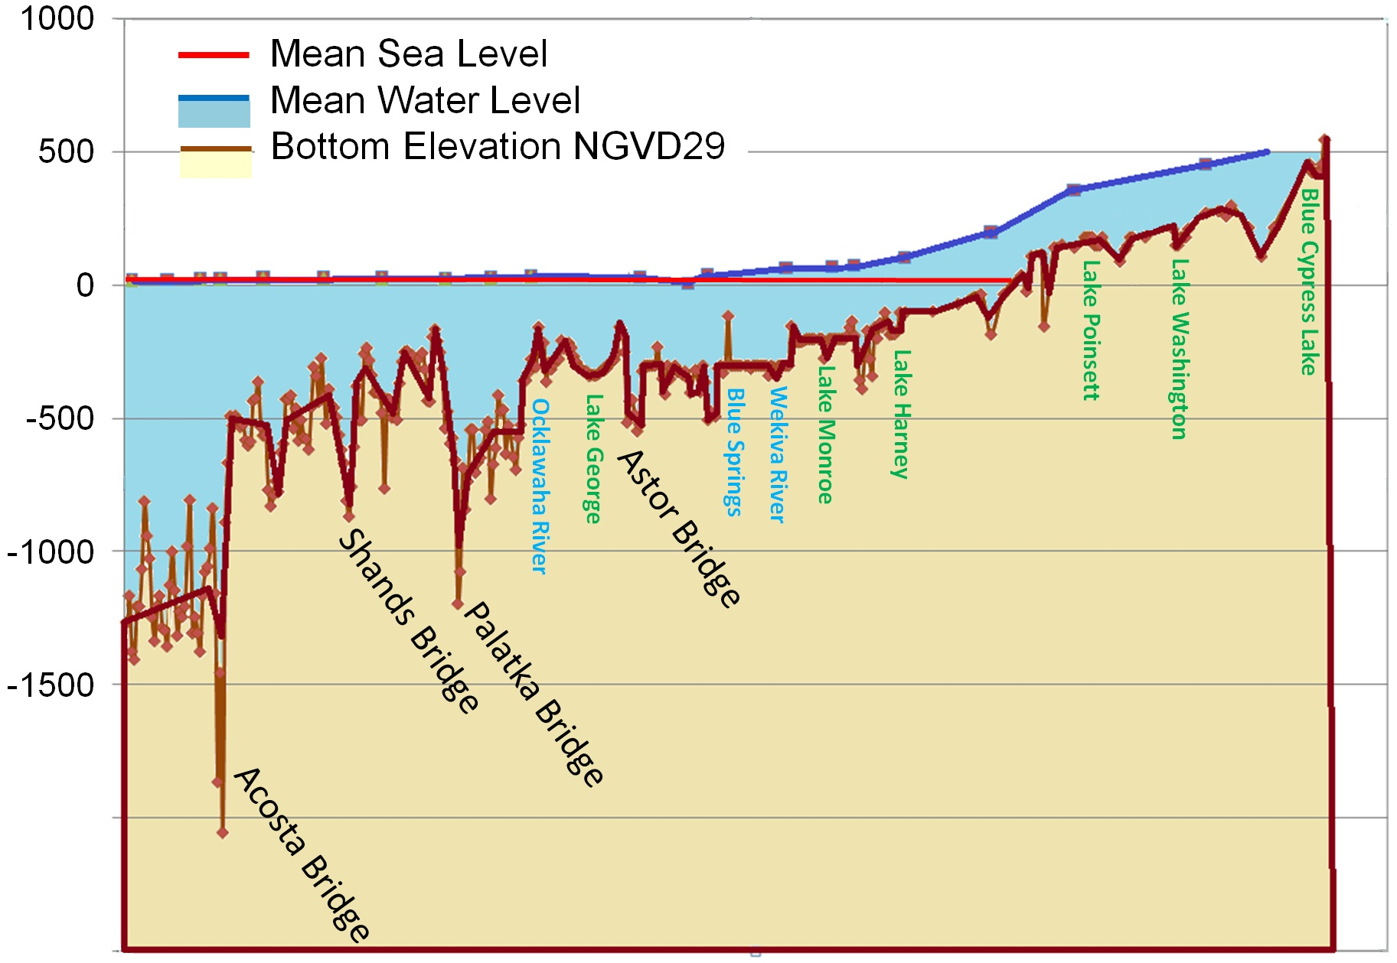
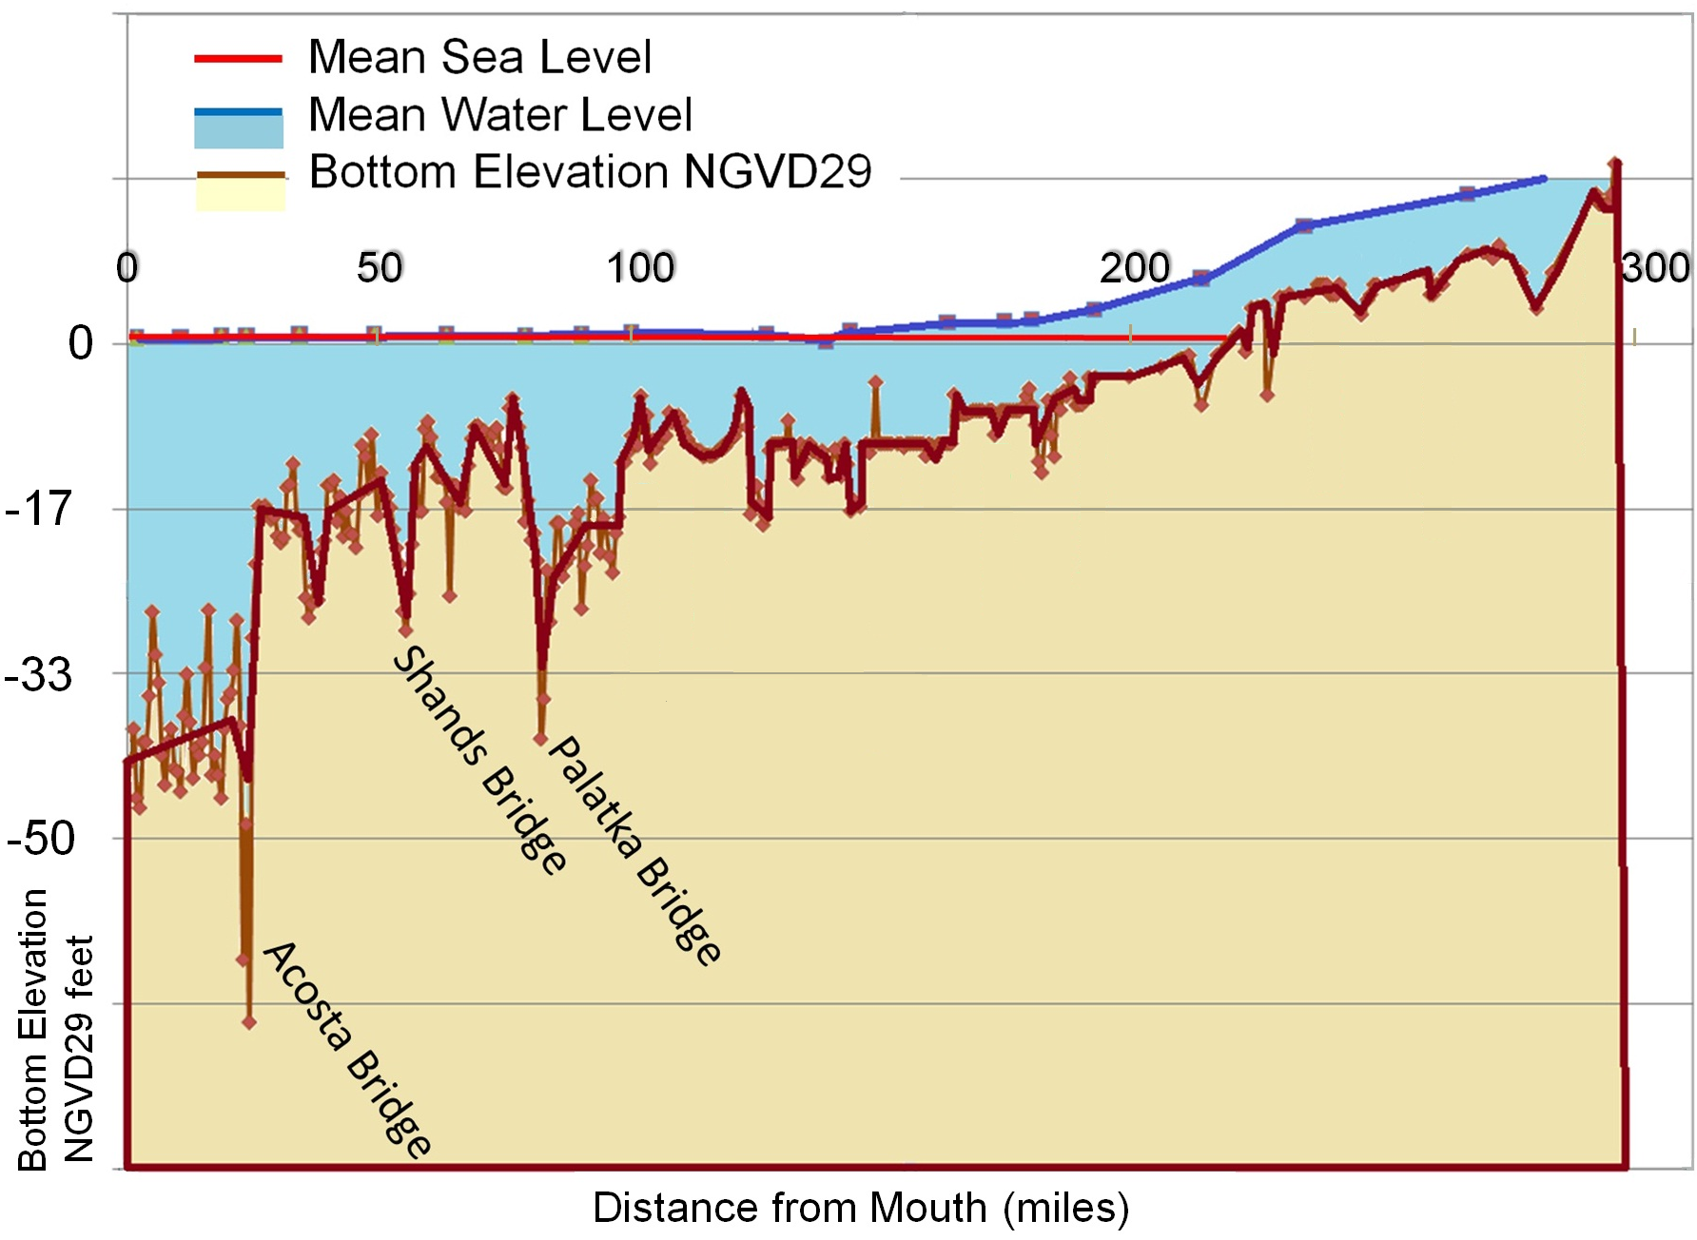
SJR Transect Bottom Elevations
0
50
100
200
300
0
Blue Cypress Lake
Lake Poinsett
Lake Washington
-17
Lake Harney
Lake Monroe
Lake George
-33
-50
Bottom Elevation
NGVD29 feet
Distance from Mouth (miles)

Slide 15
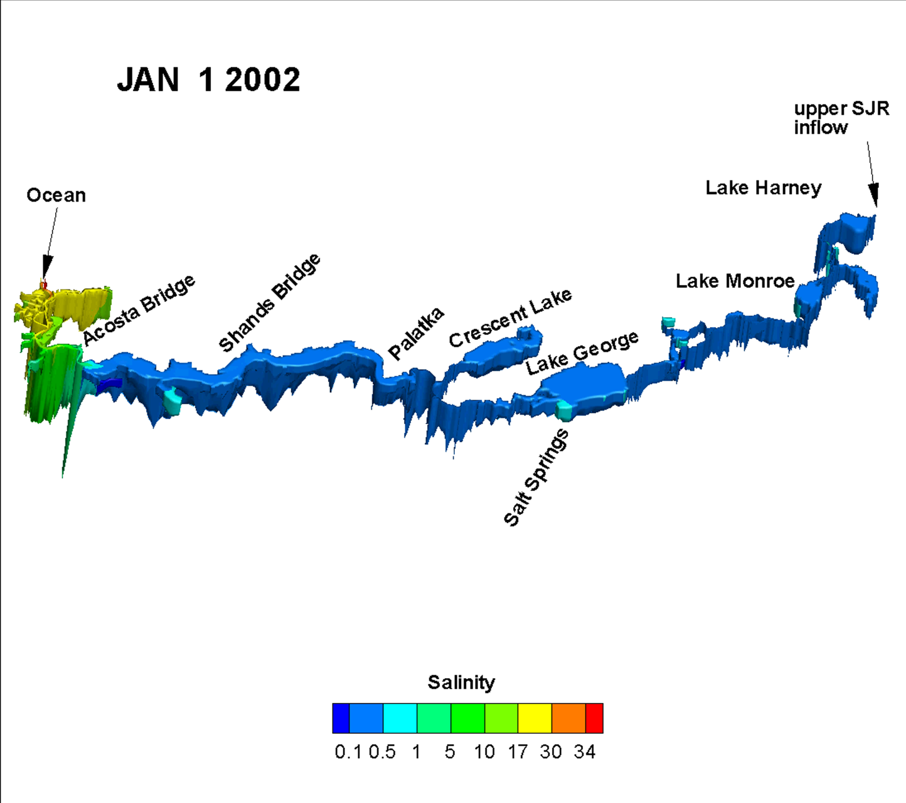

Slide 16
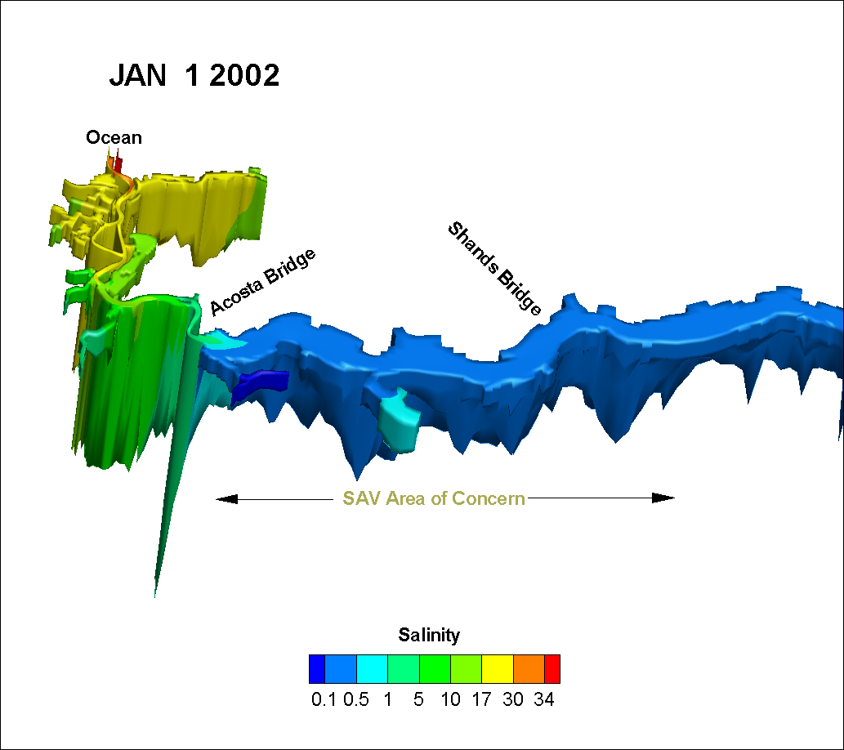
St. Johns River Salinity January 2002

Slide 17
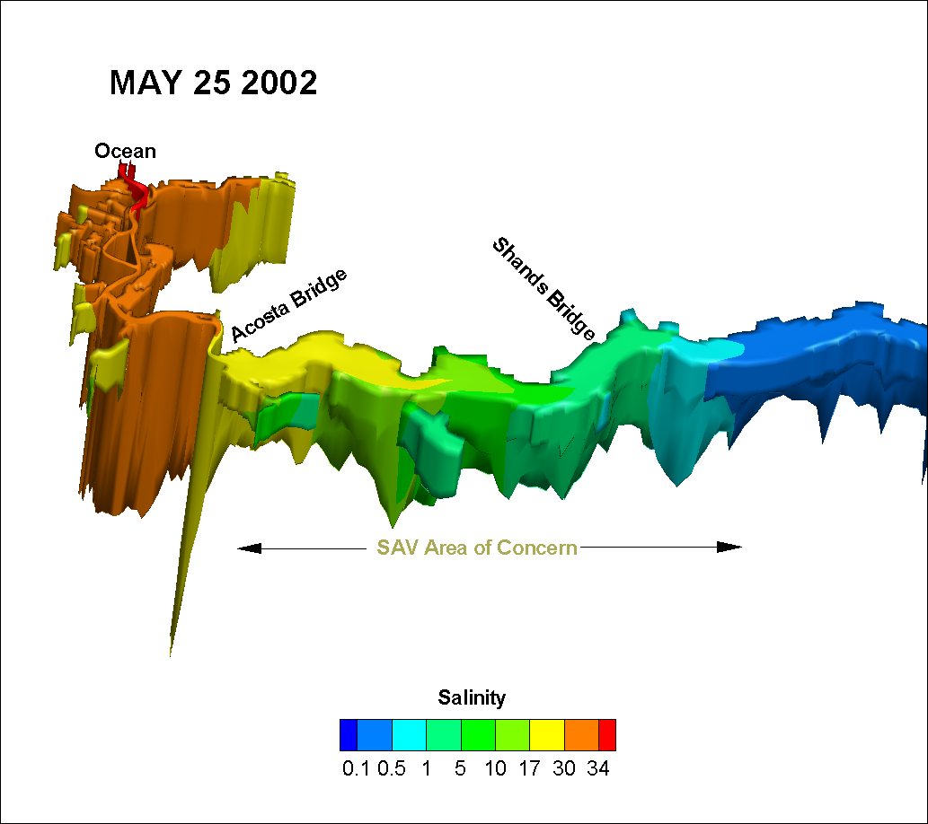
St. Johns River Salinity May 2002

Slide 18
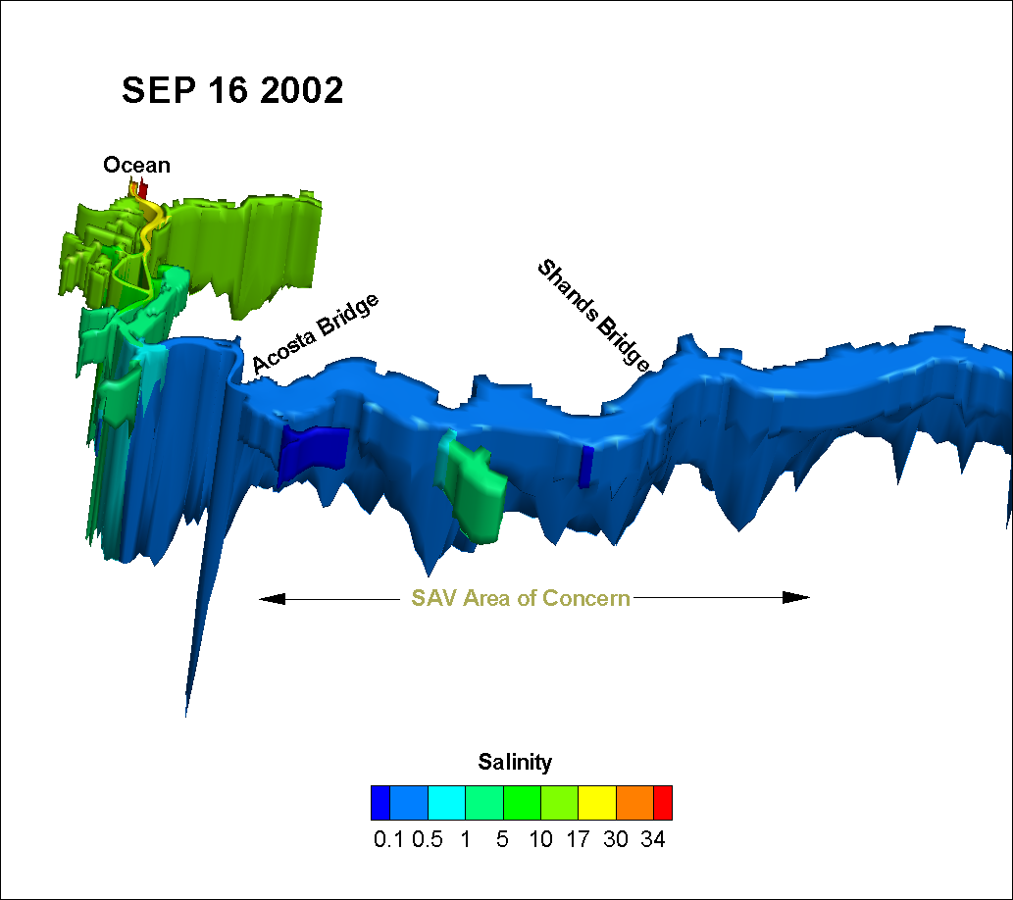
St. Johns River Salinity September 2002

Slide 19
Water Level differences for Forecast Scenarios
Total
+14 cm SLR
Land-Use
Projects
+155 mgd withdrawal
Lake George
Lake Monroe
Lake Harney
Acosta
Shands
6
4
Water Level Difference (in)
2
0
-2
0
100
200
300
Distance from River Mouth (miles)

Slide 20
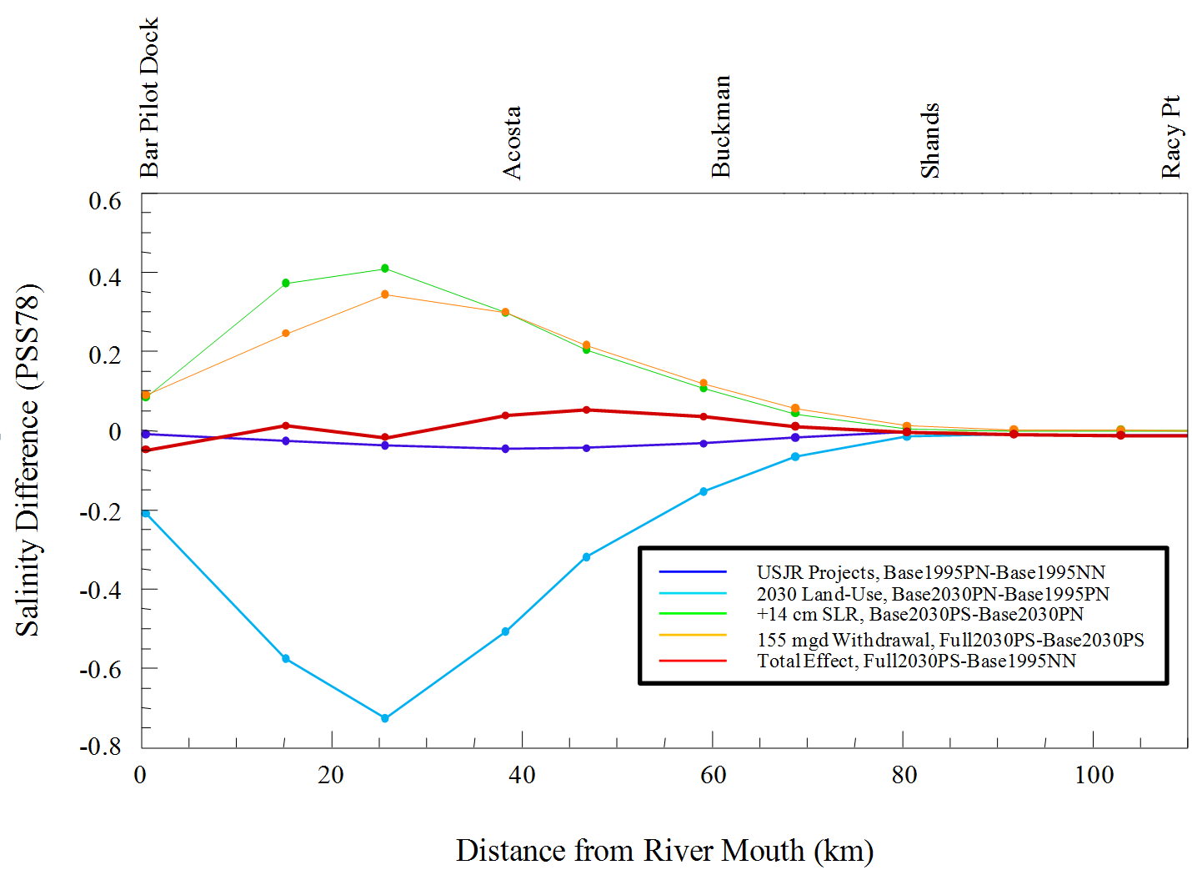
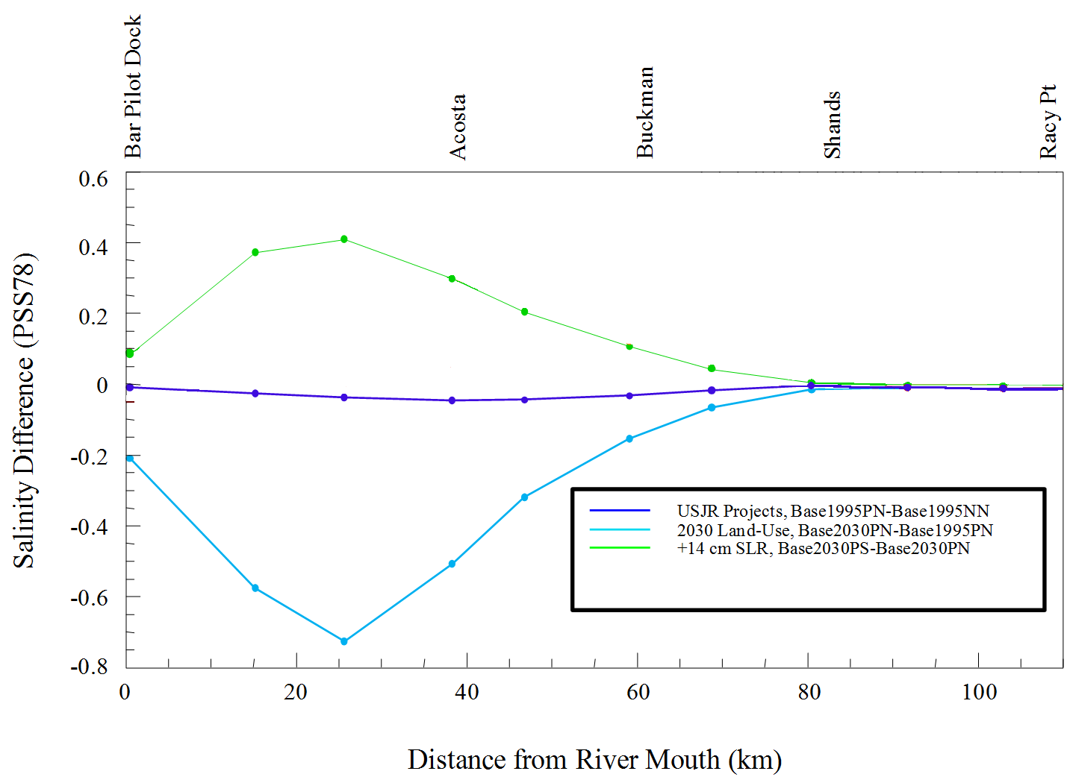
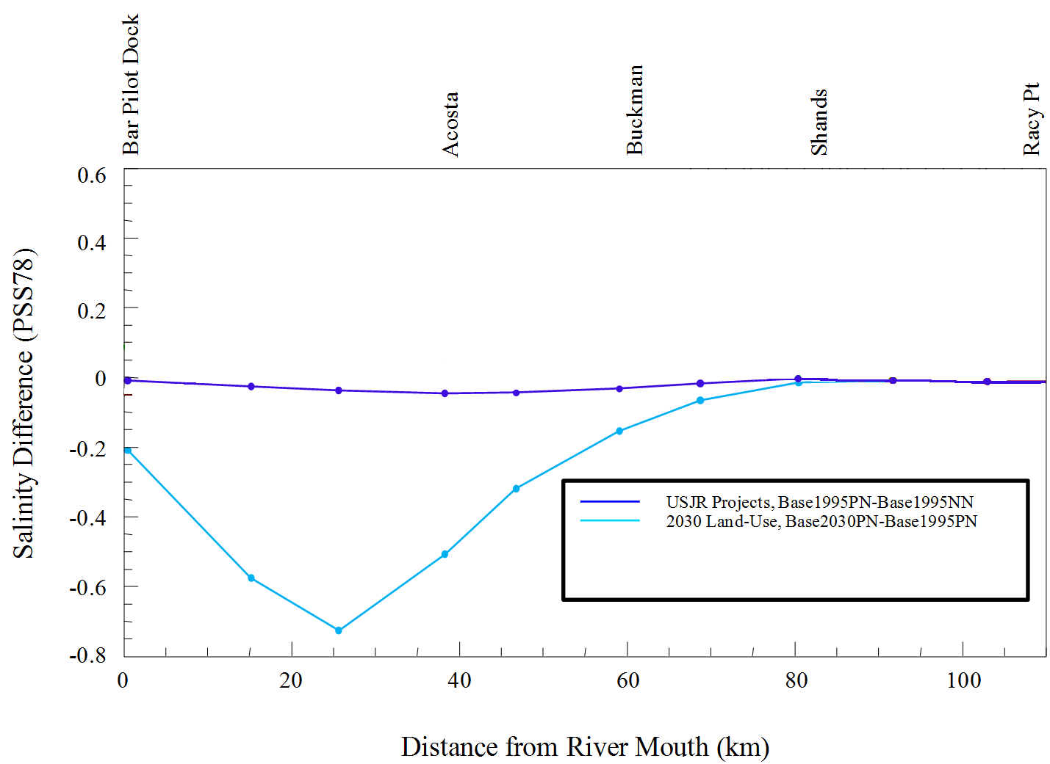
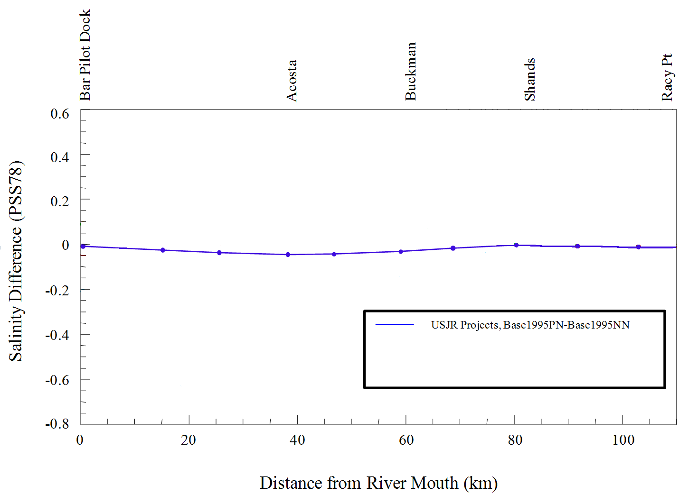
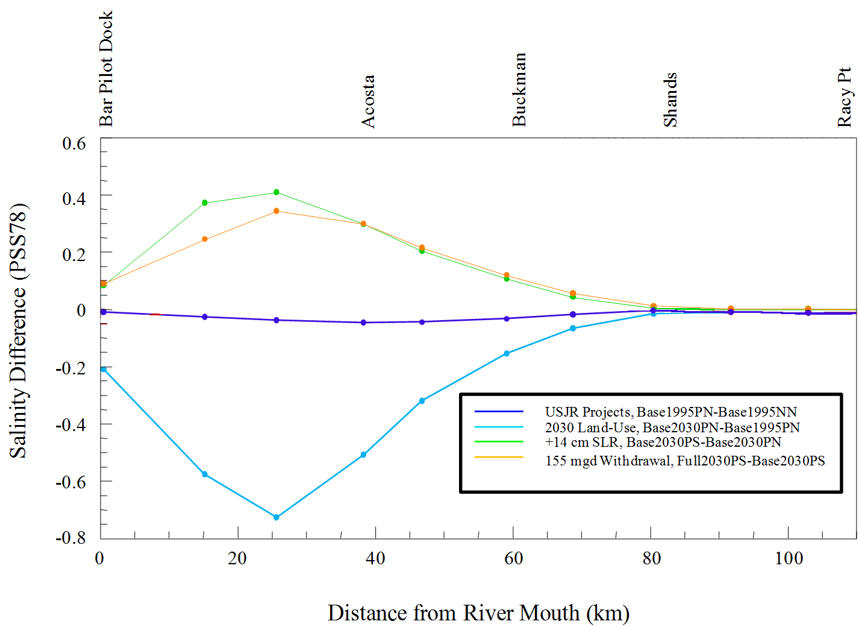
0
10
20
40
60 Miles
Distance from River Mouth (miles)

Slide 21
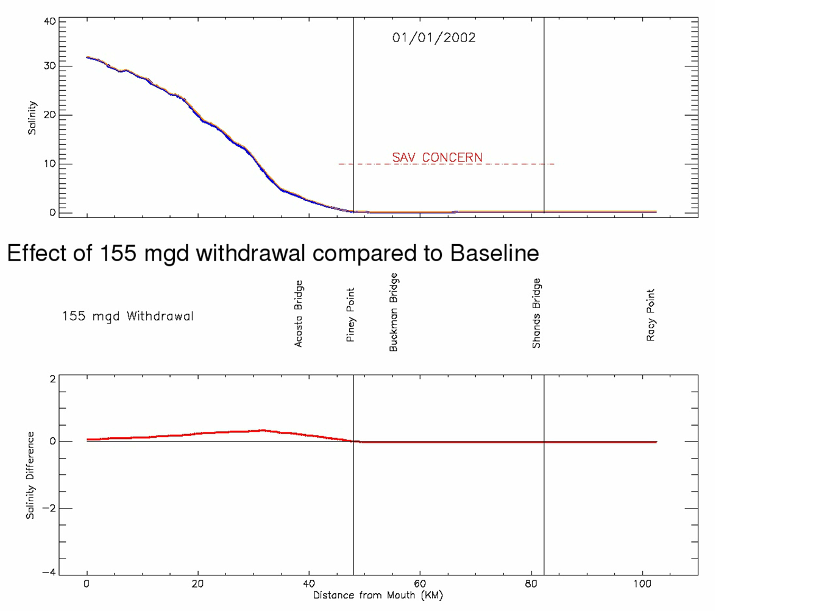

Salinitiy Animation title slide
Ocean
Simulation Date
Baseline
SAV
Stress
Withdrawal
Effect {
Scale
Ocean
Jacksonville
Ocean
0
10
20
40
60 Miles
Distance from River Mouth (miles)

Slide 22

The Next Step Was to Evaluate Hydroecological Effects
Assessing ecological change resulting from changes in river flows and levels

