Slide 1


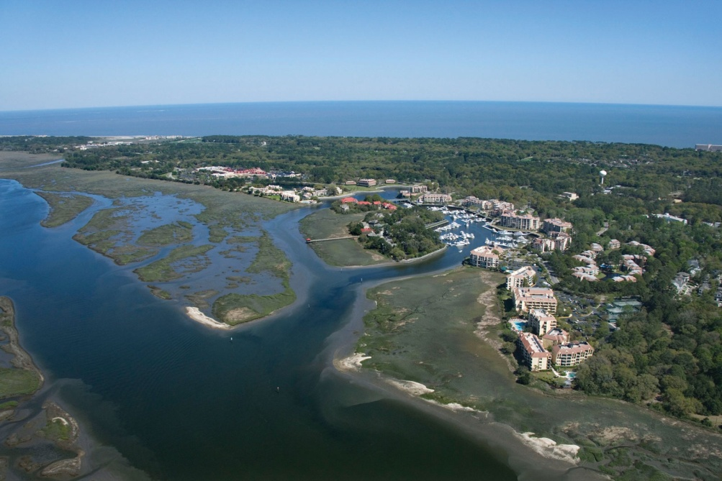
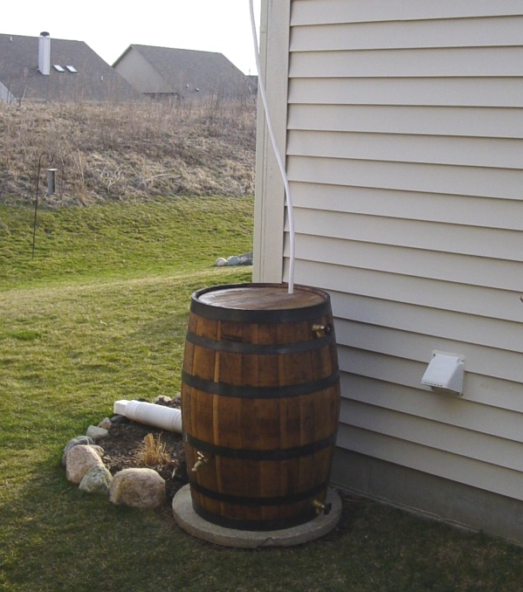
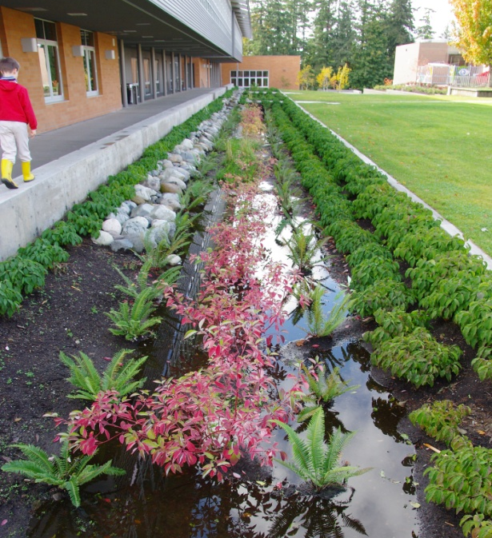
Watershed and Modeling Efforts With Economic Benefits
~ Greening in a Tough Economy ~
Dave Briglio, PE & Sam Arden, EI
August 17, 2012

Slide 2
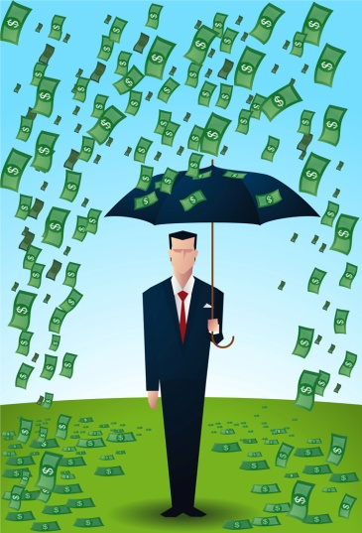
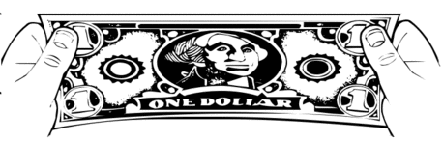
Talking Points for Today
Everything has value...But is it enough?
Support for Green Infrastructure and LID
It’s always a “green thing”….
Technology, models & “App’s”
New?..Or a new use?
Project examples with hidden value
Monetary & intrinsic value (ROI)

Slide 3
What is the Mission?
Fix it all now?...Or get started, and keep going?
Regulatory requirements (lawsuits)…
Analysis paralysis…
Measuring progress…
Learning hurts…
What’s it worth?
To you?...Them?...Us?

Slide 4

What is the problem?
What do I do about it?
Same as always – don’t loose focus
Collect enough data
Perform enough analyses
Take a smart step forward quickly
Keep moving
BUT…It all depends on the “ROI”

Slide 5
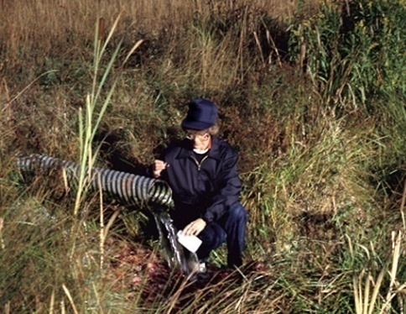
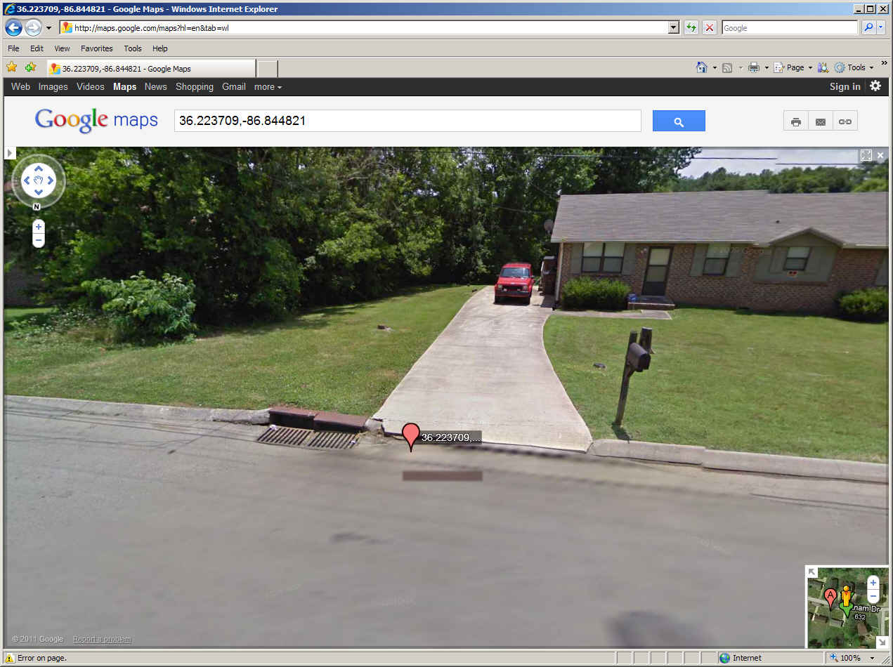

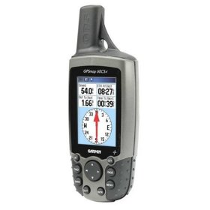
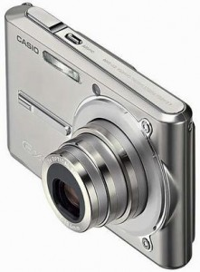

Data
How much is enough?
We need trends and magnitudes
Sampling for $1?
We can do more from our desks
Thank you Google!
We can do more with our phones
Apps are here

Slide 6
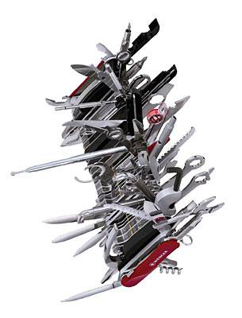
Analyses
Which tool?
One that fits with available data…
…can be used for development
…can promote action,
not more data collecting or modeling
Potential Opportunities
Blend water quantity and quality goals
Assess project value better
Get “credit” for more actions

Slide 7

Return on Investment (ROI)
What is “it” worth to you?...
Monetary
Prevention of loss (property, service)
Spending less on construction (efficiency)
More income (rent, revenues)
Property value increase (equity)
Intrinsic
Something other than money…

Slide 8
Return on Investment (ROI)
Intrinsic Valuation – Total Economic Value
Use Value
Direct Use
Recreation
Mobility
Production
Indirect Use
Env. function
Health risk avoidance
Living condition
Investment Value
Job creation
Land and facility value

Slide 9
Real Life Examples
Get some perspective, see where you find value
In-sourcing
Increased knowledge and control
Simplifying
Find the direction & a “good” step forward
Phasing
Generational problems take time to correct
Leveraging
Existing programs
Academia, volunteers & local champions

Slide 10
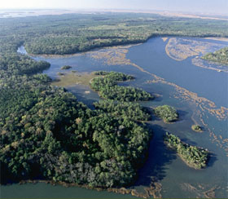
An Industry (and Image) at Risk…
May River Watershed Action Plan
Save the May River, open the oyster beds
Utilize existing info – apply common sense
Continue with Town resources
Get local support to implement
Value was found in many places
Existing CIP & 319 Grants
In-house staff skills
USCB collaboration
Opponents became supporters

Slide 11
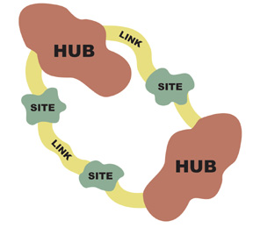
Assessing Potential…
NRCS Fisheating Creek & Scarborough & Sons Ranch
Improve the watershed by…
Restoring the wetland water quality
Managing flows & potential diversions
We found a tool help with development
Off-site treatment?
Financial opportunity?
Credits for TMDLs and BMAPs?

Slide 12
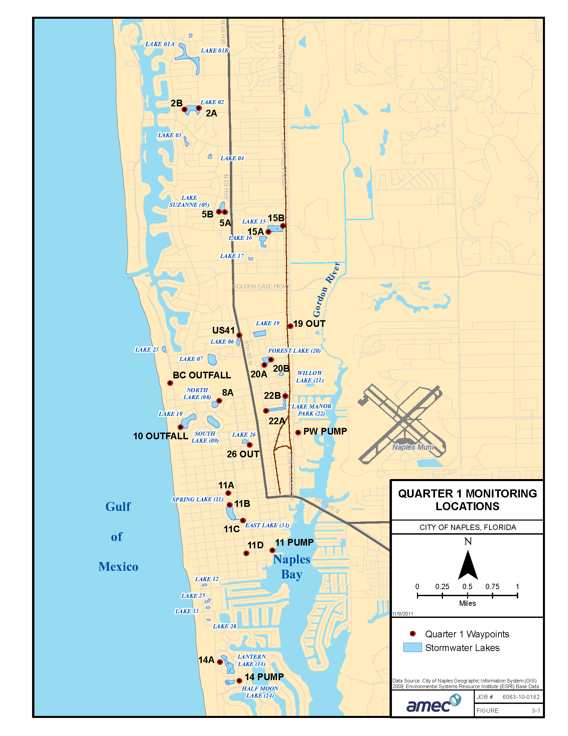
Moving Forward…
City of Naples Watershed Management Plan
28 stormwater lakes
Some historic WQ data
New quarterly samples
Downstream impairment
Prioritize future budgets!

Slide 13
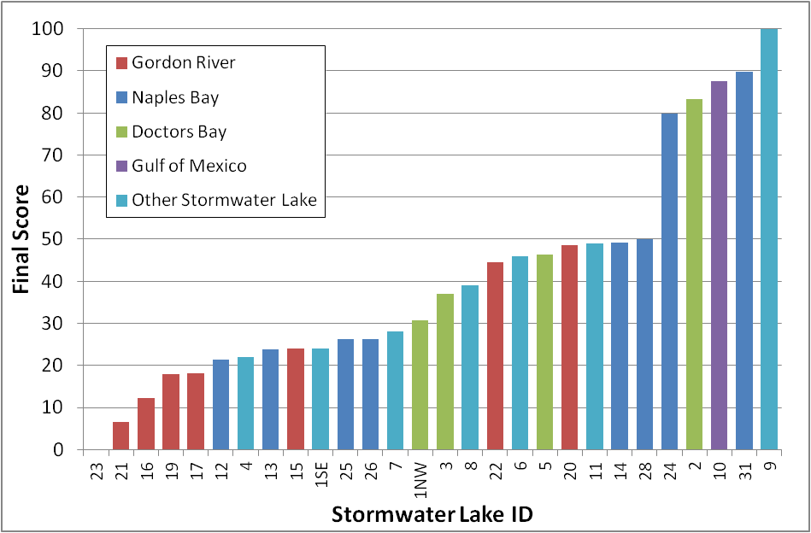
Moving Forward…
City of Naples Watershed Management Plan
?

Slide 14
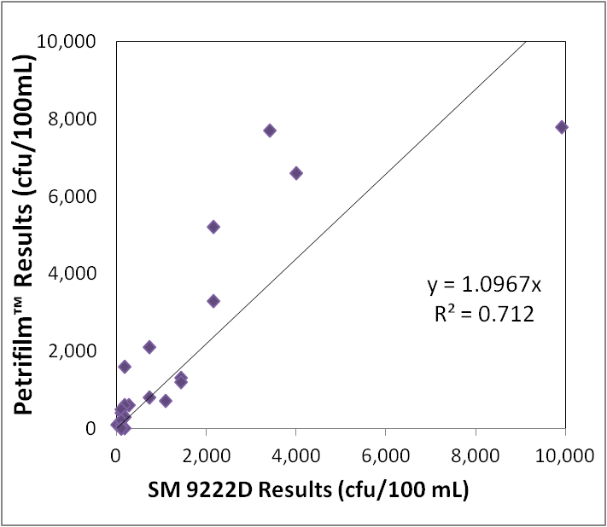
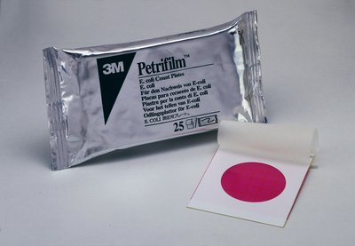
Moving Forward…
City of Naples Watershed Management Plan

Slide 15
TMDLs That Lead to Free Money…
319-Program Grants
Fear turned into an opportunity
Farm Plans and Septic Tank Repairs
60%-90%-100% funding
Businesses & residents happy
Green side of the community saved
Grants can win grants

Slide 16
TMDLs That Lead to Free Money…
And a Free Video, that keeps on giving...
Meeting turnouts low…need people to join us!
How much is too much $?
Must look good…but not “too” good
We used internal resources:
Our experts + regional videographers
County Staff wrote the script
Grant participants were the “actors”

Slide 17
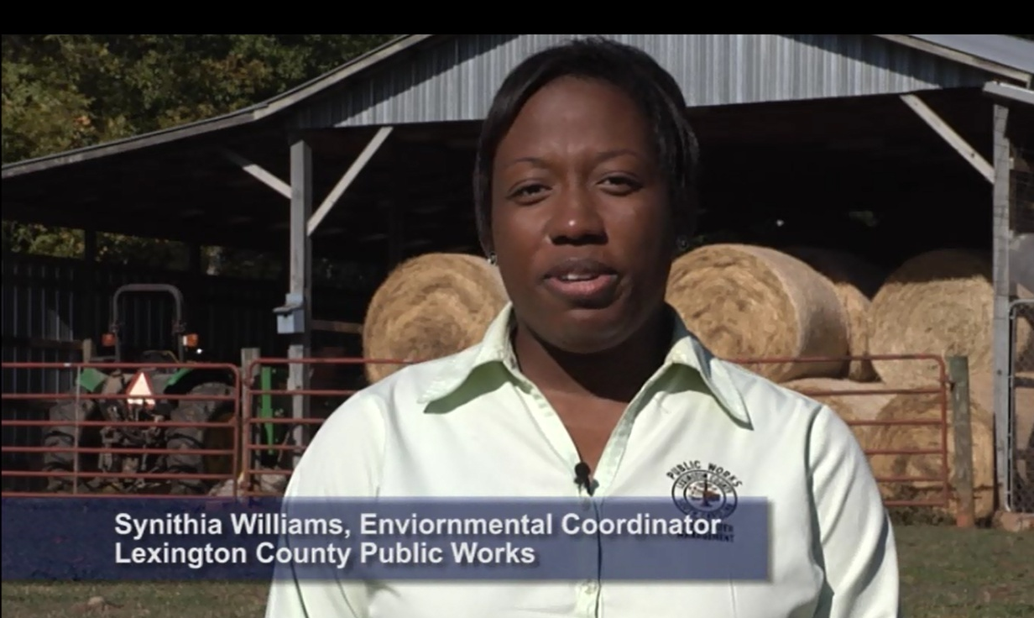
Our Video…

Slide 18
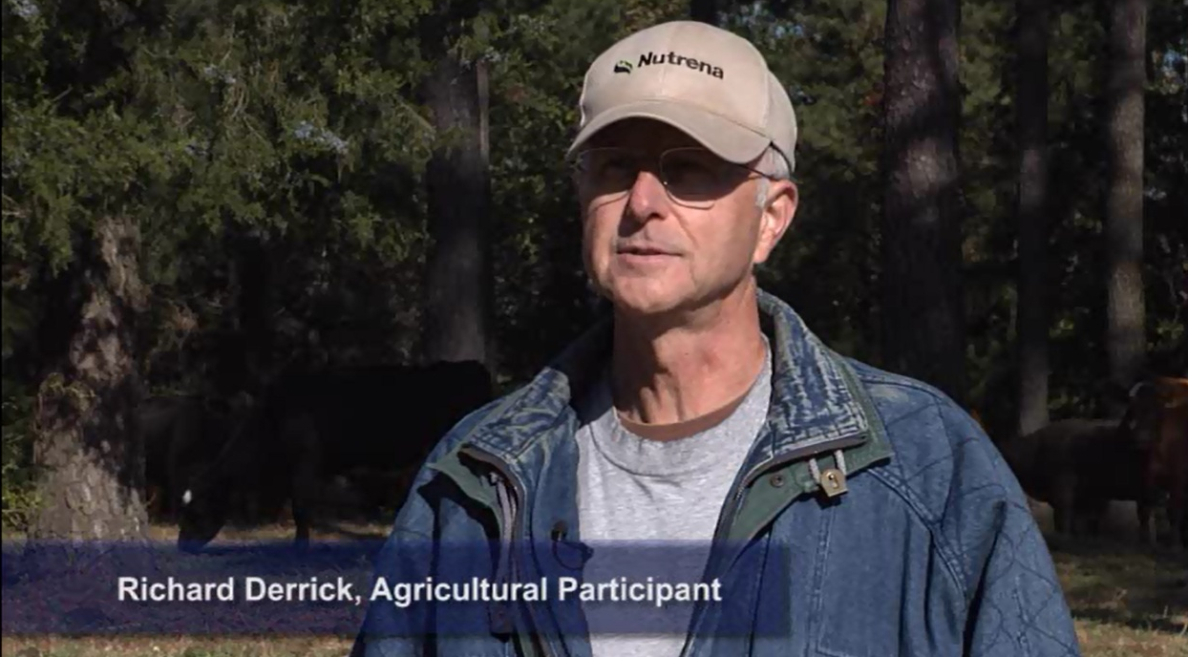
Our Video…

Slide 19
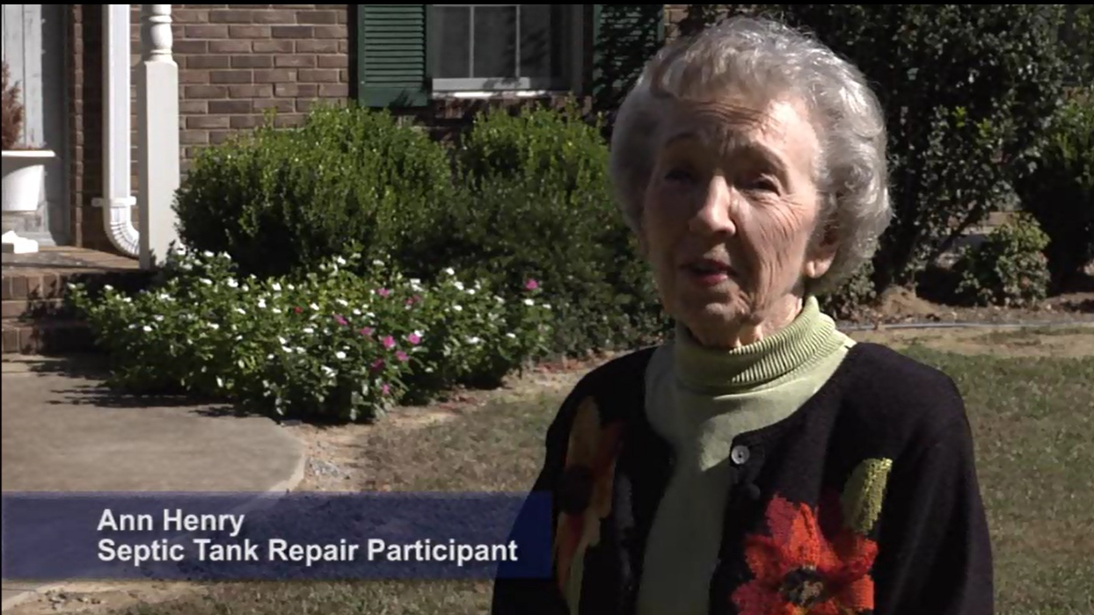
Our Video…

Slide 20
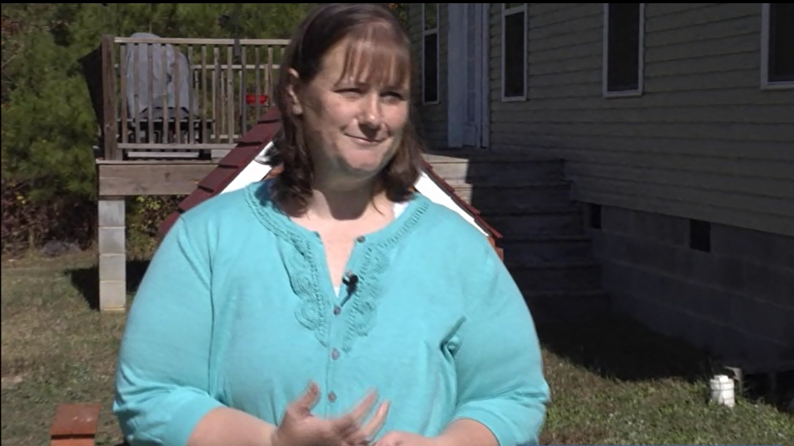
Our Video…

Slide 21
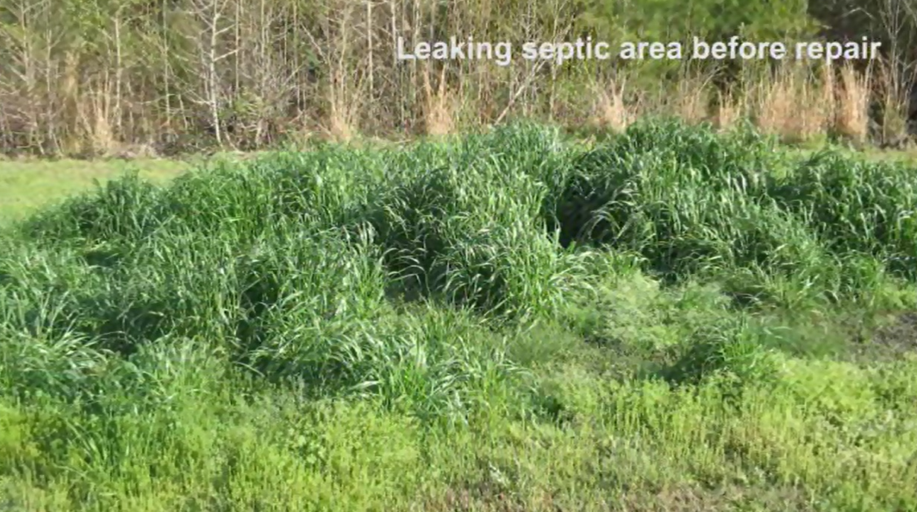
Our Video…

Slide 22
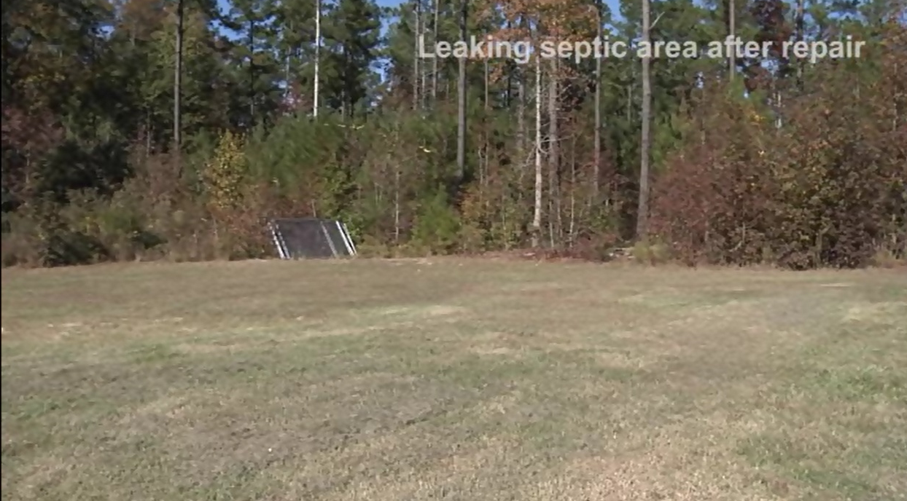
Our Video…

Slide 23
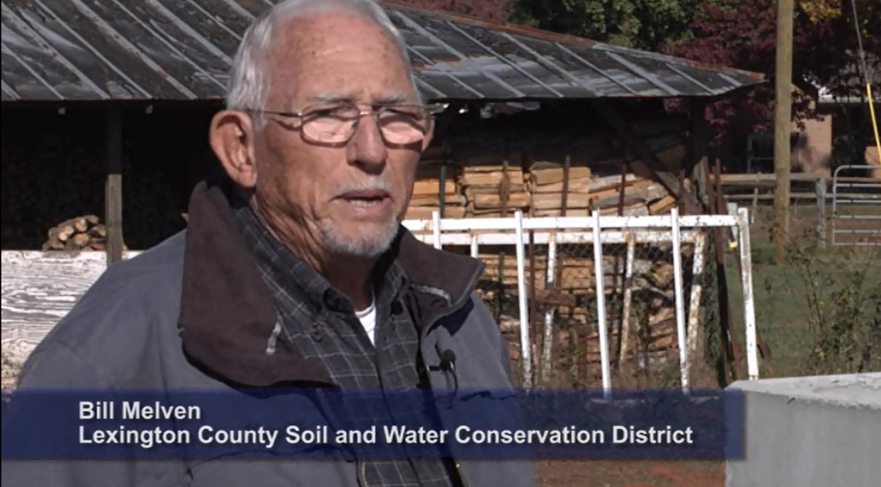
Our Video…

Slide 24

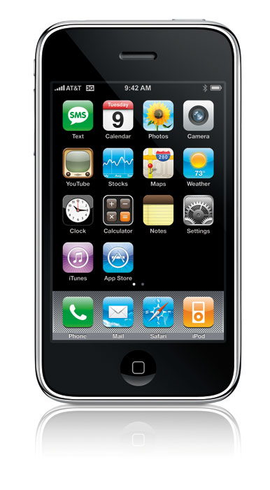
Do More With Less…
Smartphone capabilities

Slide 25
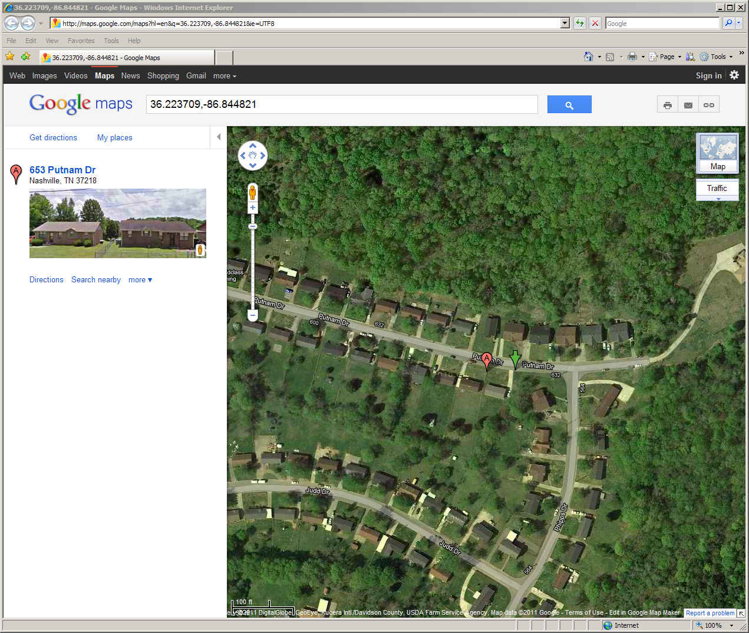
High Accuracy, High Confidence…

Slide 26
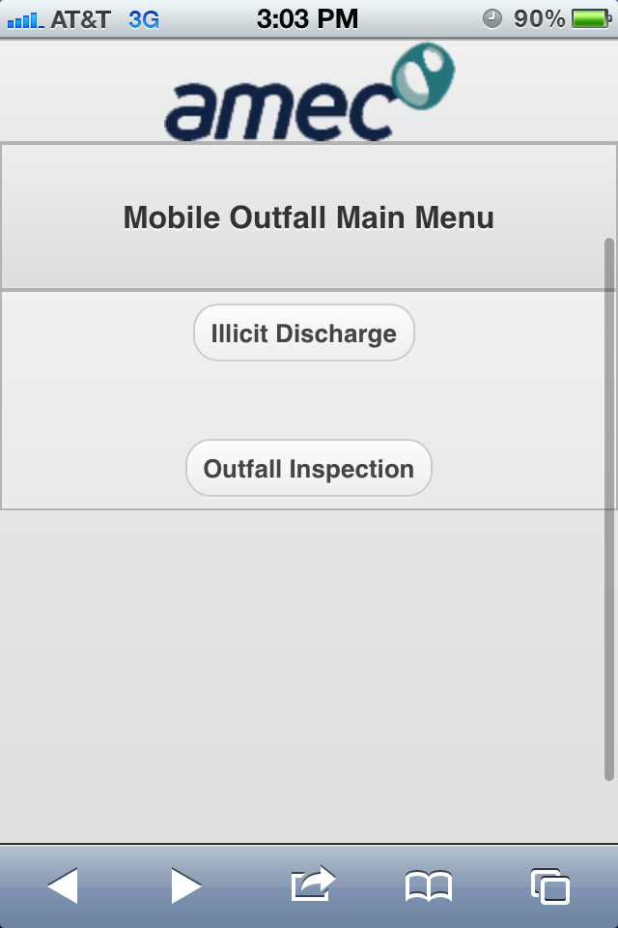
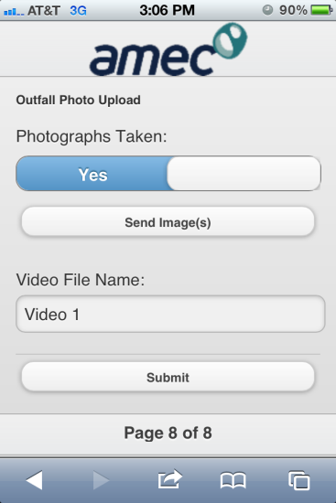
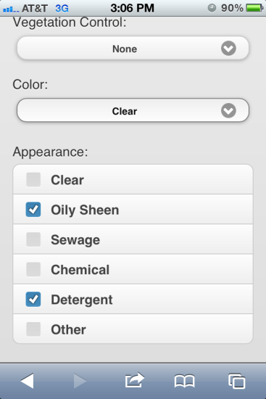
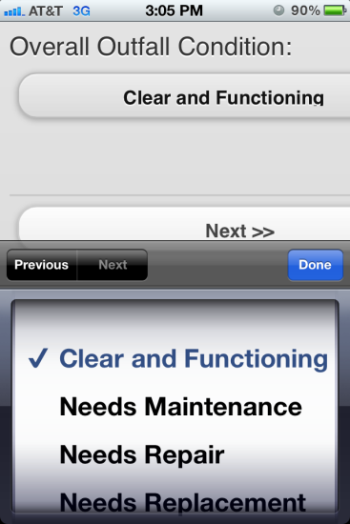
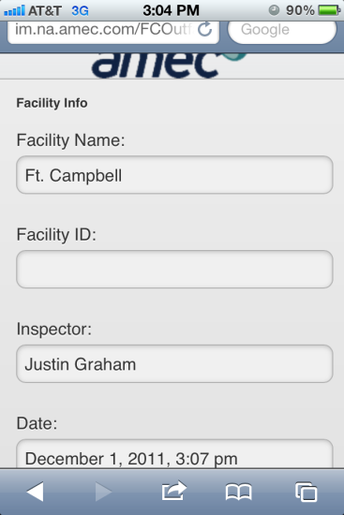
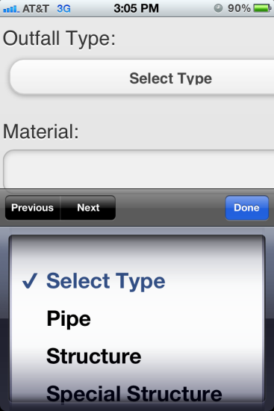
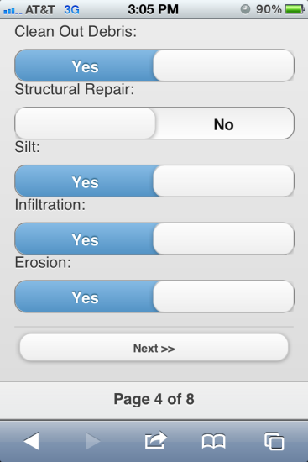
Outfall Inspections or Anything Else…
im.na.amec.com/outfall
Username – demo
Password – demo

Slide 27

…Including LID/GI Initiatives
Going green can save/make you money
It’s now EASY(-er) being green!!
More community credits for the BMAP w/o tax payer funds
Connect the User Fee and LID Manual
Continuous simulation to see what the real “baseline” condition is…are you impacting, breaking even, or improving?
Find a reduced “burden” to encourage redevelopment…and address TMDLs

Slide 28
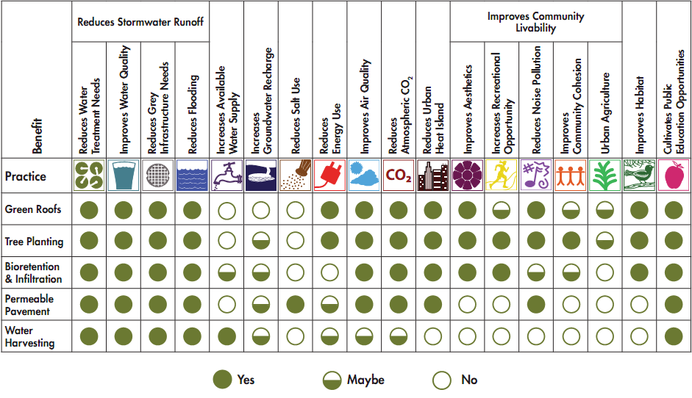
LID/GI Initiatives
Going green has value

Slide 29
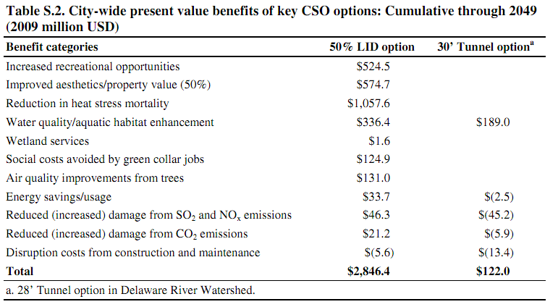
LID/GI Initiatives
23:1 ROI over a grey solution

Slide 30
Strive for a better ROI
Support to spend money wisely...
Use advances to spend less money…
Collect more data faster, cheaper…
Receive benefits sooner…
…to stop damages
…to stay/get in compliance
…to continue to grow

Slide 31
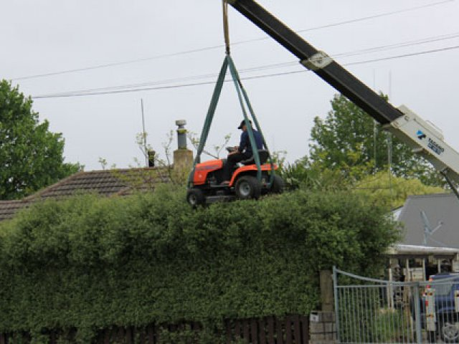
QUESTIONS?
Dave Briglio, PE: dave.briglio@amec.com
Sam Arden, EI: sam.arden@amec.com
~ Greening in a Tough Economy ~

