Slide 1
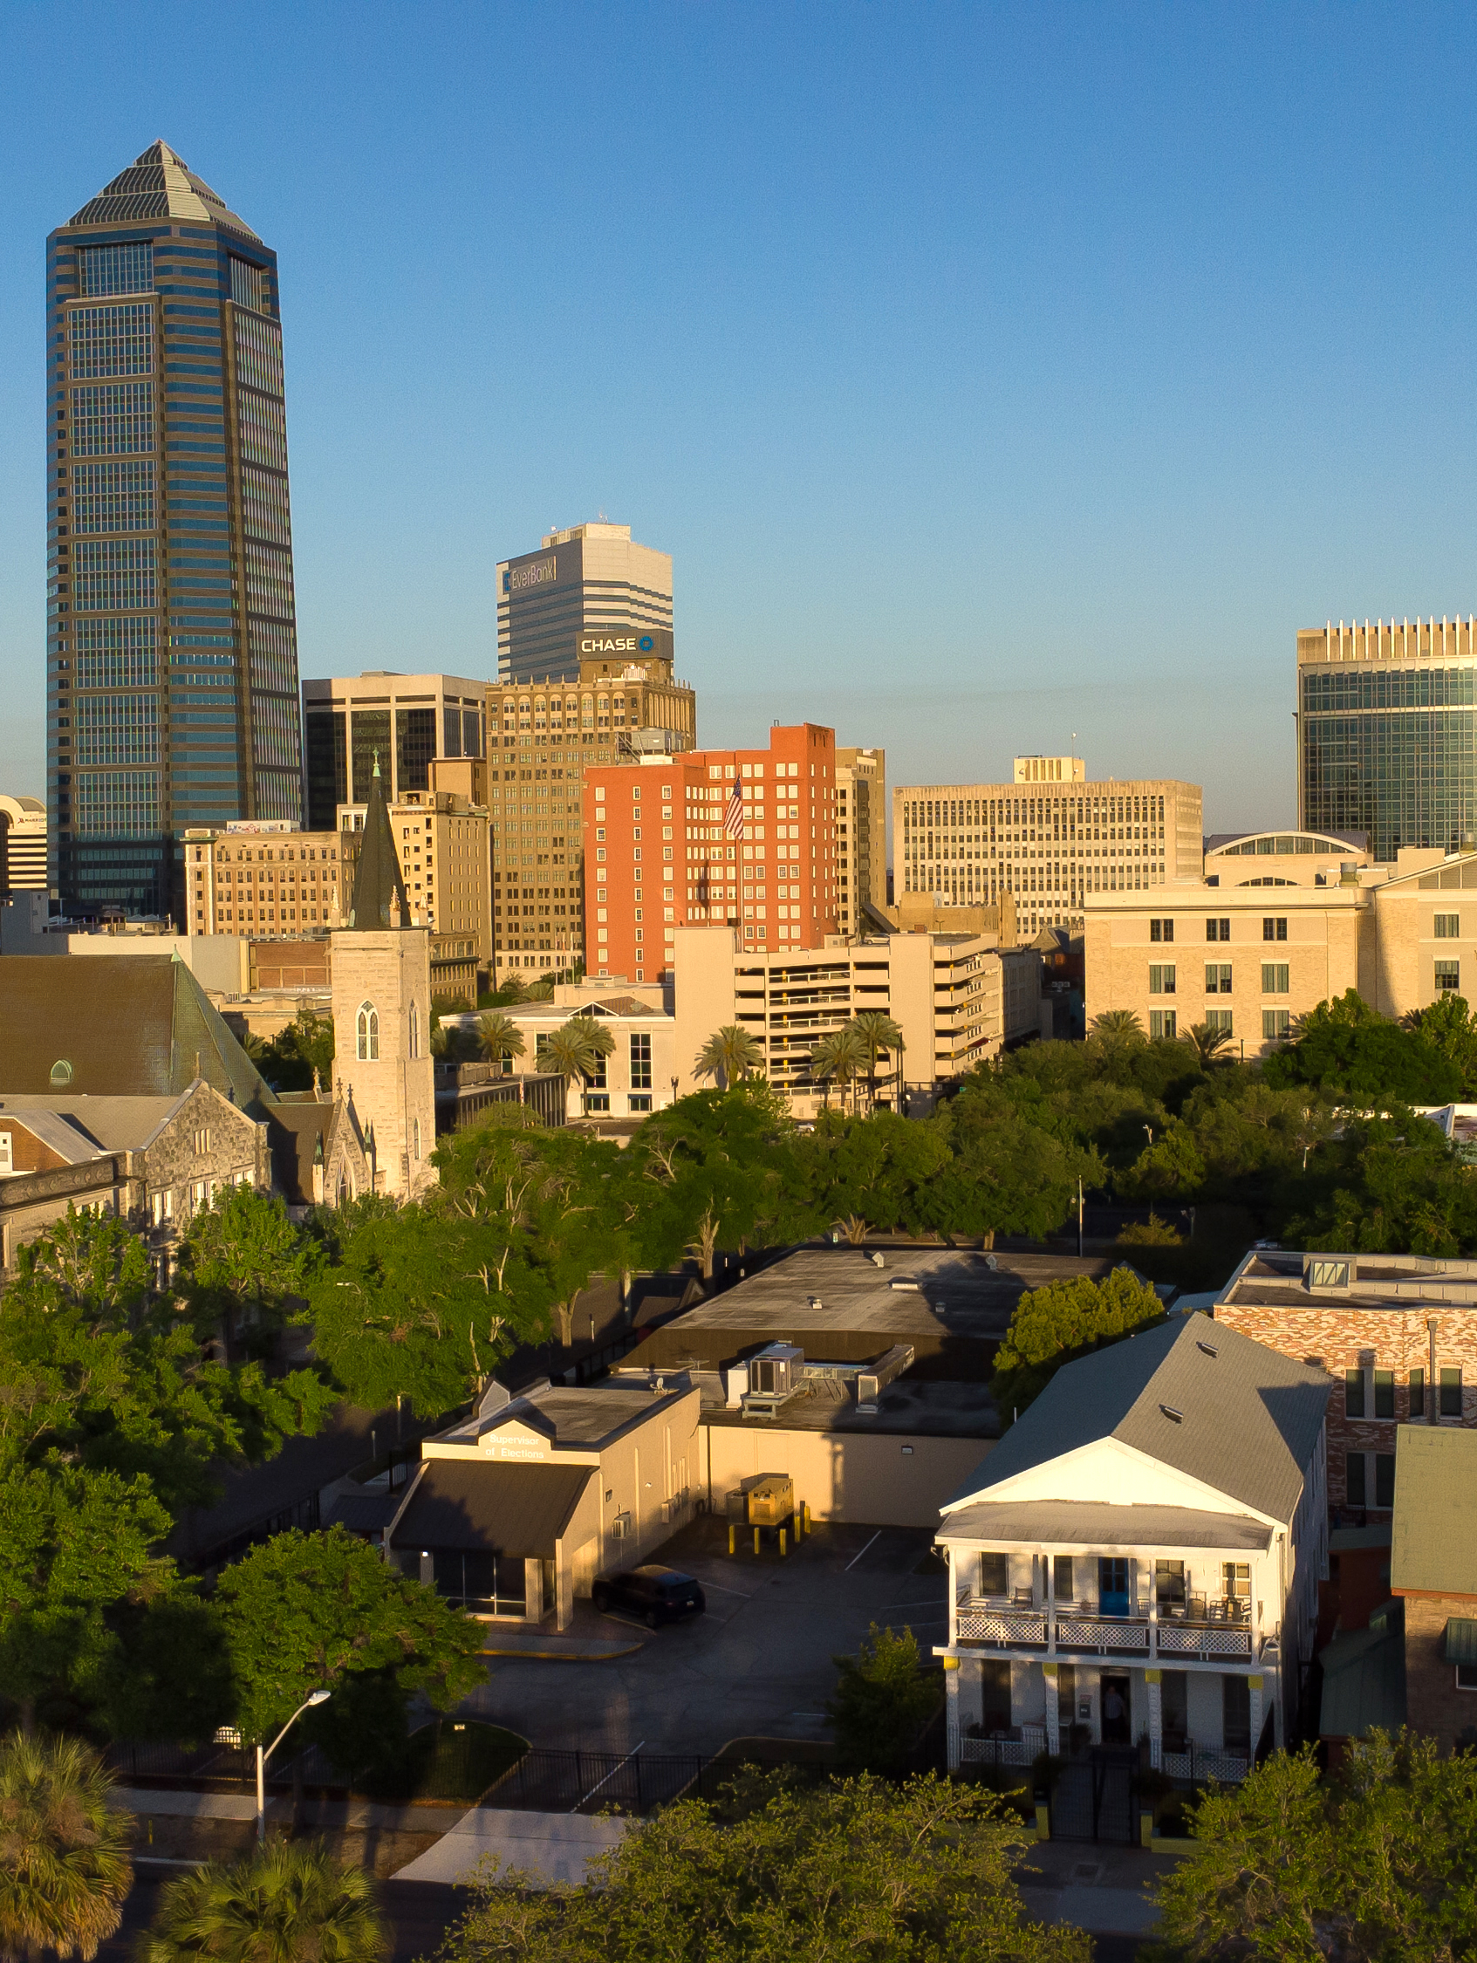

A Jacksonville You Can Afford And Be Proud Of
Promises Made | Promises Kept | What’s Next

Slide 2
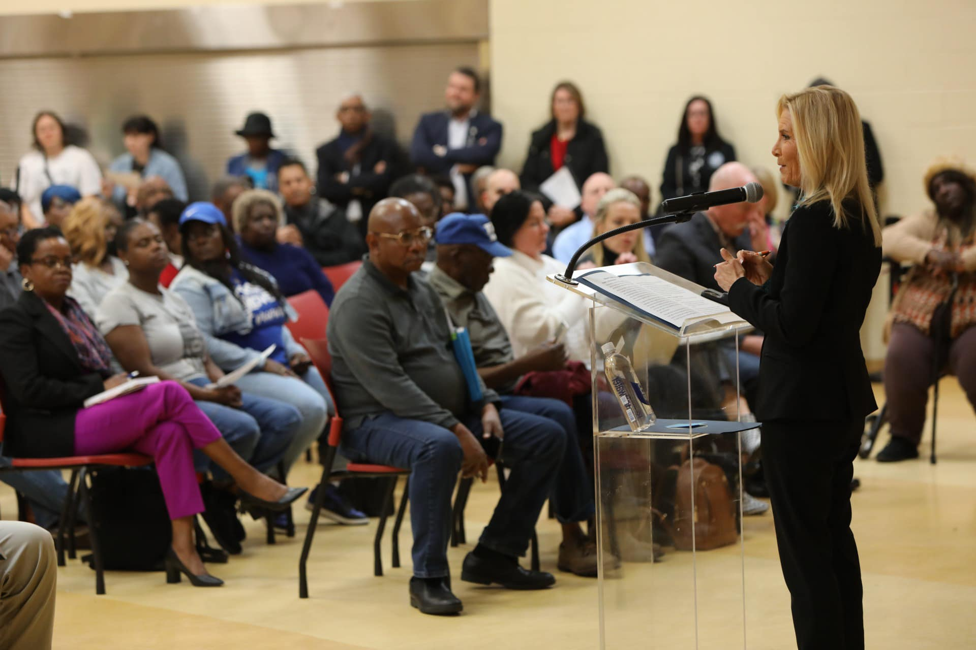



Why These
Townhalls?
Jacksonville is growing — fast
Housing affordability
Underserved
Neighborhoods
Underserved
Neighborhoods
Health Care Access
Infrastructure
Infrastructure
Infrastructure
A Jacksonville You Can Afford And Be Proud Of

Slide 3

Promises Made
1
Fight Hunger
2
Expand Affordable Housing
3
Improve Healthcare Access
4
Invest in Neighborhoods
5
Upgrade Infrastructure

Slide 4


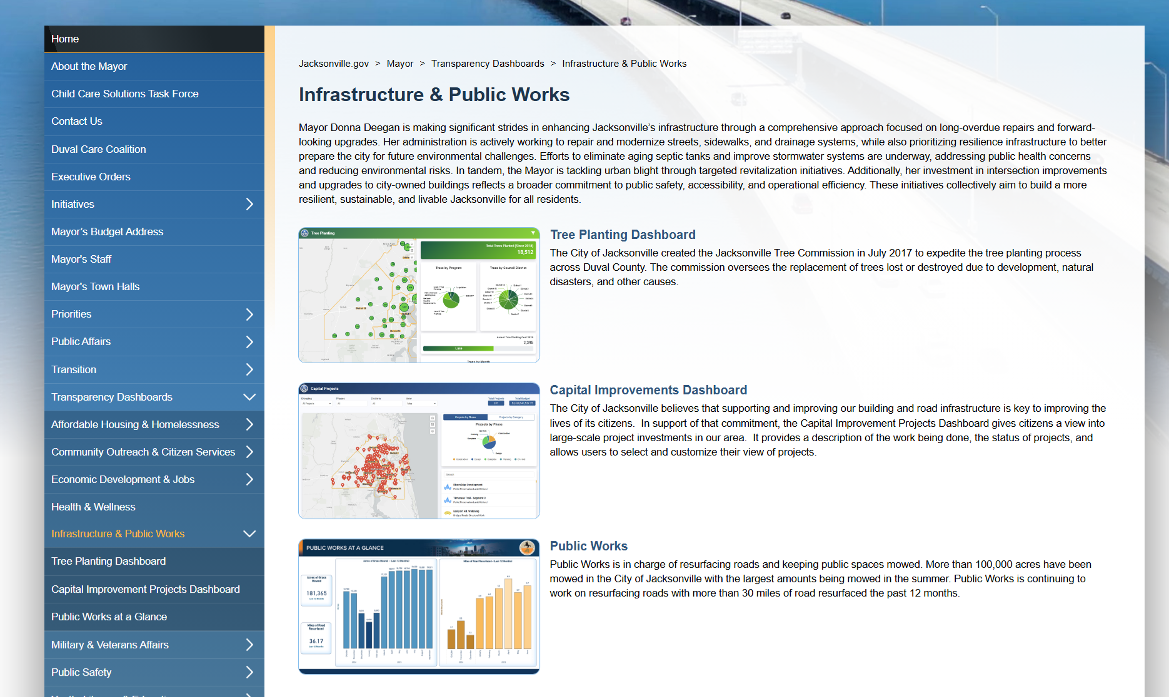
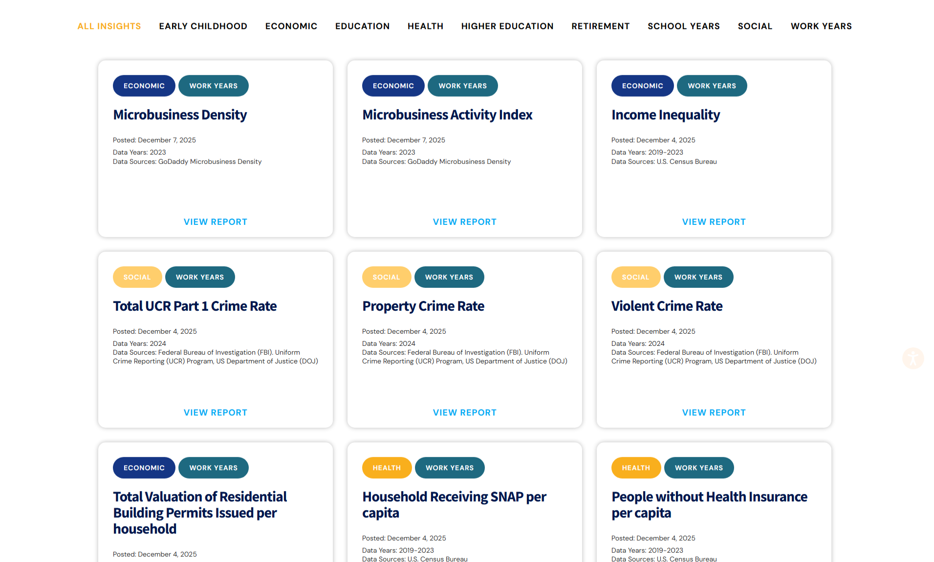
Accountability & Transparency
The Challenge
Our Response
Results
Residents want proof
- not promises
Transparency dashboards and State of Jax reporting
Clear, public tracking
of progress
jacksonville.gov/transparencydashboard
stateofjax.org
A Jacksonville You Can Afford And Be Proud Of

Slide 5
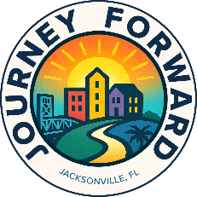

Results
Public
Safety
22 public safety recommendations are currently being implemented
Increases in first responder recruitment and retention rates
Collaboration with community partners
The Challenge
Focus on prevention, intervention, and trust-building
Residents deserve to feel safe in every neighborhood.
Our Response
Increased salary and pension benefits for first responders.
Community-led public safety approach through Journey Forward.
A Jacksonville You Can Afford And Be Proud Of

Slide 6
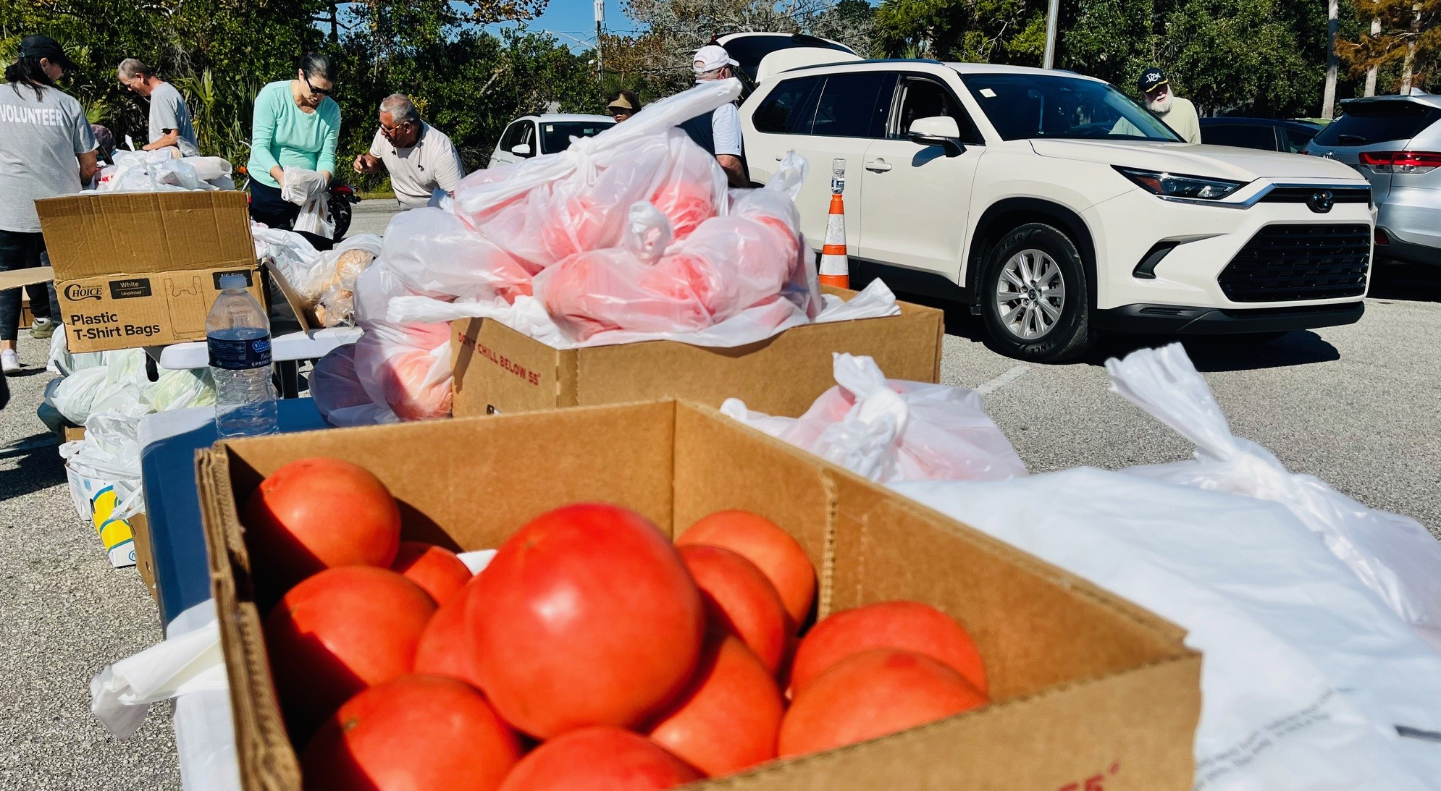
Fight
Hunger
Results
$1.7M invested in meals and elder care
$200K to Feeding Northeast Florida
Thousands of meals delivered to seniors
The Challenge
1 in 5 children face food insecurity
Our Response
Duval Care Coalition State of the Food Plan
A Jacksonville You Can Afford And Be Proud Of

Slide 7
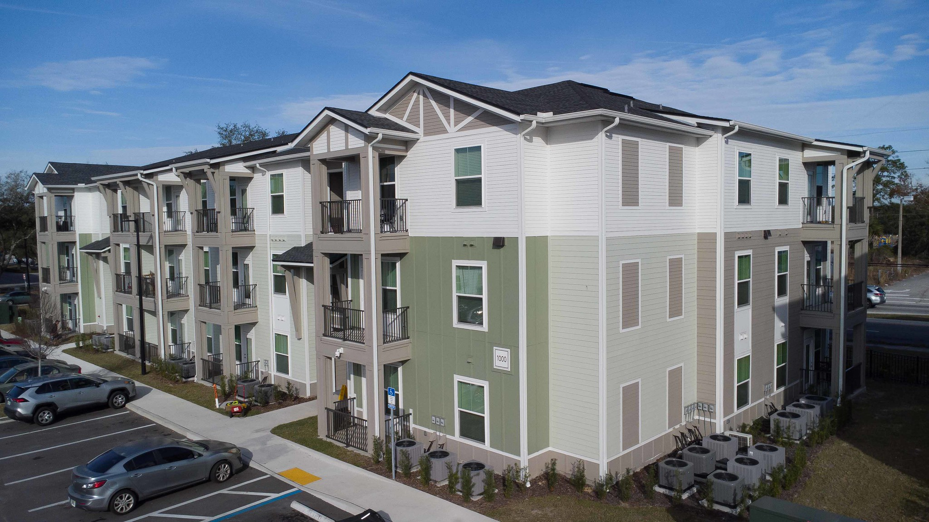
Affordable
Housing
Results
6,398 attainable housing built or approved
$2M for first-time homebuyer assistance
Emergency rent relief prevented hundreds of evictions
The Challenge
Too many families are rent- and cost-burdened
Our Response
Housing Solutions strategy
A Jacksonville You Can Afford And Be Proud Of

Slide 8
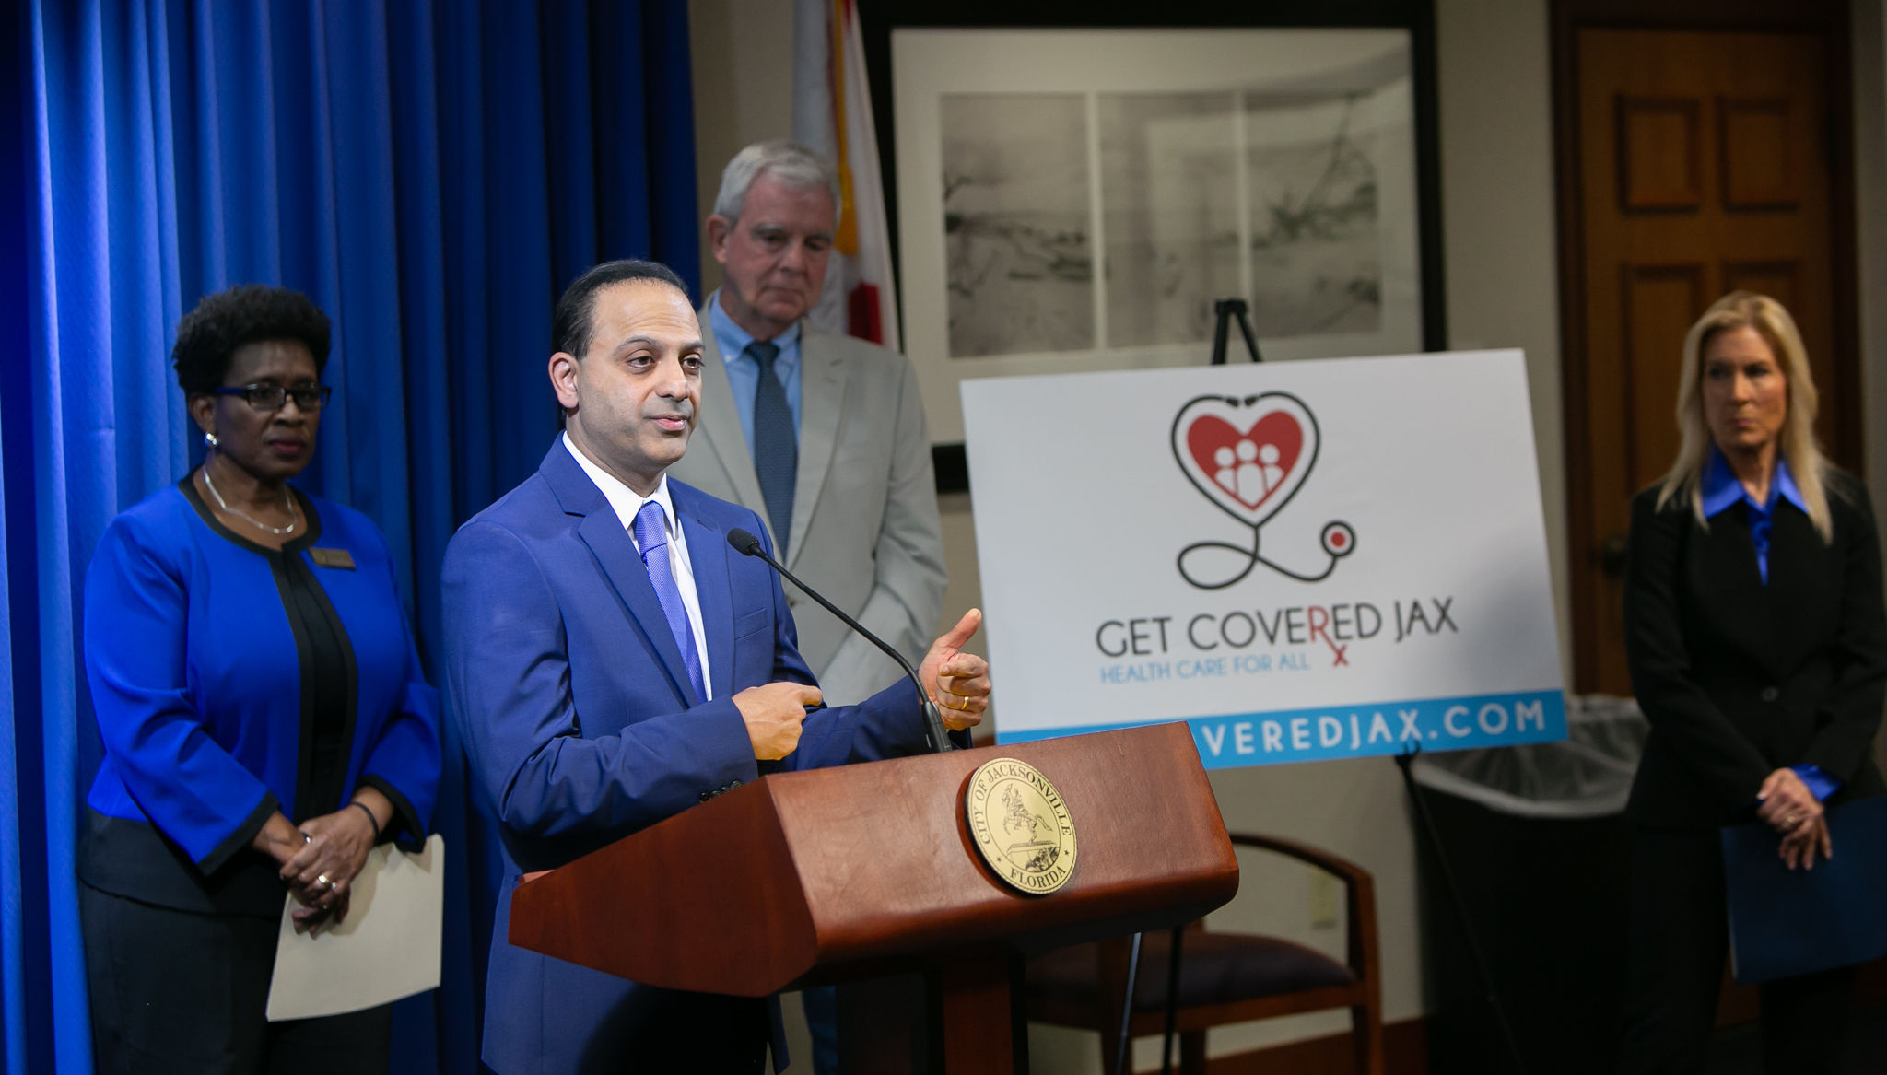
Healthcare
Access
Results
$8.7M funding increase
Uninsured population reduced by 34% in 2024
Thousands connected to care and telehealth
The Challenge
Nearly 200,000 uninsured or underinsured
Our Response
Expanded access to care
A Jacksonville You Can Afford And Be Proud Of

Slide 9
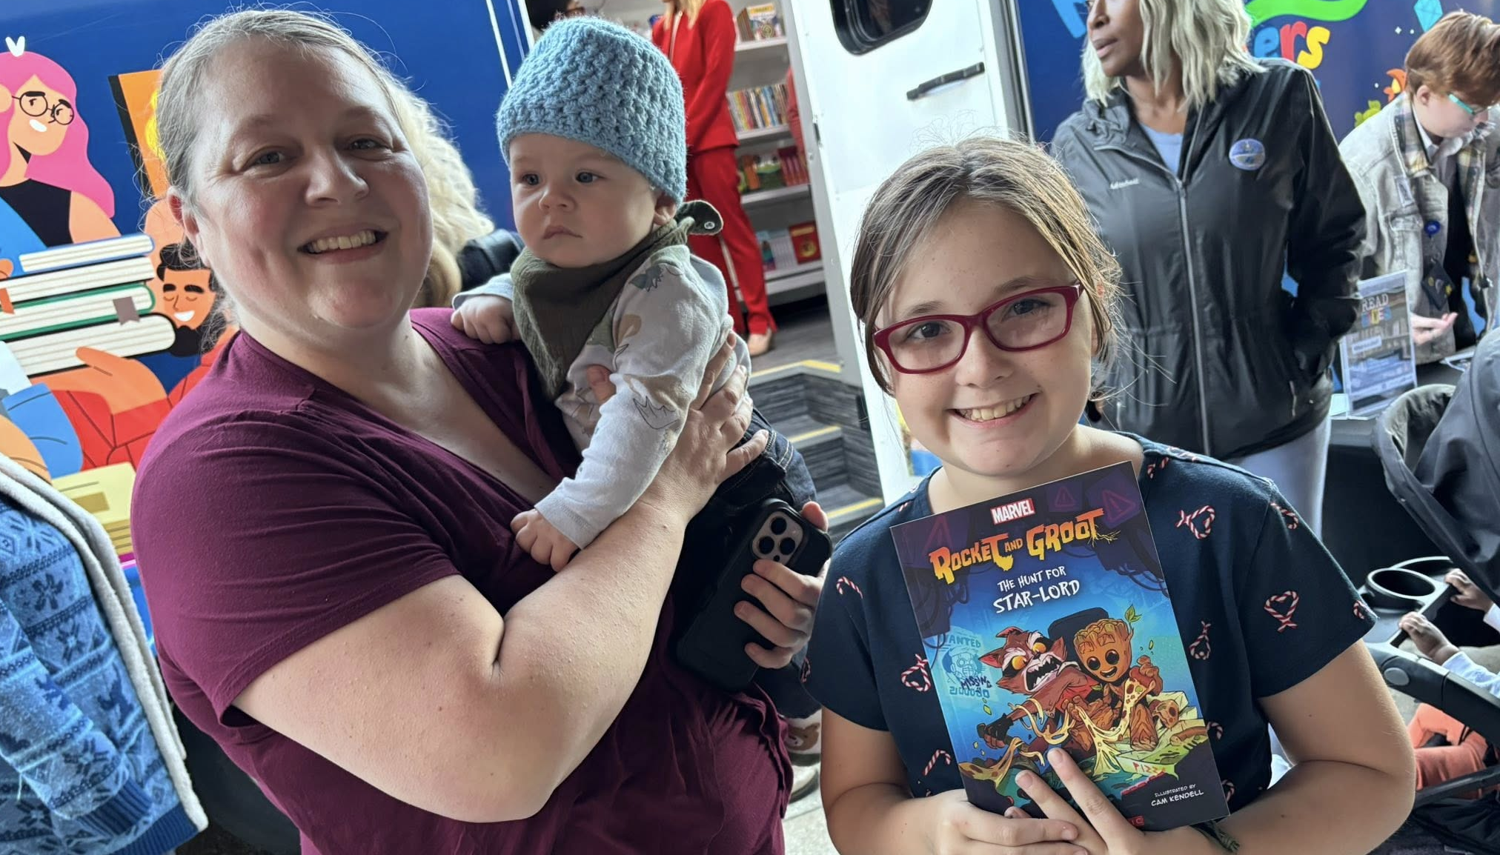
Literacy
Results
More than 3 million minutes read citywide
Duval County literacy scores above 50%
The Challenge
Thousands of new library cardholders signed via the River City Readers Bookmobile
Fewer than half of third graders are reading on grade level, making literacy a citywide priority.
Mayor’s Book Club sending a free book each month to 4-year-olds
Our Response
River City Readers and the Mayor’s Book Club, expanding access to books and early literacy.
A Jacksonville You Can Afford And Be Proud Of

Slide 10
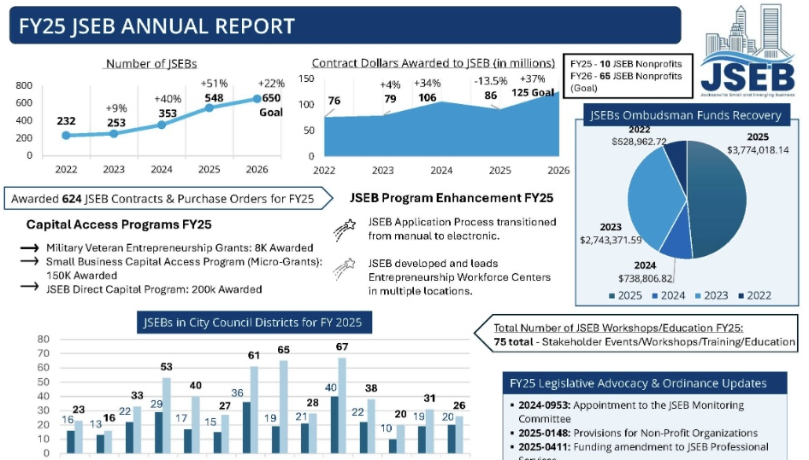
Results
Small
Business
624 contracts and purchase orders awarded
548 certified JSEB firms
$86 million in contract dollars awarded
The Challenge
75 workshops and training sessions delivered to support business growth
Small businesses face barriers to accessing capital and city contracting opportunities.
Our Response
Revamping and improving the Jacksonville Small & Emerging Business (JSEB) Program.
A Jacksonville You Can Afford And Be Proud Of

Slide 11
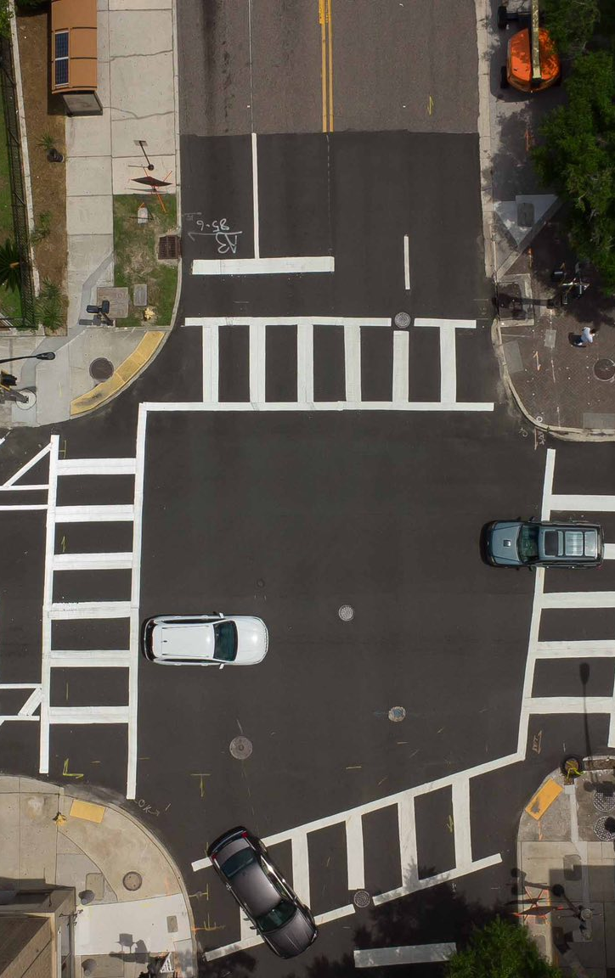

Infrastructure
The Challenge
Keeping pace with growth while addressing infrastructure needs in underserved areas of the city
Results Since July 2023
283.64 miles of roadway resurfaced, or rejuvenated
6 bridge repair or replacement completed
$60.6M invested in roadway resurfacing
36 bridge maintenance and guardrail repaired
$9.8M invested in sidewalk and curb construction and repair

Slide 12
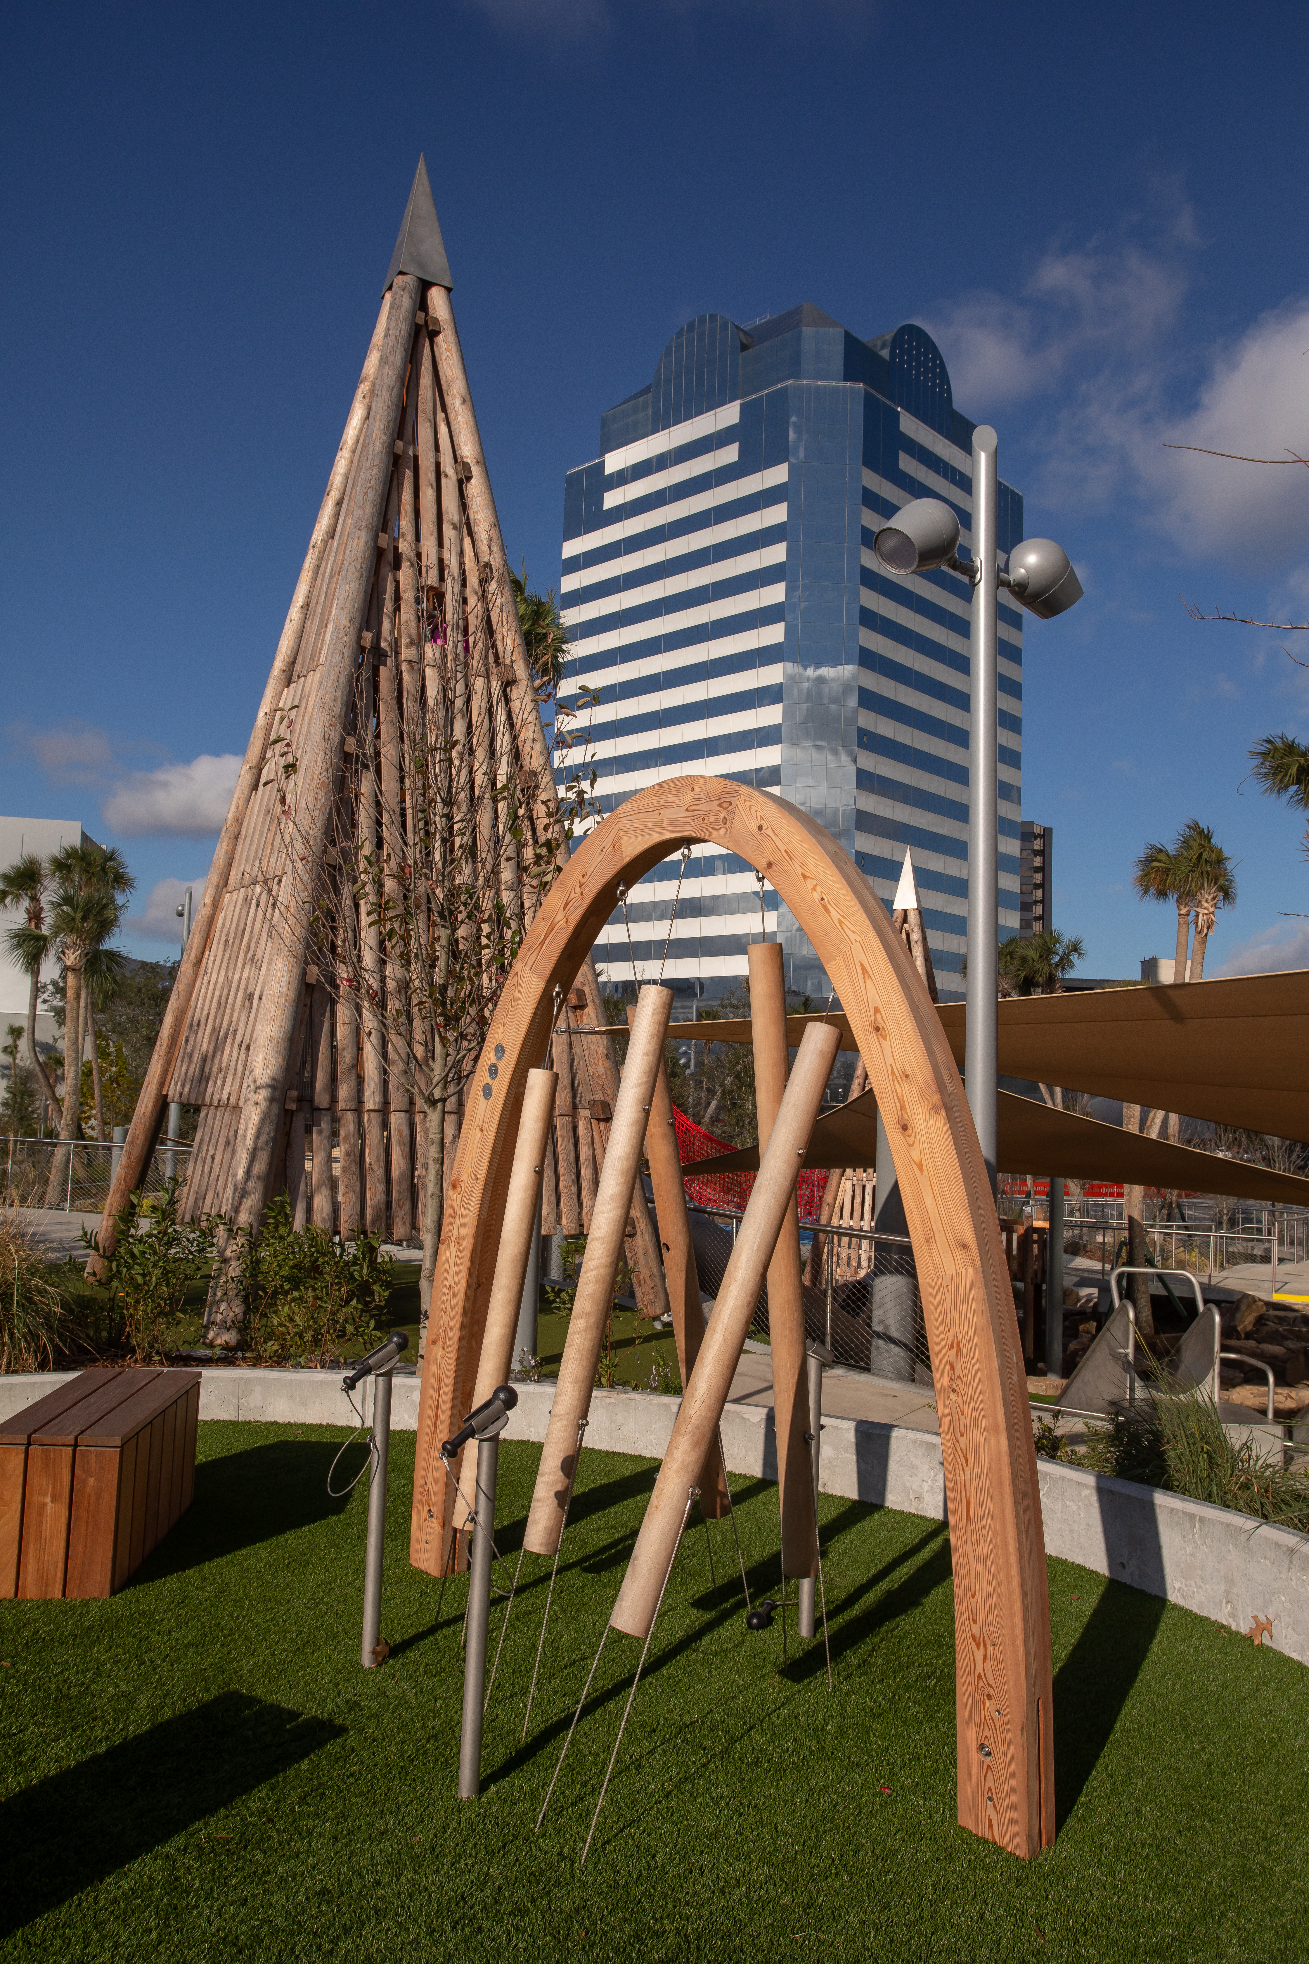
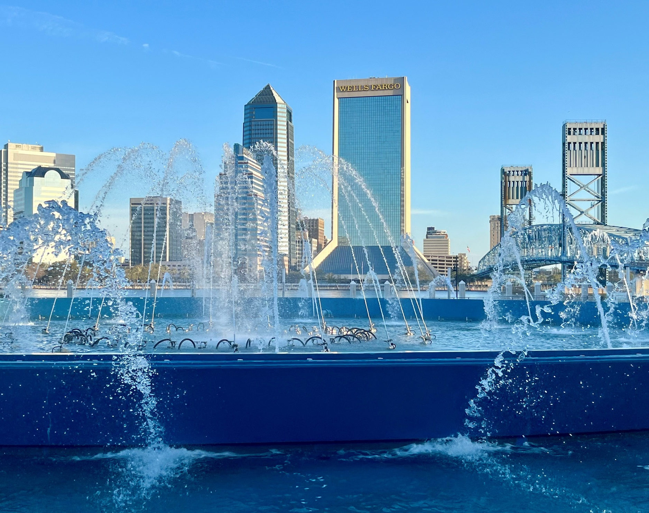
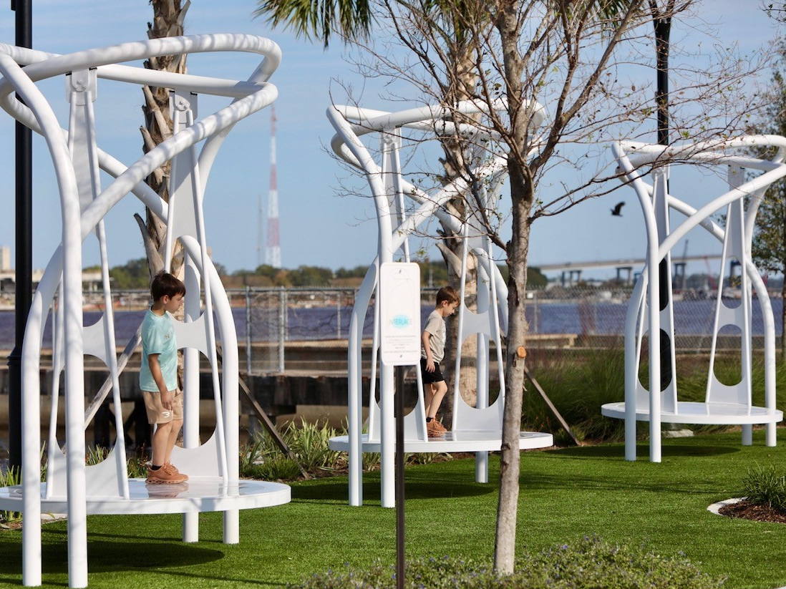
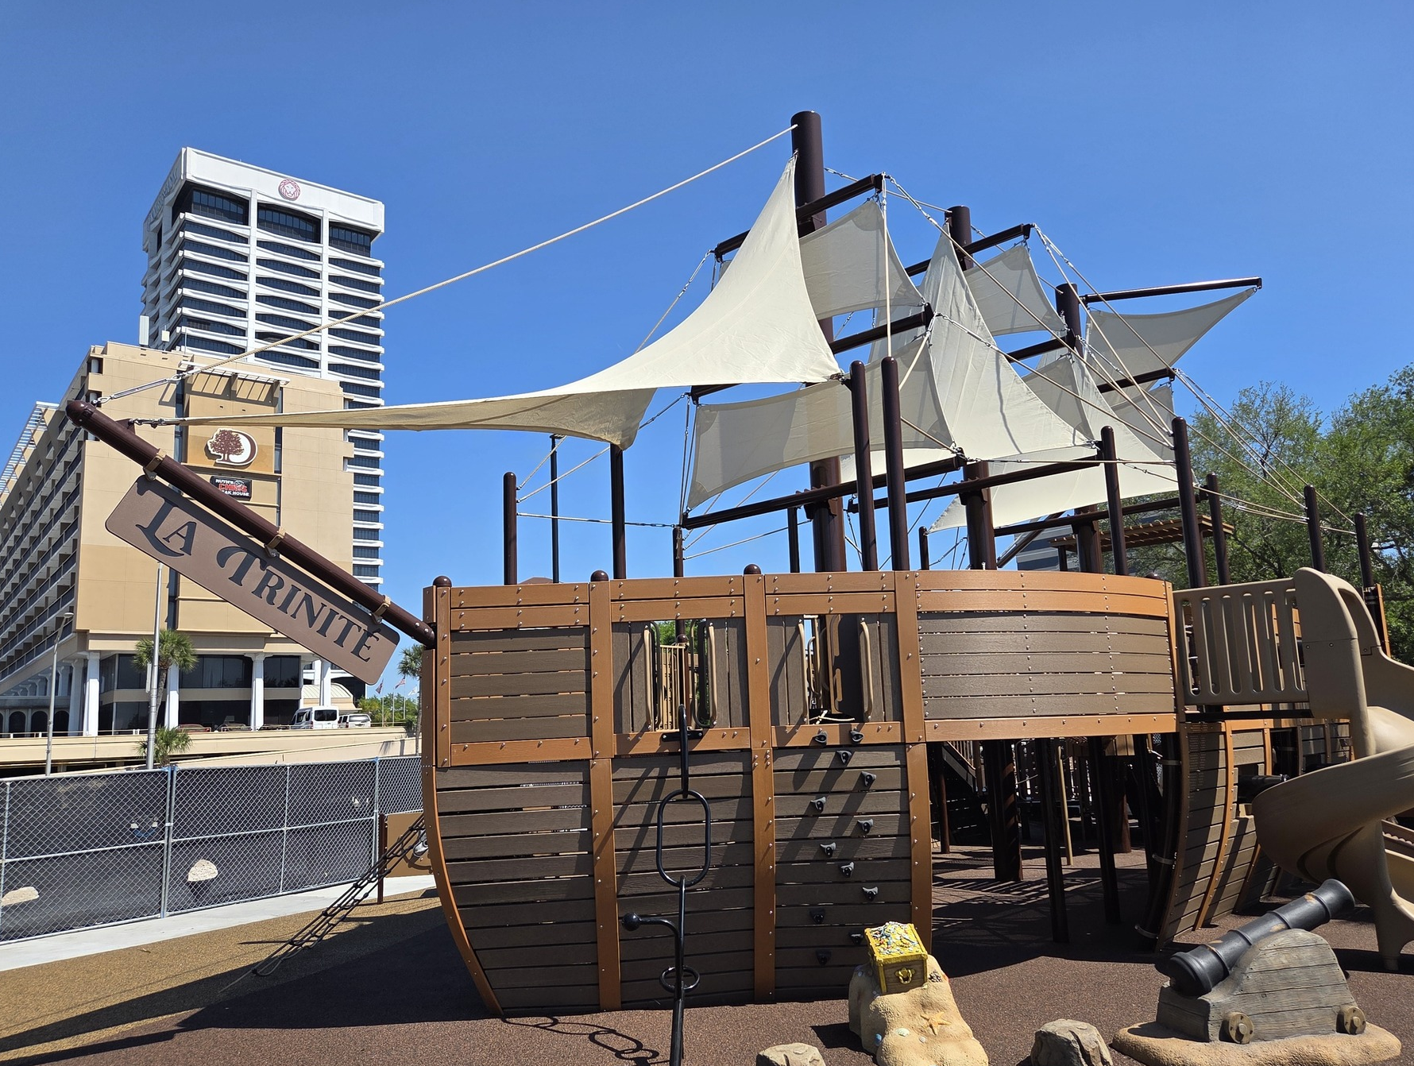
Parks & Public Spaces
The Challenge
Our Response
Improve access to public spaces across the city
Riverfront and park investments
Results
Riverfront Plaza
RiversEdge Park
Friendship Fountain
St. Johns River Park
Opened
Opened
Reopened
Reopened

Slide 13
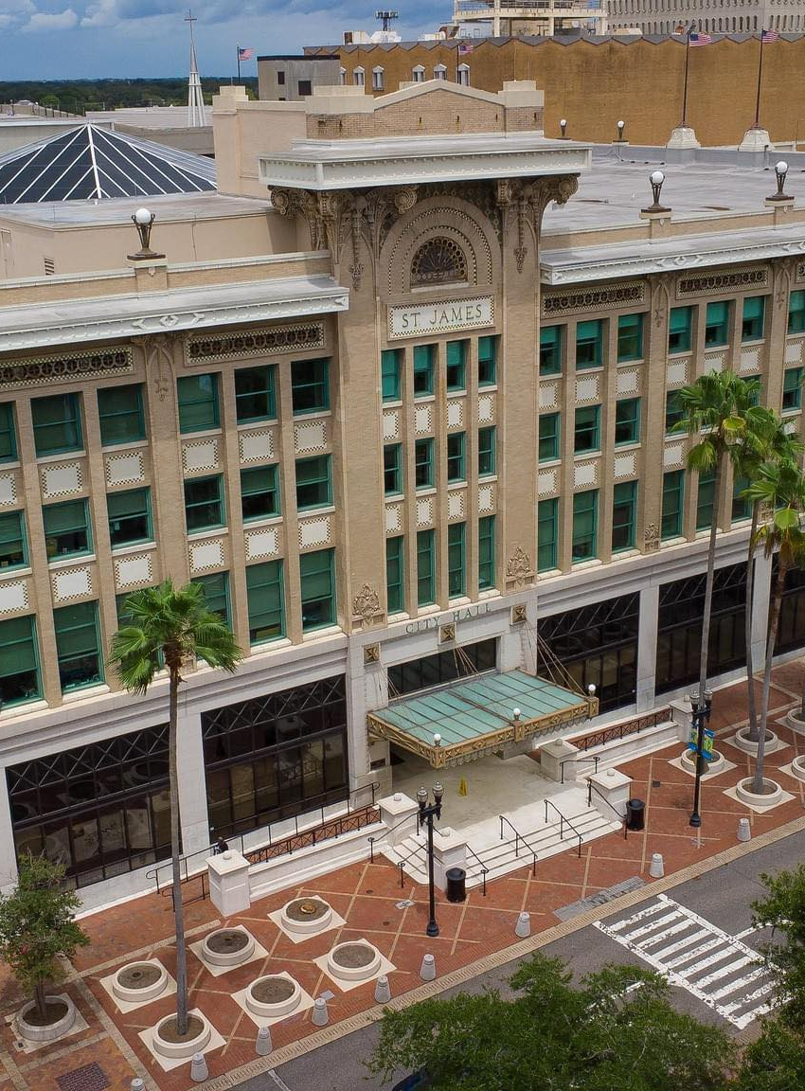
What’s Next?
1
More attainable housing
2
Affordable healthcare
3
Access to healthy food
4
Infrastructure investment
5
Underserved neighborhoods

